Slide 1
Using and Building an Automatic Program Verifier
K. Rustan M. Leino
Research in Software Engineering (RiSE)
Microsoft Research, Redmond
Lecture 5
LASER Summer School 2011
Elba, Italy
9 September 2011

Slide 2
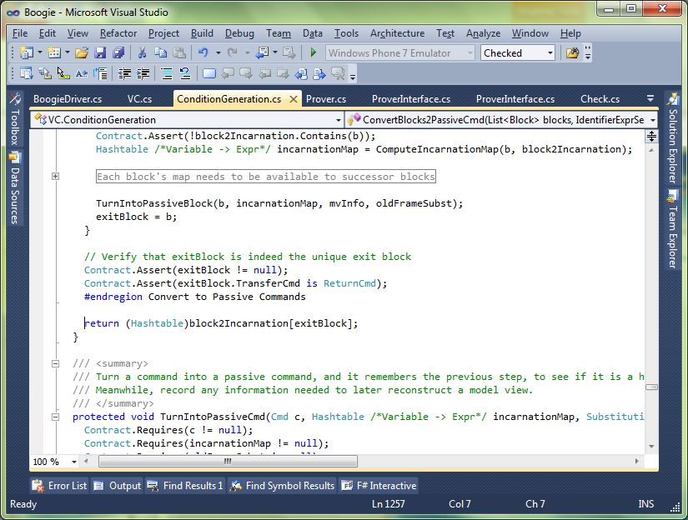

Separation of concerns
C#
C#
Intermediate representation
Intermediate verification language
Compiler
Verifier
SMT solver

Slide 3
Verification architecture
Dafny
Boogie
SMT solver

Slide 4
Verification architecture
STORM (C)
Boogie x86
…
Corral
QED
C B Analyze
Poirot
Forró
Diego-matic
Spec#
VCC
(C)
HAVOC (C)
Dafny
Chalice
Eiffel
(EveProofs)
Java
BML
Region Logic
Boogie
inference
SymDiff
Simplify
SMT Lib
Z3
TPTP
Isabelle/HOL

Slide 5
Verification architecture
Frama-C
Hi-Lite Ada
Pangoline
Krakatoa
Who
Jessie
CAO
Why
Alt-Ergo
SMT Lib
Z3
Coq
Isabelle/HOL
…

Slide 6
Boogie language overview
Mathematical features
type T
const x…
function f…
axiom E
Imperative features
var y…
procedure P… …spec…
implementation P… { …body… }

Slide 7
Boogie statements
x := E
a[i] := E
havoc x
assert E
assume E
;
call P()
if
while
break
label:
goto A, B

Slide 8
Translation basics
C
Boogie
var x: int;
procedure update(y: int)
returns ($result: int)
modifies x;
{
if (x < y) {
x := y;
}
$result := y;
}
procedure main()
modifies x;
{
call update(5);
}
int x;
int update(int y) {
if (x < y)
x = y;
return y;
}
void main() {
update(5);
}

Slide 9
Unstructured control flow
.NET bytecode (MSIL)
Boogie
.maxstack 2
.locals init ([0] int32 i,
[1] bool CS$4$0000)
IL_0000: nop
IL_0001: ldc.i4.0
IL_0002: stloc.0
IL_0003: br.s IL_000b
IL_0005: nop
IL_0006: ldloc.0
IL_0007: ldc.i4.1
IL_0008: add
IL_0009: stloc.0
IL_000a: nop
IL_000b: ldloc.0
IL_000c: ldarg.0
IL_000d: clt
IL_000f: stloc.1
IL_0010: ldloc.1
IL_0011: brtrue.s IL_0005
IL_0013: ret
var i: int, CS$4$000: bool;
var $stack0i, $stack1i: int,
$stack0b: bool;
IL_0000:
$stack0i := 0;
i := 0;
goto IL_000b;
IL_0005:
$stack1i := i;
$stack0i := $stack0i + $stack1i;
i := $stack0i;
IL_000b:
$stack0i := i;
$stack1i := n;
$stack0b := $stack0i < $stack1i;
CS$4$000 := $stack0b;
$stack0b := CS$4$000;
if ($stack0b) { goto IL_0005; }
IL_0013:
return;

Slide 10
Reasoning about loops
Java + JML
Boogie
//@ requires 0 <= n;
void m(int n)
{
int i = 0;
//@ loop_invariant i <= n;
while (i < n) {
i++;
}
//@ assert i == n;
}
procedure m(n: int)
requires 0 <= n;
{
var i: int;
i := 0;
while (i < n)
invariant i <= n;
{
i := i + 1;
}
assert i == n;
}

Slide 11
Exceptions
Boogie
Modula-3
type Outcome;
const unique Normal: Outcome;
const unique E: Outcome;
procedure Q(x: int) returns ($o: Outcome)
{
if (x == 15) {
$o := E; goto L0;
}
// ...
$o := Normal;
L0:
}
procedure P(y: int)
{
var $o: Outcome;
call $o := Q(y);
if ($o == E) { goto L1; }
// ...
goto L2;
L1:
// exception handler
L2:
}
exception E;
procedure Q(x: integer) raises {E} =
begin
if x = 15 then
raise E
end;
(* ... *)
end Q;
procedure P(y: integer) =
begin
try
Q(y);
(* ... *)
except E =>
(* exception handler *)
end
end P;

Slide 12
Custom operators: underspecification
C++
Boogie
const Two^31: int;
axiom Two^31 == 2147483648;
function LeftShift(int, int): int;
axiom (forall a: int ::
LeftShift(a, 0) == a);
function Add(int, int): int;
axiom (forall a, b: int ::
-Two^31 <= a+b && a+b < Two^31
==>
Add(a,b) == a+b);
procedure P() {
var x: int;
x := LeftShift(y, z);
x := Add(y, z);
}
void P() {
int x;
x = y << z;
x = y + z;
}

Slide 13
Definedness of expressions
F#
Boogie
let x = y + z in
let w = y / z in
// ...
// check for underflow:
assert -Two^31 <= y+z;
// check for overflow:
assert y+z < Two^31;
x := y + z;
// check division by zero:
assert z != 0;
w := Div(y, z);

Slide 14
Uninitialized variables
Pascal
Boogie
var r: integer;
if B then
r := z;
(* ... *)
if C then begin
d := r
end
var r: int;
var r$defined: bool;
if (B) {
r, r$defined :=
z, true;
}
// ...
if (C) {
assert r$defined;
d := r;
}

Slide 15
Loop termination
Eiffel
Boogie
from
Init
until
B
invariant
Inv
variant
VF
loop
Body
end
Init;
while (!B)
invariant Inv;
// check boundedness:
invariant 0 <= VF;
{
tmp := VF;
Body;
// check decrement:
assert VF < tmp;
}

Slide 16
Modeling memory
C#
Boogie
type Ref;
const null: Ref;
type Field;
const unique C.next: Field;
var Heap: [Ref,Field]Ref;
// Ref * Field --> Ref
procedure C.M(this: Ref, c: Ref)
requires this != null;
modifies Heap;
{
var x: Ref;
assert this != null;
x := Heap[this, C.next];
assert c != null;
Heap[c, C.next] := y;
}
class C {
C next;
void M(C c)
{
C x = next;
c.next = c;
}
}

Slide 17
More about memory models
Encoding a good memory model requires more effort
Boogie provides many useful features
  Polymorphic map types
  Partial commands (assume statements)
  Free pre- and postconditions
  where clauses

Slide 18
Boogie
demo
FindZero translated

Slide 19
Exercises
C Gauss into Boogie
  http://rise4fun.com/Boogie/AEp
Java swap
  http://rise4fun.com/Boogie/kU
FindZero translation errors
  http://rise4fun.com/Boogie/E01

Slide 20
Quantifiers
Instantiation via e-graph matching
A matching pattern (trigger) is a set of terms that
  together mention all the bound variables, and
  none of which is just a bound variable by itself
Examples:
  (∀x • { f(x) } 0 ≤ f(x))
  (∀x,y • { g(x,y) } f(x) < g(x,y))

Slide 21
Trigger examples
(∀x,y • { f(x), f(y) } x ≤ y ⇒ f(x) ≤ f(y))
(∀x • { f(x) } x ≠ null ⇒ f(x) ≤ f(next(x)))
(∀x • { f(next(x)) }
x ≠ null ⇒ f(x) ≤ f(next(x)))
(∀x,y • { f(x), f(y) } f(x) = f(y) ⇒ x = y)
(∀x • { f(x) } fInv(f(x)) = x)
(∀x • { fInv(f(x)) } fInv(f(x)) = x)
(∀x • { f(x+1) } f(x) ≤ f(x+1))
(∀x,y,z • { x*(y+z) } x*(y+z) = x*y + x*z)
(∀x,y • { P(x,y) } x = y ⇒ P(x,y) = 10)
(∀x • { P(x,x) } P(x,x) = 10)

Slide 22
Future
More inference
Better specification constructs
Improved user interface
  More aggressive and clever background proving
  Prioritize what to check next
  Suppress some complaints

Slide 23
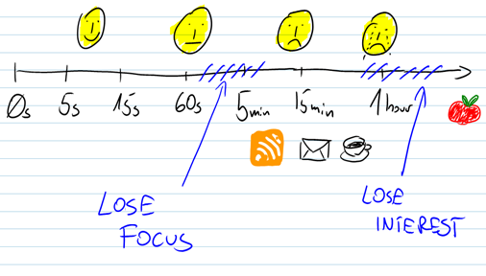
Turn-around time
Time to get a failed proof must be short
(Time to re-run a proof does not matter)

Slide 24
Post-mortem verification
Forward-looking design
Idea
Code
Test
Verification
Timeline
Ouch!
Need specifications

Slide 25
More help during software design
More expressive languages
Refinement
Synthesis
…

Slide 26
Take-home messages
Program verification tools exist
  Use them to prove tricky algorithms
  Use them to learn reasoning concepts
  Use them in teaching
  Extend them
To build a verifier, use an intermediate verification language (IVL)
  An IVL is a thinking tool
  IVL lets you reuse and share infrastructure

Slide 27
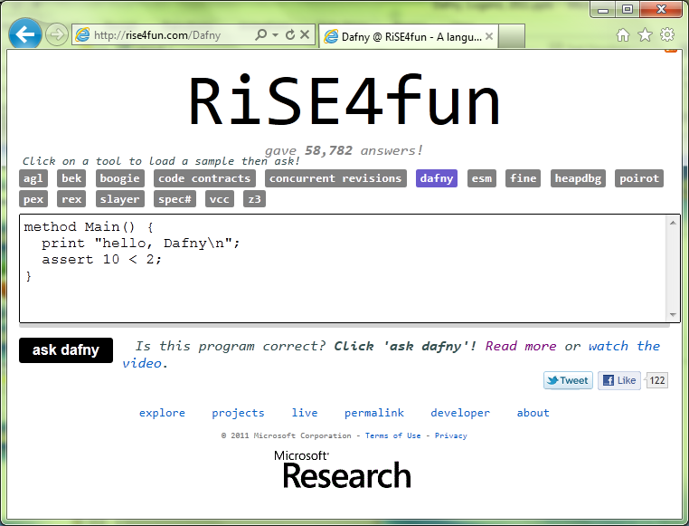

Links
Dafny
  research.microsoft.com/dafny
  rise4fun.com/Dafny/tutorial/guide
Boogie
  boogie.codeplex.com
rise4fun
  rise4fun.com
Verification Corner
  research.microsoft.com/verificationcorner

