Slide 1
Using and Building an Automatic Program Verifier
K. Rustan M. Leino
Research in Software Engineering (RiSE)
Microsoft Research, Redmond
Lecture 4
LASER Summer School 2011
Elba, Italy
8 September 2011

Slide 2
Abstraction, frames
demo
Counter
Notes:
method Main()
{
var c := new Counter.Init();
c.Inc(); c.Inc();
c.Dec();
c.Inc();
assert c.Value == 2;
}
class Counter
{
var Value: int;
constructor Init()
modifies this;
ensures Value == 0;
{
Value := 0;
}
method GetValue() returns (x: int)
ensures x == Value;
{
x := Value;
}
method Inc()
modifies this;
ensures Value == old(Value) + 1;
{
Value := Value + 1;
}
method Dec()
modifies this;
ensures Value == old(Value) - 1;
{
Value := Value - 1;
}
}
// --------------------------------------------
method Main()
{
var c := new Counter.Init();
c.Inc(); c.Inc();
c.Dec();
c.Inc();
assert c.Value == 2;
}
class Counter
{
// public
ghost var Value: int;
// private
var incs: int;
var decs: int;
function Valid(): bool
reads this;
{
Value == incs - decs
}
constructor Init()
modifies this;
ensures Valid();
ensures Value == 0;
{
incs, decs, Value := 0, 0, 0;
}
method GetValue() returns (x: int)
requires Valid();
ensures x == Value;
{
x := incs - decs;
}
method Inc()
requires Valid();
modifies this;
ensures Valid();
ensures Value == old(Value) + 1;
{
incs, Value := incs + 1, Value + 1;
}
method Dec()
requires Valid();
modifies this;
ensures Valid();
ensures Value == old(Value) - 1;
{
decs, Value := decs + 1, Value - 1;
}
}
// --------------------------------------------
method Main()
{
var c := new Counter.Init();
c.Inc(); c.Inc();
c.Dec();
c.Inc();
assert c.Value == 2;
}
class Counter
{
// public
ghost var Value: int;
ghost var Repr: set<object>;
// private
var incs: Cell;
var decs: Cell;
function Valid(): bool
reads this, Repr;
{
this in Repr && null !in Repr &&
incs != null && incs in Repr &&
decs != null && decs in Repr &&
incs != decs &&
Value == incs.data - decs.data
}
constructor Init()
modifies this;
ensures Valid() && fresh(Repr - {this});
ensures Value == 0;
{
incs, decs := new Cell, new Cell;
incs.data, decs.data, Value := 0, 0, 0;
Repr := {this};
Repr := Repr + {incs, decs};
}
method GetValue() returns (x: int)
requires Valid();
ensures x == Value;
{
x := incs.data - decs.data;
}
method Inc()
requires Valid();
modifies Repr;
ensures Valid() && fresh(Repr - old(Repr));
ensures Value == old(Value) + 1;
{
incs.data, Value := incs.data + 1, Value + 1;
}
method Dec()
requires Valid();
modifies Repr;
ensures Valid() && fresh(Repr - old(Repr));
ensures Value == old(Value) - 1;
{
decs.data, Value := decs.data + 1, Value - 1;
}
}
class Cell {
var data: int;
}

Slide 3
Dynamic frames, recap
Conceptually:
class C { invariant J; … }
Explicitly in Dafny:
class C {
function Valid(): bool … { J }
ghost var Repr: set<object>;
constructor Init()
modifies this;
ensures Valid() && fresh(Repr – {this});
method Mutate()
requires Valid();
modifies Repr;
ensures Valid() && fresh(Repr – old(Repr));
}

Slide 4
Dynamic frames idiom
demo
RockBand, RockBand2
Notes:
method Main()
{
var r := new RockBand.Init();
r.Play();
r.Play();
}
class RockBand {
var gigs: int;
var milos: Guitar;
ghost var Repr: set<object>;
function Valid(): bool
reads this, Repr;
{
this in Repr && null !in Repr &&
0 <= gigs &&
milos != null && milos in Repr && this !in milos.Repr && milos.Repr <= Repr &&
milos.Valid()
}
constructor Init()
modifies this;
ensures Valid() && fresh(Repr - {this});
{
gigs := 0;
milos := new Guitar.Init();
Repr := {this} + milos.Repr;
}
method Play()
requires Valid();
modifies Repr;
ensures Valid() && fresh(Repr - old(Repr));
{
gigs := gigs + 1;
milos.Strum();
Repr := Repr + milos.Repr;
}
}
class Guitar {
var Repr: set<object>;
function Valid(): bool
reads this, Repr;
ensures this in Repr && null !in Repr;
constructor Init()
modifies this;
ensures Valid() && fresh(Repr - {this});
method Strum()
requires Valid();
modifies Repr;
ensures Valid() && fresh(Repr - old(Repr));
}
// ----------------------------------------------------------------------------------
method Main()
{
var r := new RockBand.Init();
r.Play();
r.Play();
}
class RockBand {
var gigs: int;
var milos: Guitar;
var nadia: Guitar;
ghost var Repr: set<object>;
function Valid(): bool
reads this, Repr;
{
this in Repr && null !in Repr &&
0 <= gigs &&
milos != null && milos in Repr && this !in milos.Repr && milos.Repr <= Repr &&
milos.Valid() &&
nadia != null && nadia in Repr && this !in nadia.Repr && nadia.Repr <= Repr &&
nadia.Valid() &&
milos.Repr !! nadia.Repr
}
constructor Init()
modifies this;
ensures Valid() && fresh(Repr - {this});
{
gigs := 0;
milos := new Guitar.Init();
nadia := new Guitar.Init();
Repr := {this} + milos.Repr + nadia.Repr;
}
method Play()
requires Valid();
modifies Repr;
ensures Valid() && fresh(Repr - old(Repr));
{
gigs := gigs + 1;
milos.Strum();
Repr := Repr + milos.Repr;
nadia.Strum();
Repr := Repr + nadia.Repr;
}
}
class Guitar {
var Repr: set<object>;
function Valid(): bool
reads this, Repr;
ensures Valid() ==> this in Repr && null !in Repr;
constructor Init()
modifies this;
ensures Valid() && fresh(Repr - {this});
method Strum()
requires Valid();
modifies Repr;
ensures Valid() && fresh(Repr - old(Repr));
}

Slide 5
Exercises
List
  http://rise4fun.com/Dafny/nAW

Slide 6
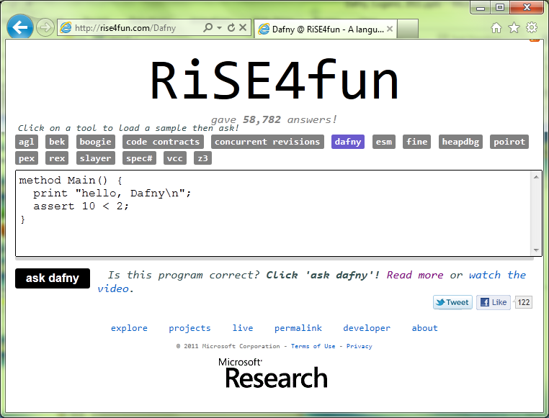

Links
Dafny
  research.microsoft.com/dafny
  rise4fun.com/Dafny/tutorial/guide
rise4fun
  rise4fun.com
Verification Corner
  research.microsoft.com/verificationcorner

