Slide 1
Using and Building an Automatic Program Verifier
K. Rustan M. Leino
Research in Software Engineering (RiSE)
Microsoft Research, Redmond
Lecture 3
LASER Summer School 2011
Elba, Italy
8 September 2011

Slide 2
Review
Methods specifications have pre- and postconditions
Loops are specified with loop invariants
Termination is specified used variant functions
Debugging
  Verification debugger gives a way to inspect values in a trace of a counterexample
  Assert statements check that a condition is known to hold and can be used as lemmas
  Assume statements restrict attention to certain executions and are useful for verification debugging

Slide 3
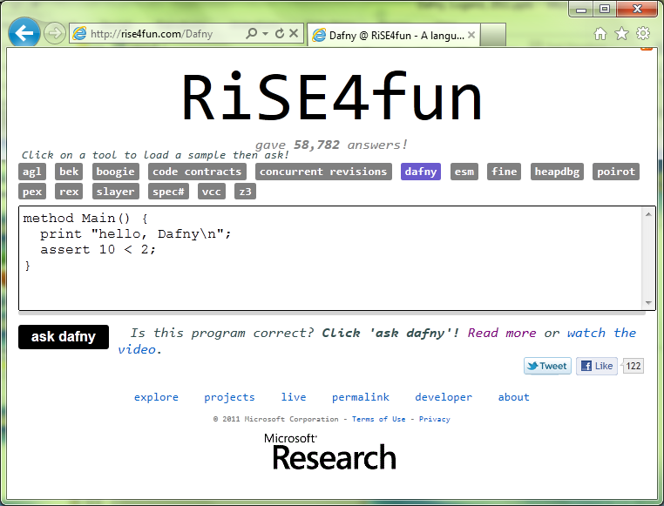

Links
For Dafny syntax and constructs, see Dafny Quick Reference
Dafny
  research.microsoft.com/dafny
  rise4fun.com/Dafny/tutorial/guide
rise4fun
  rise4fun.com
Verification Corner
  research.microsoft.com/verificationcorner

Slide 4
Expanding on yesterday’s lectures
Lemma methods can be declared as ghost
Loops and breaks

Slide 5
Cubes program: Hint
var c := 0;
while (n < a.Length)
invariant 0 <= n <= a.Length;
invariant c == n*n*n;
invariant forall i :: 0 <= i < n ==> …
{
a[n] := c;
c := (n+1)*(n+1)*(n+1);
n := n + 1;
}

Slide 6
Lemma in action, ghost statements
demo
FindZero, revisited
Notes:
method FindZero(a: array<int>) returns (n: int)
requires a != null;
requires forall i :: 0 <= i < a.Length ==> 0 <= a[i];
requires forall i :: 0 <= i-1 && i < a.Length ==> a[i-1]-1 <= a[i];
ensures 0 <= n ==> n < a.Length && a[n] == 0;
ensures n < 0 ==> forall i :: 0 <= i < a.Length ==> a[i] != 0;
{
n := 0;
while (n < a.Length)
invariant forall i :: 0 <= i < n && i < a.Length ==> a[i] != 0;
{
if (a[n] == 0) { return; }
//Lemma(a, n);
ghost var m := n;
while (m < n + a[n])
invariant n <= m <= n + a[n] && m < a.Length;
invariant n+a[n] - m <= a[m];
invariant forall i :: n <= i < m ==> a[i] != 0;
{
m := m + 1;
if (m == a.Length) { break; }
}
ghost var j := 0;
while (j < 10) { j := j + 1; }
n := n + a[n];
}
n := -1;
}
ghost method Lemma(a: array<int>, n: int)
requires a != null;
requires 0 <= n < a.Length;
requires forall i :: 0 <= i < a.Length ==> 0 <= a[i];
requires forall i :: 0 <= i-1 && i < a.Length ==> a[i-1]-1 <= a[i];
ensures forall i :: n <= i < n+a[n] && i < a.Length ==> a[i] != 0;
{
var m := n;
while (m < n + a[n])
invariant n <= m <= n + a[n] && m < a.Length;
invariant n+a[n] - m <= a[m];
invariant forall i :: n <= i < m ==> a[i] != 0;
{
m := m + 1;
if (m == a.Length) { break; }
}
}

Slide 7
Exercise
Mirror²
  http://rise4fun.com/Dafny/sn1

Slide 8
Links
Dafny
  research.microsoft.com/dafny
  rise4fun.com/Dafny/tutorial/guide
rise4fun
  rise4fun.com
Verification Corner
  research.microsoft.com/verificationcorner

