Slide 1
Using and Building an Automatic Program Verifier
K. Rustan M. Leino
Research in Software Engineering (RiSE)
Microsoft Research, Redmond
Lecture 0
LASER Summer School 2011
Elba, Italy
4 September 2011

Slide 2
Reasoning about programs
Central to any programming task
  From safety critical applications to scripting
  From initial development to maintenance to debugging
Minimizes faults, security problems, time/cost to market
Thinking skill

Slide 3
Reasoning using specifications
demo
Notes:
method Main()
{
var r := new RockBand.Init();
r.Play();
r.Play();
}
class RockBand {
var gigs: int;
var gt: Guitar;
ghost var Repr: set<object>;
function Valid(): bool
reads this, Repr;
{
this in Repr && null !in Repr &&
0 <= gigs &&
gt != null && gt in Repr && this !in gt.Repr && gt.Repr <= Repr &&
gt.Valid()
}
constructor Init()
modifies this;
ensures Valid() && fresh(Repr - {this});
{
gigs := 0;
gt := new Guitar.Init();
Repr := {this} + gt.Repr;
}
method Play()
requires Valid();
modifies Repr;
ensures Valid() && fresh(Repr - old(Repr));
{
gigs := gigs + 1;
gt.Strum();
Repr := Repr + gt.Repr;
}
}
class Guitar {
var Repr: set<object>;
function Valid(): bool
reads this, Repr;
{
this in Repr && null !in Repr
}
constructor Init()
modifies this;
ensures Valid() && fresh(Repr - {this});
{
Repr := {this};
}
method Strum()
requires Valid();
modifies Repr;
ensures Valid() && fresh(Repr - old(Repr));
{
// ...
}
}

Slide 4
Static program verifier
A verification tool can be used
  to establish the correctness of a program
  as a vehicle for learning to reason about programs

Slide 5
Program verification
Dafny
and others
traditional mechanical program verification
hand proofs (or hand waving)
functional correctness
assurance level
extended static checking
limited checking
human effort
technology:
automatic
decision
procedures
(SMT solvers)
interactive
proof assistants
no
machine assistance

Slide 6
Dafny
demo
Notes:
method Main()
{
var r := new RockBand.Init();
r.Play();
r.Play();
}
class RockBand {
var gigs: int;
var gt: Guitar;
ghost var Repr: set<object>;
function Valid(): bool
reads this, Repr;
{
this in Repr && null !in Repr &&
0 <= gigs &&
gt != null && gt in Repr && this !in gt.Repr && gt.Repr <= Repr &&
gt.Valid()
}
constructor Init()
modifies this;
ensures Valid() && fresh(Repr - {this});
{
gigs := 0;
gt := new Guitar.Init();
Repr := {this} + gt.Repr;
}
method Play()
requires Valid();
modifies Repr;
ensures Valid() && fresh(Repr - old(Repr));
{
gigs := gigs + 1;
gt.Strum();
Repr := Repr + gt.Repr;
}
}
class Guitar {
var Repr: set<object>;
function Valid(): bool
reads this, Repr;
{
this in Repr && null !in Repr
}
constructor Init()
modifies this;
ensures Valid() && fresh(Repr - {this});
{
Repr := {this};
}
method Strum()
requires Valid();
modifies Repr;
ensures Valid() && fresh(Repr - old(Repr));
{
// ...
}
}

Slide 7
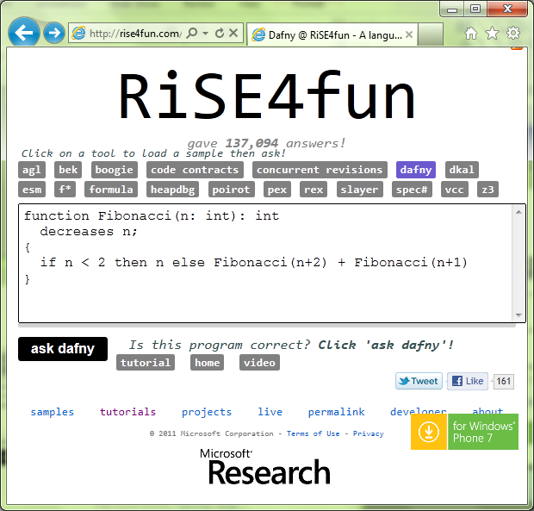
Using Dafny on the web
Dafny tutorial

Slide 8
My lectures
How to use a program verifier
  Basics: asserts, pre/post-conditions
  Invariants
  Termination
  Heap properties
How to build a program verifier
  Encoding via an intermediate verification language

Slide 9
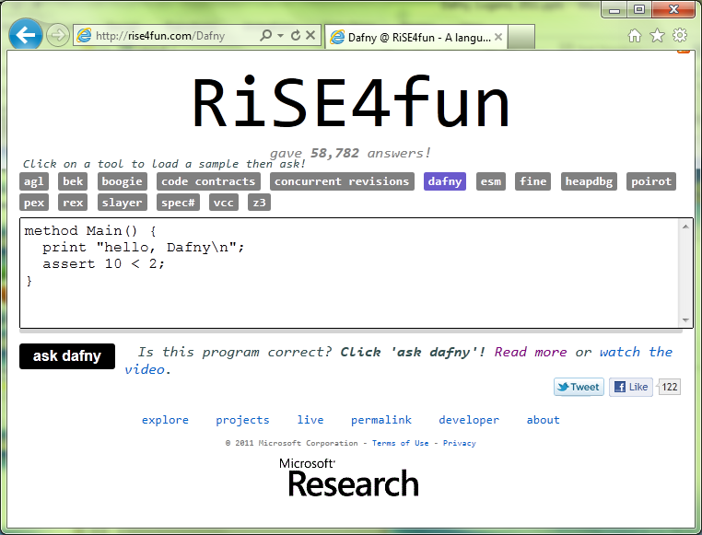

Links
Dafny
  research.microsoft.com/dafny
  rise4fun.com/Dafny/tutorial/guide
rise4fun
  rise4fun.com
Verification Corner
  research.microsoft.com/verificationcorner

