Slide 1
Using and Building an Automatic Program Verifier
K. Rustan M. Leino
Research in Software Engineering (RiSE)
Microsoft Research, Redmond
Lecture 2
Marktoberdorf Summer School 2011
Bayrischzell, BY, Germany
6 August 2011

Slide 2
Isar and Dafny
lemma name: P
proof
hence Q by sledgehammer
hence R by simp
thus S by grind
end

Slide 3
Isar and Dafny
lemma name: P
proof
assert Q by sledgehammer
assert R by simp
assert S by grind
end

Slide 4
Isar and Dafny
ghost method name()
ensures P
{
assert Q by sledgehammer
assert R by simp
assert S by grind
}

Slide 5
Isar and Dafny
ghost method name()
ensures P
{
assert Q by dafny
assert R by dafny
assert S by dafny
}

Slide 6
Isar and Dafny
ghost method name()
ensures P;
{
assert Q;
assert R;
assert S;
}

Slide 7
Ghost variables, ghost code
demo
FindZero continued
Notes:
method FindZero(a: array<int>) returns (n: int)
requires a != null;
requires forall i :: 0 <= i < a.Length ==> 0 <= a[i];
requires forall i :: 0 <= i && i+1 < a.Length ==> a[i]-1 <= a[i+1];
ensures 0 <= n ==> n < a.Length && a[n] == 0;
ensures n < 0 ==> forall i :: 0 <= i < a.Length ==> a[i] != 0;
{
n := 0;
while (n < a.Length)
invariant 0 <= n;
invariant forall i :: 0 <= i < n && i < a.Length ==> a[i] != 0;
{
if (a[n] == 0) { return; }
ghost var m := n;
while (m < n + a[n])
invariant n <= m <= n + a[n] && m < a.Length;
invariant n + a[n] - m <= a[m];
invariant forall k :: n <= k < m ==> a[k] != 0;
{
m := m + 1;
if (m == a.Length) { break; }
}
n := n + a[n];
}
n := -1;
}
ghost method Lemma(a: array<int>, n: int)
requires a != null && 0 <= n < a.Length;
requires forall i :: 0 <= i < a.Length ==> 0 <= a[i];
requires forall i :: 0 <= i && i+1 < a.Length ==> a[i]-1 <= a[i+1];
ensures forall k :: n <= k < n + a[n] && k < a.Length ==> a[k] != 0;
{
var m := n;
while (m < n + a[n])
invariant n <= m <= n + a[n] && m < a.Length;
invariant n + a[n] - m <= a[m];
invariant forall k :: n <= k < m ==> a[k] != 0;
{
m := m + 1;
if (m == a.Length) { break; }
}
}

Slide 8
Object structures
demo
List
Notes:
class List<T> {
ghost var Contents: seq<T>;
ghost var Repr: set<object>;
function Valid(): bool
reads this, Repr;
{
this in Repr && null !in Repr &&
a != null && a in Repr &&
1 <= a.Length &&
0 <= n <= a.Length &&
n == |Contents| &&
forall i :: 0 <= i < n ==> Contents[i] == a[i]
}
var a: array<T>;
var n: int;
constructor Init()
modifies this;
ensures Valid() && fresh(Repr - {this});
ensures Contents == [];
{
a := new T[10];
n := 0;
Contents := [];
Repr := {this};
Repr := Repr + {a};
}
method Get(i: int) returns (t: T)
requires Valid();
requires 0 <= i < |Contents|;
ensures t == Contents[i];
{
t := a[i];
}
method Set(i: int, t: T)
requires Valid();
requires 0 <= i < |Contents|;
modifies Repr;
ensures Valid() && fresh(Repr - old(Repr));
ensures Contents == old(Contents)[i := t];
{
a[i] := t;
Contents := Contents[i := t];
}
method Append(t: T)
requires Valid();
modifies Repr;
ensures Valid() && fresh(Repr - old(Repr));
ensures Contents == old(Contents) + [t];
{
if (n == a.Length) {
var b := new T[2*n];
Array.Copy(a, 0, n, b);
a := b;
Repr := Repr + {a};
}
a[n] := t;
n := n + 1;
Contents := Contents + [t];
}
}
method Main()
{
var list := new List<int>.Init();
list.Append(34);
assert list.Contents == [34];
list.Append(55);
list.Set(1, 89);
var x := list.Get(0);
assert x == 34;
}
class Array {
static method Copy<T>(a: array<T>, start: int, howMany: int, b: array<T>)
requires a != null && 0 <= start <= start + howMany <= a.Length;
requires b != null && howMany <= b.Length;
requires a != b;
modifies b;
ensures forall k :: 0 <= k < howMany ==> b[k] == a[start+k];
{
var i := 0;
while (i < howMany)
invariant 0 <= i <= howMany;
invariant forall k :: 0 <= k < i ==> b[k] == a[start+k];
{
b[i] := a[start + i];
i := i + 1;
}
}
}

Slide 9
Exercises
List
  http://rise4fun.com/Dafny/MbH
RockBand
  http://rise4fun.com/Dafny/wjD

Slide 10
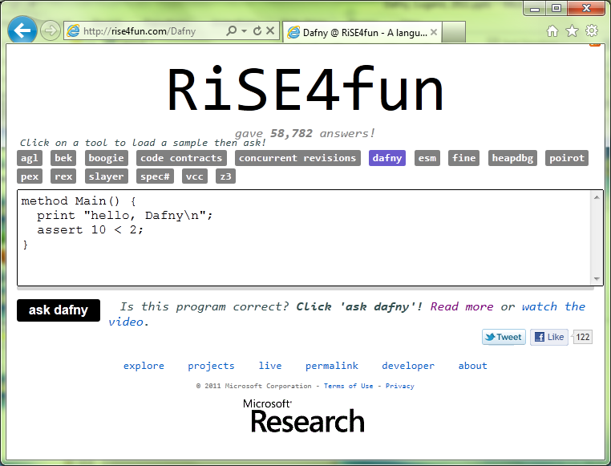

Links
Dafny
  research.microsoft.com/dafny
rise4fun
  rise4fun.com
Verification Corner
  research.microsoft.com/verificationcorner

