Slide 1
Using and Building an Automatic Program Verifier
K. Rustan M. Leino
Research in Software Engineering (RiSE)
Microsoft Research, Redmond
Lecture 1
Marktoberdorf Summer School 2011
Bayrischzell, BY, Germany
5 August 2011

Slide 2
Recap:
Reasoning about loops
A loop invariant
  holds at the top of every iteration
  is the only thing the verifier remembers from one iteration to another (about the variables being modified)
while (B)
{
S;
}
Loop invariant holds here

Slide 3
Cubes program: Hint
var c := 0;
while (n < a.Length)
invariant 0 <= n <= a.Length;
invariant c == n*n*n;
invariant forall i :: 0 <= i < n ==> …
{
a[n] := c;
c := (n+1)*(n+1)*(n+1);
n := n + 1;
}

Slide 4
Termination
A variant function is an expression whose values goes down (in some well-founded ordering) with every iteration/call
At the time of the call, the callee’s variant function must be less than the caller’s
while (B)
{
S;
}
method M()
{
P();
}
At the time a loop back-edge is taken, the value of the variant function must be less than at the beginning of the iteration

Slide 5
Proving termination
demo
Termination
Notes:
method ComputeSum(a: array<int>) returns (s: int)
requires a != null;
{
var n := 0;
s := 0;
while (n < a.Length)
decreases a.Length - n;
{
s := s + a[n];
n := n + 1;
}
}
function Sum(xs: seq<int>): int
decreases xs;
{
if xs == [] then 0 else xs[0] + Sum(xs[1..])
}
function Ackermann(m: int, n: int): int
decreases m, n;
{
if m <= 0 then
n + 1
else if n <= 0 then
Ackermann(m - 1, 1)
else
Ackermann(m - 1, Ackermann(m, n - 1))
}

Slide 6
demo
FindZero
Notes:
method FindZero(a: array<int>) returns (n: int)
requires a != null;
requires forall i :: 0 <= i < a.Length ==> 0 <= a[i];
requires forall i :: 0 <= i && i+1 < a.Length ==> a[i]-1 <= a[i+1];
ensures 0 <= n ==> n < a.Length && a[n] == 0;
ensures n < 0 ==> forall i :: 0 <= i < a.Length ==> a[i] != 0;
{
n := 0;
while (n < a.Length)
invariant 0 <= n <= a.Length;
invariant forall i :: 0 <= i < n ==> a[i] != 0;
{
if (a[n] == 0) { return; }
n := n + a[n];
}
n := -1;
}

Slide 7
Lemmas, induction
demo
Gauss², Mirror²
Notes:
// n ( n )^2
// SUM i^3 == ( SUM i )
// i=0 ( i=0 )
function SumOfCubes(n: int): int
requires 0 <= n;
{
if n == 0 then 0 else SumOfCubes(n-1) + n*n*n
}
function Gauss(n: int): int
requires 0 <= n;
{
if n == 0 then 0 else Gauss(n-1) + n
}
ghost method M()
ensures forall n :: 0 <= n ==>
SumOfCubes(n) == Gauss(n) * Gauss(n) &&
2*Gauss(n) == n*(n+1);
{
}
ghost method Theorem(n: int)
requires 0 <= n;
ensures SumOfCubes(n) == Gauss(n) * Gauss(n);
{
if (n == 0) {
// easy!
} else {
Theorem(n-1);
assert forall n :: 0 <= n ==> 2*Gauss(n) == n*(n+1);
//Lemma(n-1);
}
}
ghost method Lemma(n: int)
requires 0 <= n;
ensures 2 * Gauss(n) == n * (n + 1);
{
if (n != 0) {
Lemma(n-1);
}
}
// --------------------------------------------------------------------------------------
datatype Tree = Leaf | Node(Tree, int, Tree);
function mirror(t: Tree): Tree
{
match t
case Leaf => t
case Node(l,x,r) => Node(mirror(r), x, mirror(l))
}
ghost method Theorem(t: Tree)
ensures mirror(mirror(t)) == t;
{
// assert forall g :: mirror(mirror(g)) == g;
match (t) {
case Leaf =>
case Node(l,x,r) =>
Theorem(l);
Theorem(r);
}
}

Slide 8
Exercises
McCarthy
  http://rise4fun.com/Dafny/6bq
Coincidence
  http://rise4fun.com/Dafny/WvG
Saddleback search
  http://rise4fun.com/Dafny/U5h
Max is transitive
  http://rise4fun.com/Dafny/z9J
Reverse-Reverse
  http://rise4fun.com/Dafny/1g

Slide 9
Exercises
List
  http://rise4fun.com/Dafny/MbH

Slide 10
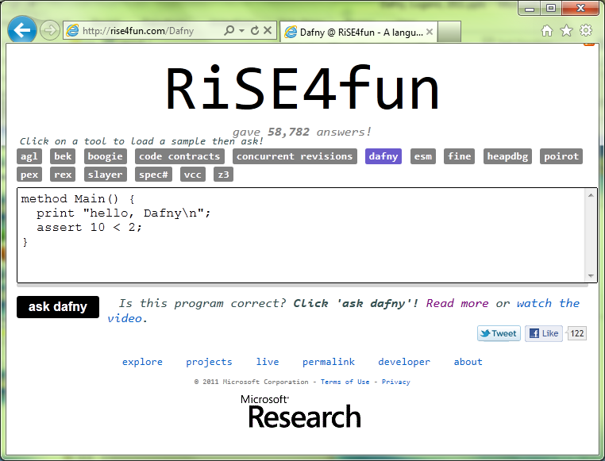

Links
Dafny
  research.microsoft.com/dafny
rise4fun
  rise4fun.com
Verification Corner
  research.microsoft.com/verificationcorner

