Slide 1
Contracts, tools, verification
K. Rustan M. Leino
Research in Software Engineering (RiSE)
Microsoft Research, Redmond
Keynote, ASWEC 2010; Auckland, NZ; 8 April 2010

Slide 2
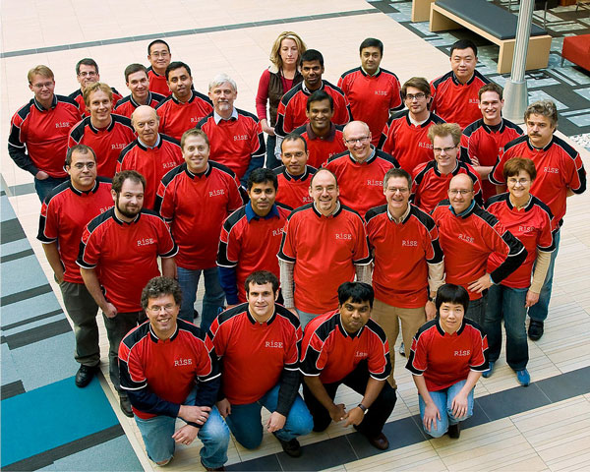
RiSE
Research in Software Engineering
Microsoft Research,
Redmond
http://research.microsoft.com/rise
Related groups: PPT (MSR Cambridge) and RSE (MSR India)
[picture: Microsoft Research]

Slide 3
We want to develop software…
with the right features
that is easy to use
that is hard to misuse
  accidentally
  maliciously
can be developed effectively
  on schedule
  free of defects
can be maintained
  to add features
  to adapt to new environments
  to preserve/transfer knowledge between developers

Slide 4
Reasoning about programs
Semantics
Specifications (contracts)
Tools

Slide 5
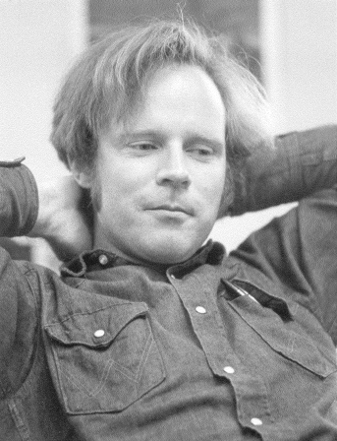
Robert W. Floyd [1967]
Add assertions on edges of the
program’s flow graph
0 ≤ N
r := 0
r² ≤ N
(r+1)² ≤ N
r² ≤ N
r² ≤ N ⋀ (r+1)² ≤ N
no
yes
r := r + 1
r² ≤ N < (r+1)²
[picture: sigact.acm.org/floyd]

Slide 6
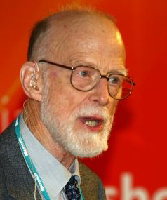
C.A.R. Hoare [1969]
{ P } S { Q }
S is a program
P and Q are assertions (predicates, conditions) about the program state
The triple says: started in a state satisfying P, every outcome of S will satisfy Q
[picture: Microsoft Research]

Slide 7

Hoare triples: example
{ 0 ≤ N }
{ r² ≤ N }
{ r² ≤ N ⋀ (r+1)² ≤ N }
{ r² ≤ N }
{ r² ≤ N < (r+1)² }
r := 0;
while (r+1)² ≤ N do
r := r + 1
end
Loop invariant

Slide 8
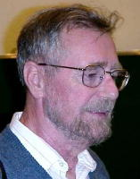
Edsger W. Dijkstra [1976]
For { P } S { Q }
  Given P and S, the most precise
  assertion Q is called their
  strongest postcondition, denoted sp(S, P)
  Given S and Q, the most general
  assertion P is called their
  weakest precondition, denoted wp(S, Q)
sp(S, P) ⇒ Q
P ⇒ wp(S, Q)
non-determinism easy
calculates the conditions (especially for ; )
[picture: www.lifeinlegacy.com]

Slide 9
From scientific ideal…
… to engineering reality

Slide 10
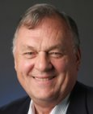
James C. King [1976]
Symbolic execution
x < 0
x < 0
0 ≤ x
y := -x
y := x
x < 0 ⋀ y = -x
0 ≤ x ⋀ y = x
y = abs(x)
[picture:site07.goscon.org/speaker]

Slide 11
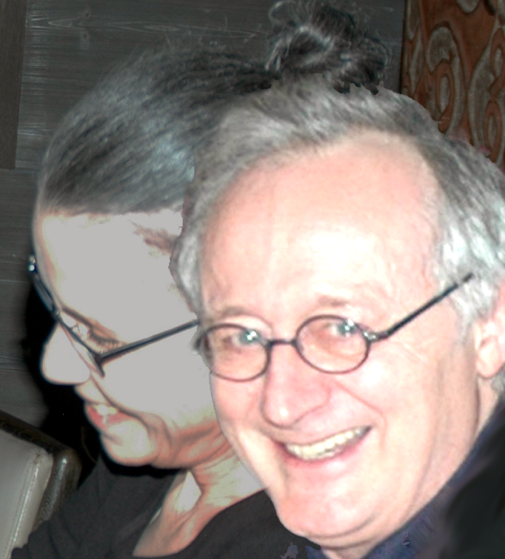
Patrick and Radhia Cousot [1977]
Abstract interpretation
Automatically compute fix-points
for loops using given a domain
[picture: Leino]

Slide 12
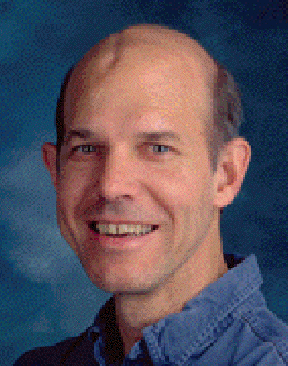
Greg Nelson [1979]
Cooperating decision procedures
Instantiating quantifiers
[picture: Compaq Research]

Slide 13
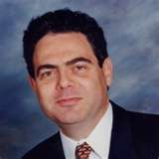
Bertrand Meyer [1988]
Specifications (contracts) in an
object-oriented programming
language
A precondition is a contract that says what is to hold on entry to a procedure
  caller’s responsibility to establish
  implementation can assume on entry
A postcondition is a contract that says what is to hold on exit from a procedure
  implementation’s responsibility to establish
  caller can assume upon return
[picture:cacm.acm.org/blogs/blog-cacm/48033]

Slide 14
Spec#
demo
Formatting phone numbers
Notes:
using System.Text;
public class PhoneNumberFormat
{
/// <summary>
/// Converts an array with characters "aaa-bbb-cccc" to
/// a string containing just the digits "aaabbbcccc".
/// </summary>
public string PhoneNumberDigits(char[] a)
requires a.Length == 12;
ensures result.Length == 10;
{
StringBuilder sb = new StringBuilder();
sb.Append(a, 0, 3);
sb.Append(a, 4, 3);
sb.Append(a, 8, 4);
return sb.ToString();
}
}

Slide 15
Verification architecture
contracts
Spec#
C
Eiffel
Dafny
…
Boogie
wp
abstract interpretation
Simplify
Z3
SMT Lib
…
decision procedures

Slide 16
Dafny
demo
ISqrt
Notes:
method ISqrt(N: int) returns (r: int)
requires 0 <= N;
ensures r*r <= N && N < (r+1)*(r+1);
{
r := 0;
while ((r+1)*(r+1) <= N)
invariant r*r <= N;
decreases N - r;
{
r := r + 1;
}
}

Slide 17
Some tools at Microsoft
PREfix, PREfast
  [Pincus, Sielaff, et al., 1999-]
  symbolic execution
  partial summaries
  sort error messages by priority
  applied to Windows
SLAM, SDV
  [Ball, Rajamani, et al., 2001-]
  model checking (symbolic execution)
  counterexample-guided predicate abstraction
  applied to device drivers
Code Contracts
  [Barnett, Fähndrich, Grunkemeyer, Logozzo, et al., 2009-]
  used in .NET library

Slide 18
Code Contracts tools
Contract library
Binary rewriter
Static analyzer (Clousot)
Test generator (Pex)

Slide 19
Code Contracts
demo
Trim Suffix
Notes:
using System;
using System.Collections.Generic;
using System.Text;
using System.Diagnostics.Contracts;
public class Program
{
public static void Main()
{
TrimSuffix("aswec", "2010");
}
public static string TrimSuffix(string str, string suffix)
{
Contract.Requires(str != null);
Contract.Requires(!String.IsNullOrEmpty(suffix));
Contract.Ensures(Contract.Result<string>() != null);
Contract.Ensures(!Contract.Result<string>().EndsWith(suffix));
var result = str;
if (result.EndsWith(suffix))
result = result.Substring(0, result.Length - suffix.Length);
return result;
}
}

Slide 20
Conclusions
Contracts
  help define interfaces
  shape thinking
  are used in practice
Contracts need tools
  … and give the opportunity to use/apply tools
In the extreme, can lead to full verification
Code Contracts research.microsoft.com/contracts
Spec# specsharp.codeplex.com
Dafny and Boogie boogie.codeplex.com
Projects and videos research.microsoft.com/rise
Various papers research.microsoft.com/~leino/papers.html

Slide 21
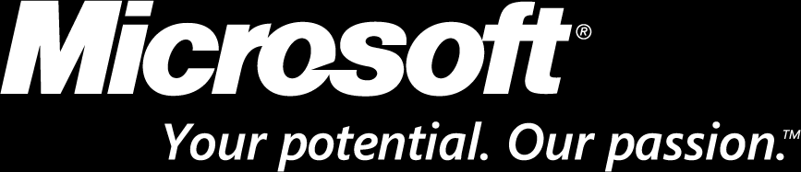
© 2008 Microsoft Corporation. All rights reserved. Microsoft, Windows, Windows Vista and other product names are or may be registered trademarks and/or trademarks in the U.S. and/or other countries.
The information herein is for informational purposes only and represents the current view of Microsoft Corporation as of the date of this presentation. Because Microsoft must respond to changing market conditions, it should not be interpreted to be a commitment on the part of Microsoft, and Microsoft cannot guarantee the accuracy of any information provided after the date of this presentation.
MICROSOFT MAKES NO WARRANTIES, EXPRESS, IMPLIED OR STATUTORY, AS TO THE INFORMATION IN THIS PRESENTATION.

