Slide 1
Hidden Markov Map Matching Through Noise and Sparseness
Paul Newson and John Krumm
Microsoft Research
ACM SIGSPATIAL ’09
November 6th, 2009

Slide 2
Agenda
Rules of the game
Using a Hidden Markov Model (HMM)
Robustness to Noise and Sparseness
Shared Data for Comparison

Slide 3
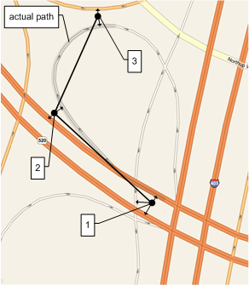
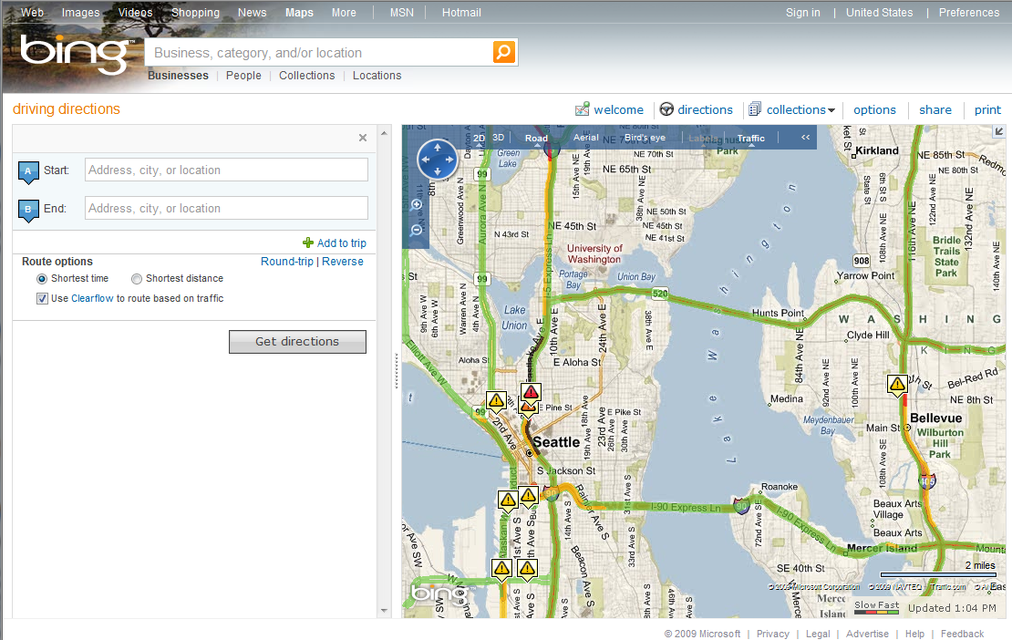

Rules of the Game
Some Applications:
Route compression
Navigation systems
Traffic Probes
Notes:
Here we see a diagram of what map matching is all about. We have three GPS points, in time sequence, and we have to decide which roads in the network the vehicle actually traversed. That’s all there is to it.
Note that in our work, we’re performing map matching as a post process, on a complete GPS trail. We expect that the same techniques could be applied to a suitably sized sliding window of points in a real time scenario, but we have not actually performed that experiment to determine how large that sliding window would need to be.
I have underlined Traffic Probes on the slide because that is the context in which our group currently uses the map matching implementation described here. We have a large database of GPS trails that are used to build traffic models as part of the Clearflow project. Map matching is the first step in using those GPS trails.

Slide 4
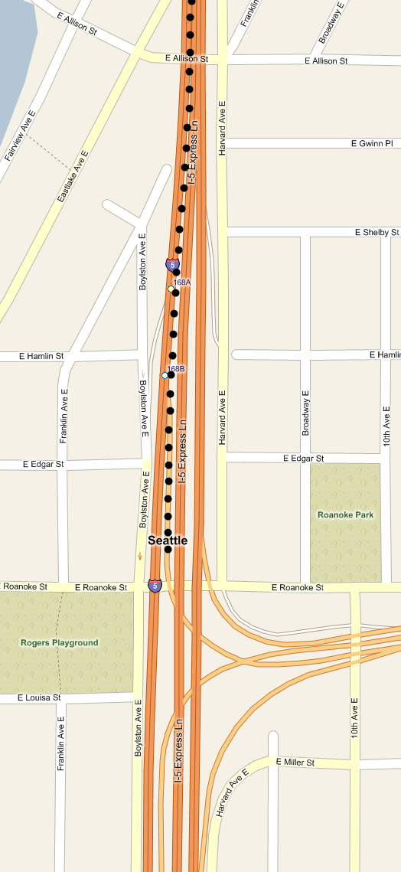
Map Matching is Trivial!
“I am not convinced to which extent the problem of path matching to a map is still relevant with current GPS accuracy”
- Anonymous Reviewer 3
Notes:
Map matching, in our application, is the process of determining which roads a vehicle actually travelled on, given a time series of GPS points, or GPS trail. More generally, you are trying to constrain a GPS routes to allowed pathways. This is usually vehicles on roads, as we discuss here, but the same techniques could be used for other applications with the same structure.
I thank Anonymous Reviewer 3 for proving us with this quote, which accurately reflects the reaction we get from most people to whom we describe this work. If you are in the audience I’d love to talk to you after this session to see if our presentation addressed your comment to your satisfaction.
As you can see from this figure, map matching with modern GPS accuracy, and a high sample rate, is often completely trivial. Any number of simple algorithms, including nearest road, would correctly match this sequence of points.
However…

Slide 5
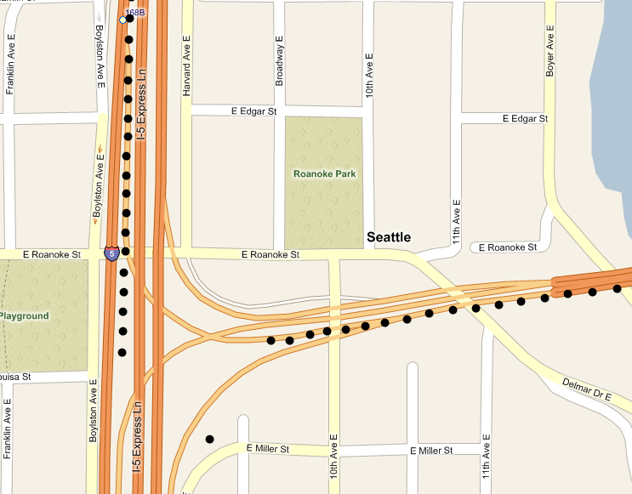
Except When It’s Not…
Notes:
Now you can see the challenge. It is anomalies like this in the dataset that make map matching interesting. Everyone in the audience has no doubt correctly concluded that the vehicle was moving southbound on the north/south freeway, which is I-5, and then took the offramp onto the east/west freeway, which is SR-520. Anyone familiar with this interchange will know exactly what’s going on here. The ramp from I-5 southbound onto 520 eastbound goes through a tunnel. The GPS device appears to lose signal, use some dead reckoning for a while, and then, when it emerges from the tunnel it recovers, but not before generating several obviously wrong data points.
If you get nothing else from this talk, I hope you will not fall into the trap of treating map matching as a trivial problem. I am not claiming that map matching is a particularly hard problem, if you use the techniques we describe in our paper, but it is tricky enough that if you assume the problem is trivial, and try to apply an ad-hoc approach, I expect you will end up spending an inordinate amount of time building a map matcher that never quite works when it encounters anomalies like the one shown here.

Slide 6
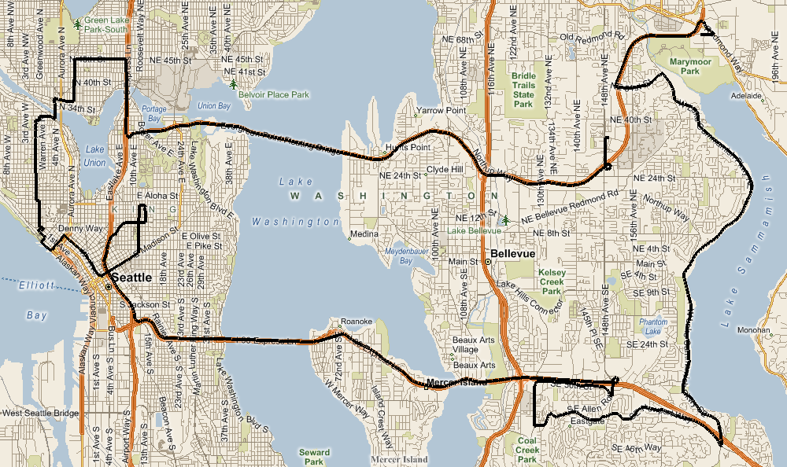
Our Test Route
Notes:
This route is 2 hours, 6 minutes long, and consists of 7531 points, sampled at a 1 second period.

Slide 7
Three Insights
Correct matches tend to be nearby
Successive correct matches tend to be linked by simple routes
Some points are junk, and the best thing to do is ignore them

Slide 8
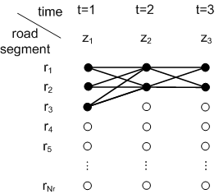
Mapping to a Hidden Markov Model (HMM)
Notes:
Insights 1 and 2 leads us very naturally to an HMM for the map match problem, as shown here. Each point in the GPS trail becomes a step in the HMM. Each possible road segment match becomes a node in the HMM graph.

Slide 9
Three Insights, Three Choices
Match Candidate Probabilities
Route Transition Probabilities
“Junk” Points
Notes:
The “best match” is the most likely route through the HMM graph. By assigning a probability to each match candidate, we can assign a probability to each node in the graph. By assigning a probability to each route transition between these match candidates, we can assign the transition probabilities between nodes. Finding the most likely route through the graph can then be performed with dynamic programming in a reasonable amount of time.

Slide 10
Match Error is Gaussian (sort of)
Notes:
Since we have the ground truth, we can calculate the actual distance between the GPS point and the correctly matched point. When we plot these, we get the chart shown here, to which we can easily fit a one sided Gaussian distribution. We estimate the standard deviation by calculating the median absolute deviation of our data set and multiplying by the appropriate scale factor. This provides us with the nicely fit curve shown here. For our no noise added data set, we found that standard deviation was 4.07 meters, and the largest error was about 47 meters.

Slide 11
Route Error is Exponential
Notes:
To assign transition probabilities to the HMM, we used the observation that correct routes tend to be straightforward. First we find the shortest path between the matched points on the road network. A straightforward route will tend to have a shortest path routing distance close to the Euclidian distance between the matched points. A tortured and incorrect route will often have a routing distance that is much longer than the Euclidian distance. For our fitness function we took the absolute value of the difference between these two values. Looking at the data, we then fit an exponential curve to it to produce our transition probability distribution, shown here.

Slide 12
Three Insights, Three Choices
Match Candidate Probabilities
Route Transition Probabilities
“Junk Points”
Notes:
In a theoretically perfect HMM implementation of map matching, we would consider every possible match candidate on the map. For a map of the North American road network, that would be about 66 million possible matches for each step. Then we would find the shortest path between each pair of those possible matches, which would generate 4.3 billion transition probabilities for each step. This is not feasible to do in reasonable amount of time, therefore we choose some “reasonable” limits to bound the computation to a “reasonable” time. “Reasonable” is of course a context dependant description.

Slide 13
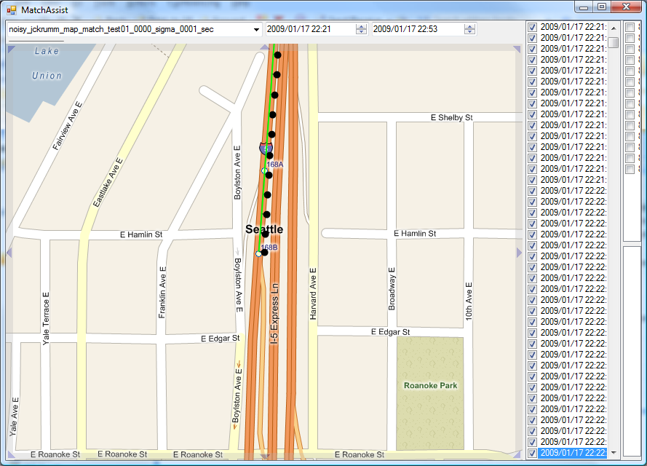
Notes:
This animation captures the HMM thus far, using only the two probability distributions discussed.

Slide 14
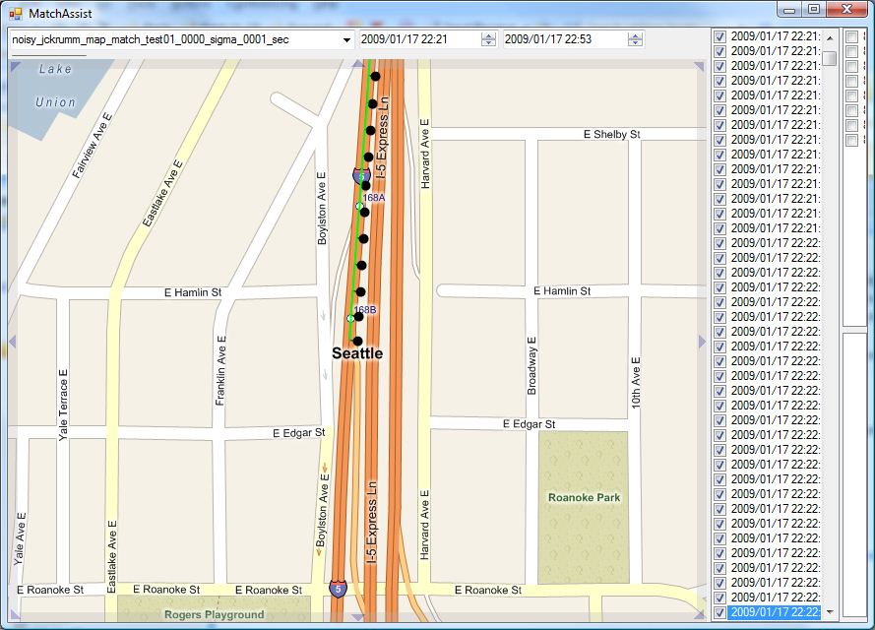

Slide 15
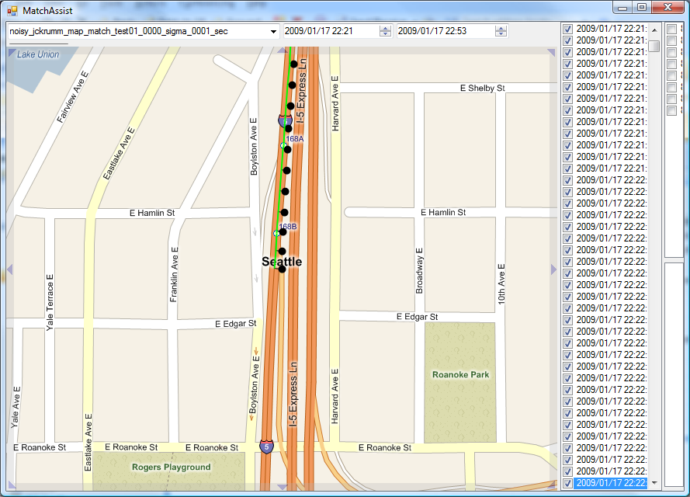

Slide 16
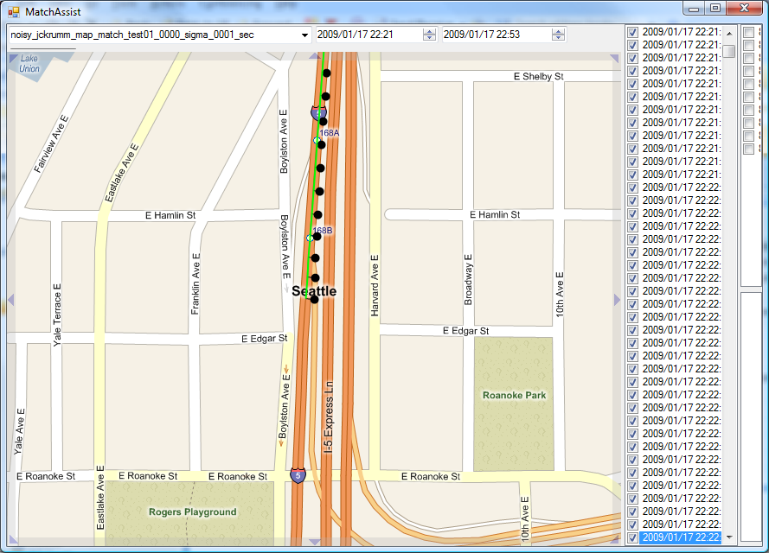

Slide 17
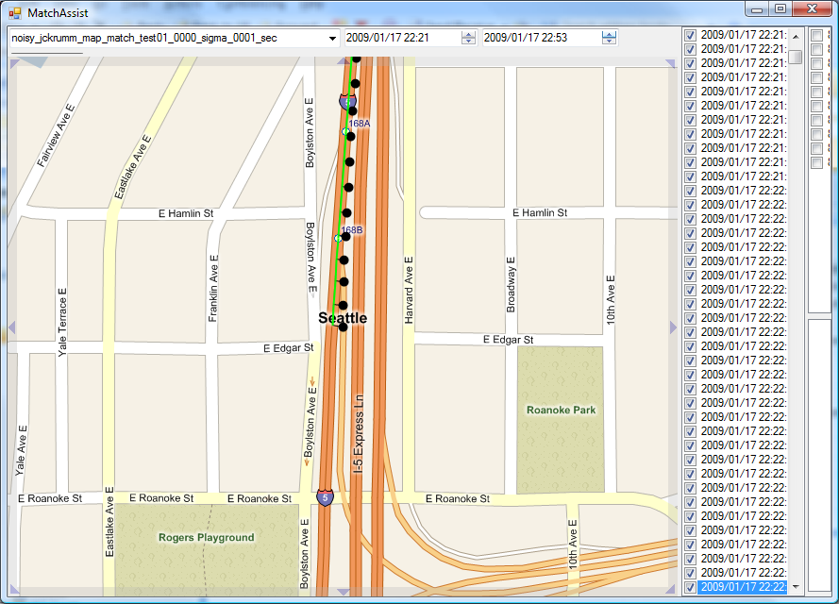

Slide 18
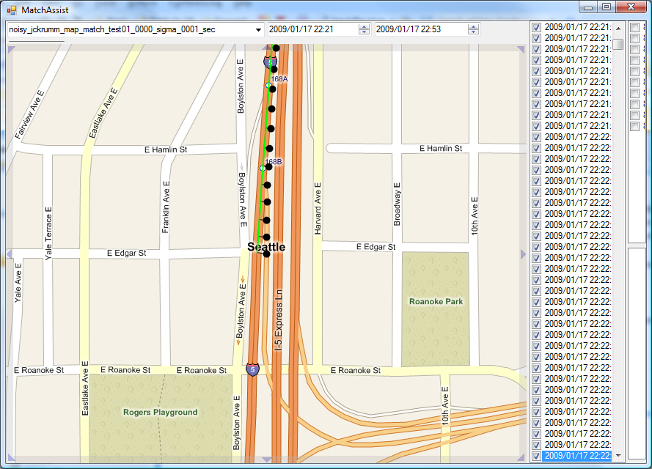
Notes:
Note that so far, it has incorrectly concluded we have not taken the off ramp, but the next point…

Slide 19
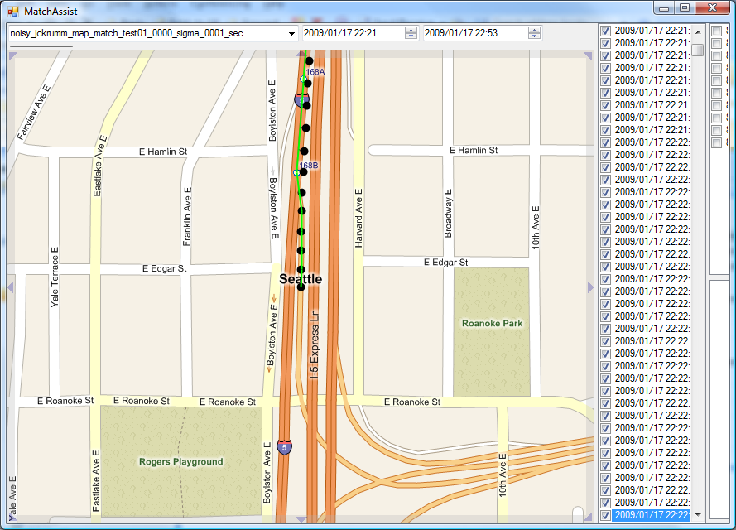
Notes:
It changes its mind, because the most probable route has now become the offramp.

Slide 20
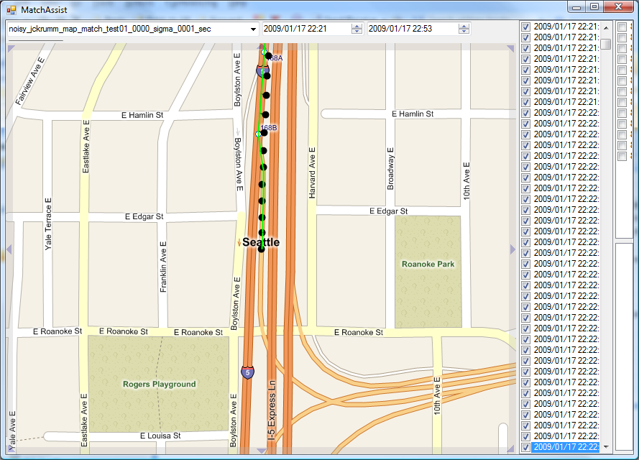

Slide 21
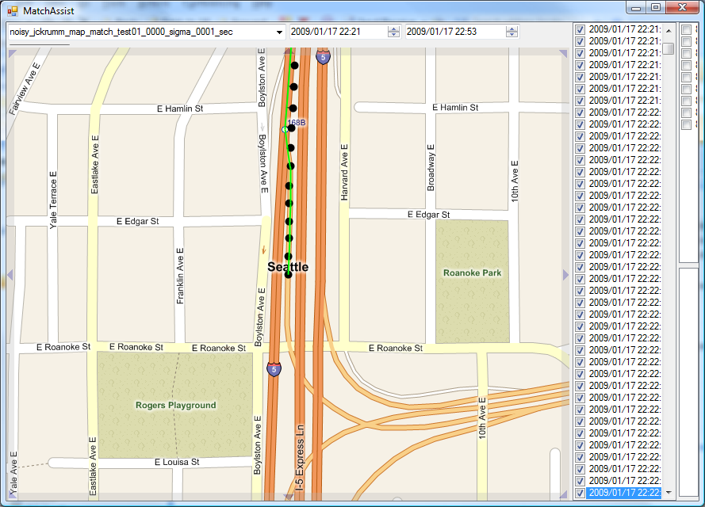

Slide 22
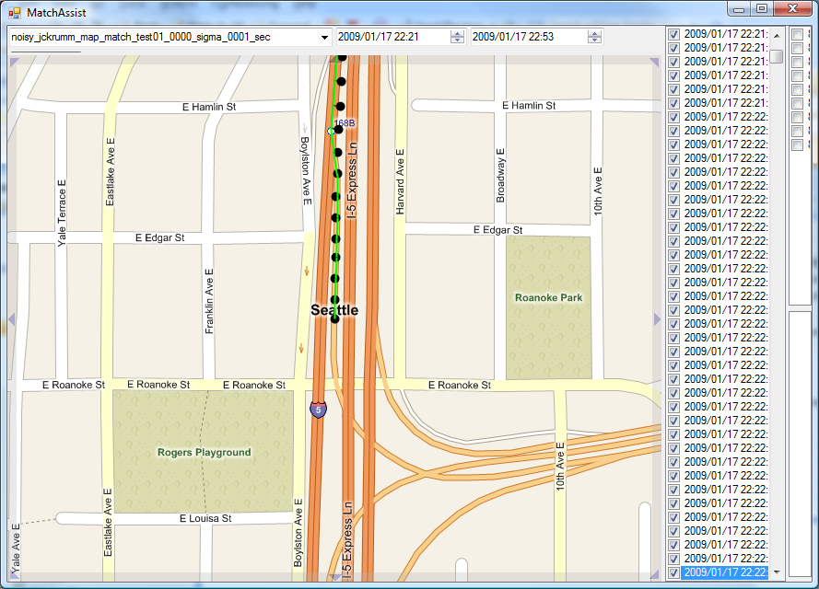

Slide 23
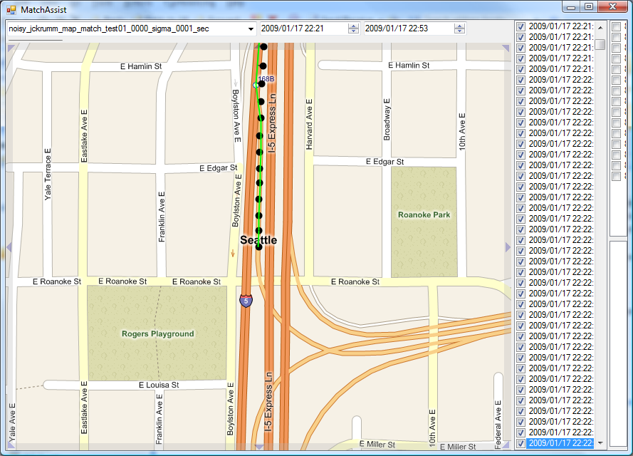

Slide 24
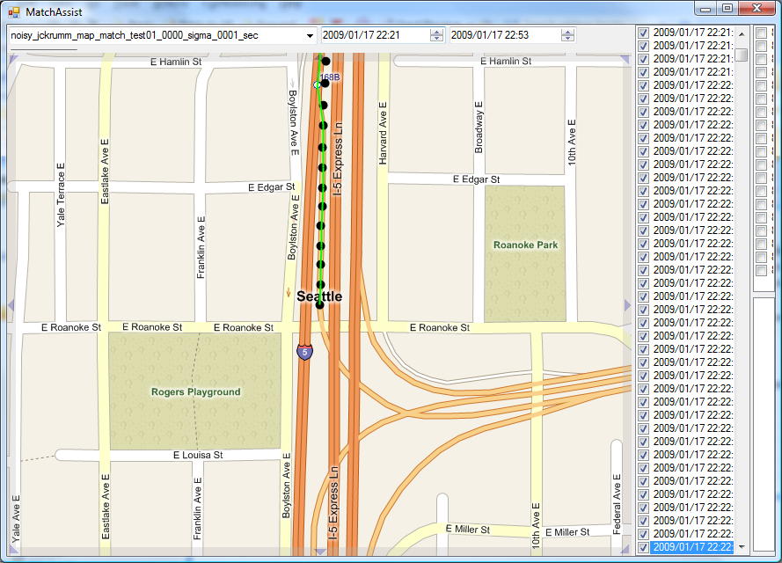

Slide 25
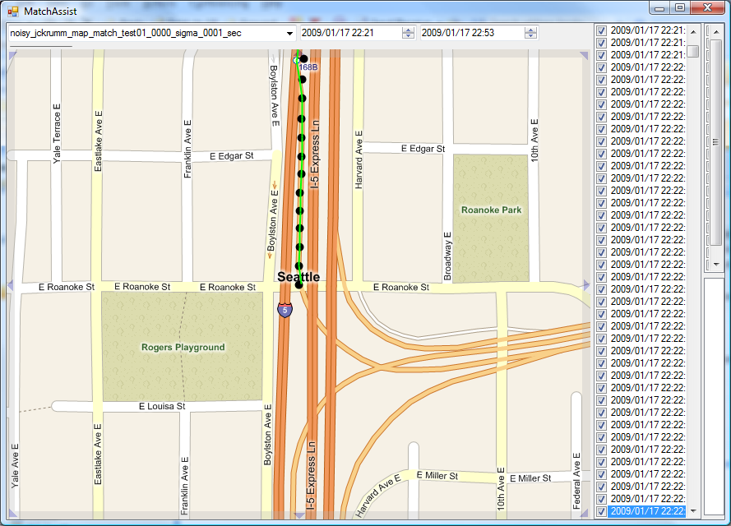

Slide 26
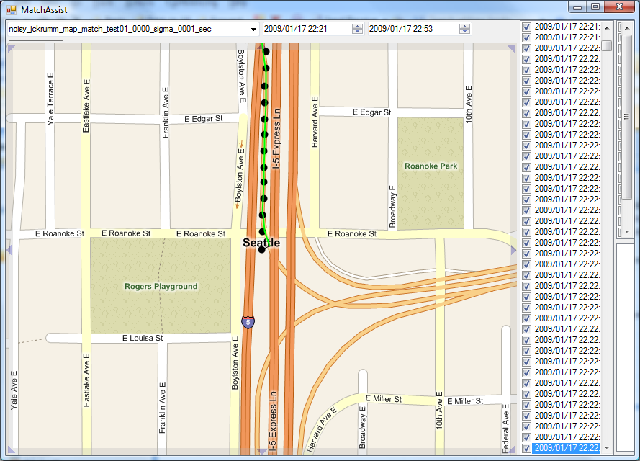
Notes:
Now we’re starting to get into the questionable points, caused by the tunnel, let’s see what the HMM does with these…

Slide 27
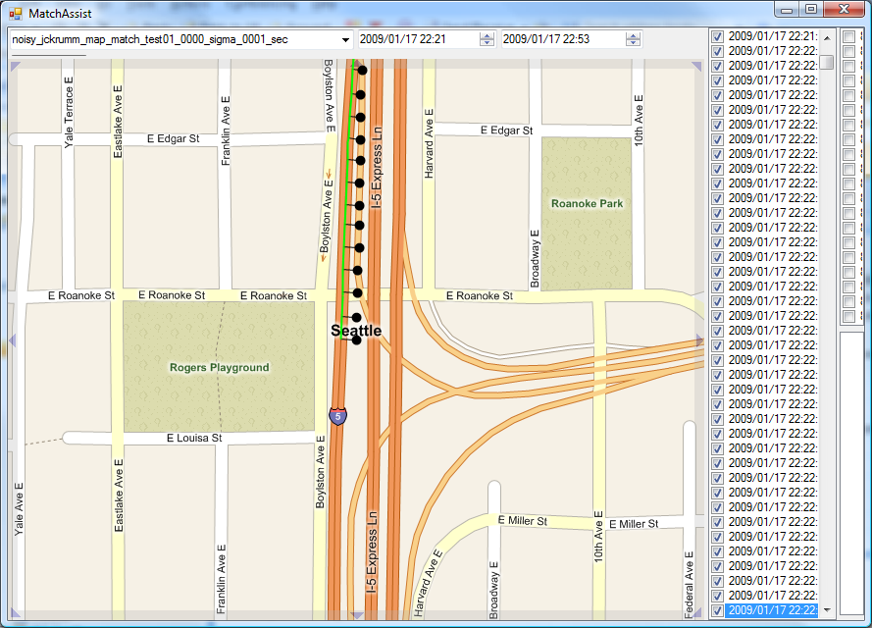
Notes:
At this point, it is quite reasonable for the HMM to conclude that you’re still on I-5. Clearly you can’t be on the off ramp, or you would be turning by now…

Slide 28
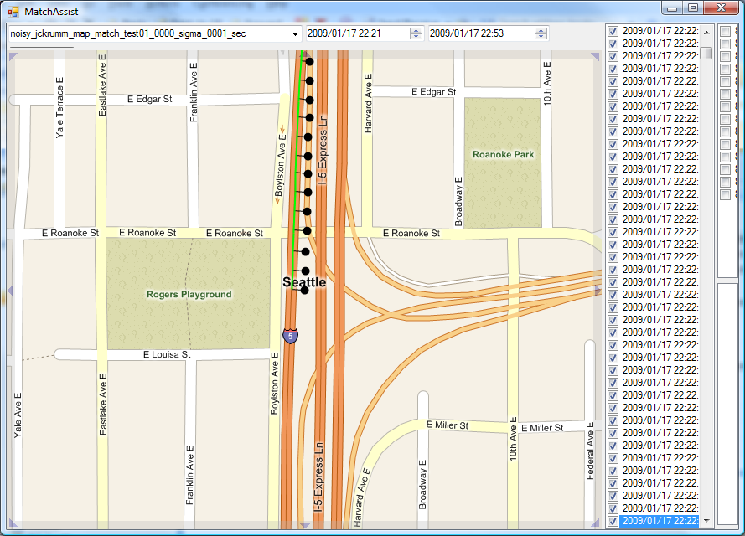

Slide 29
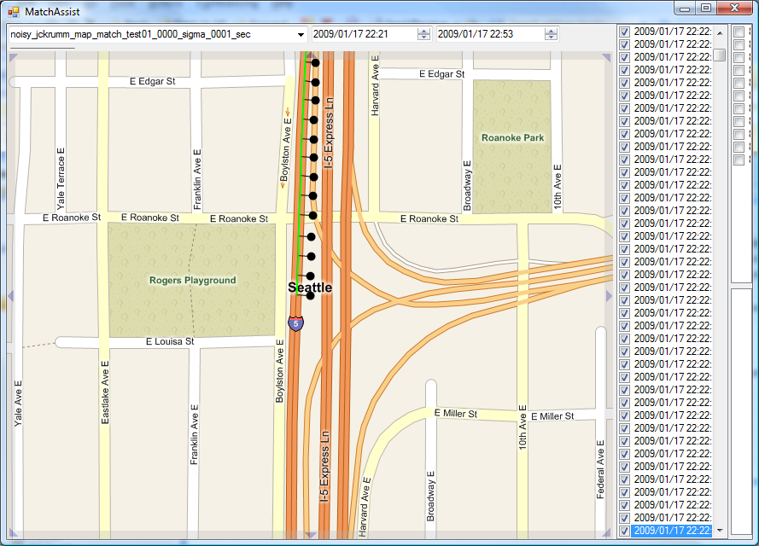

Slide 30
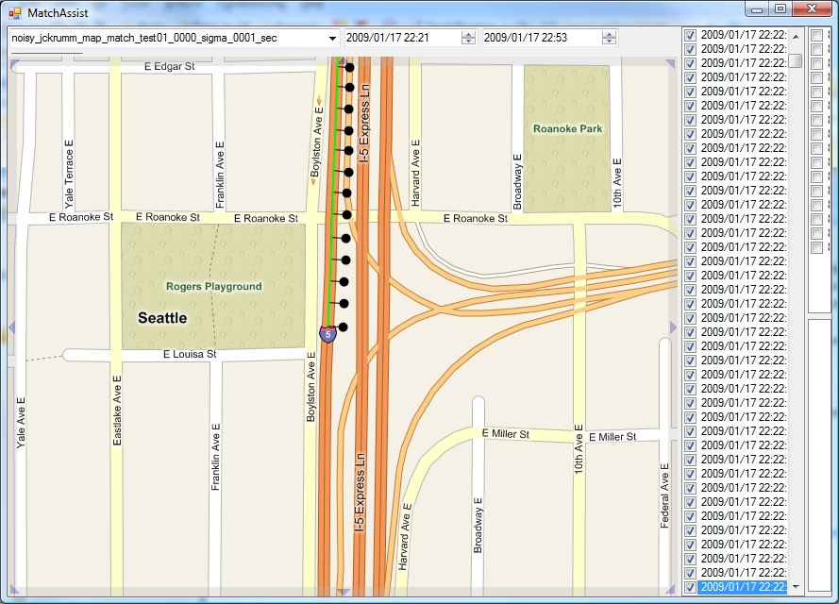

Slide 31
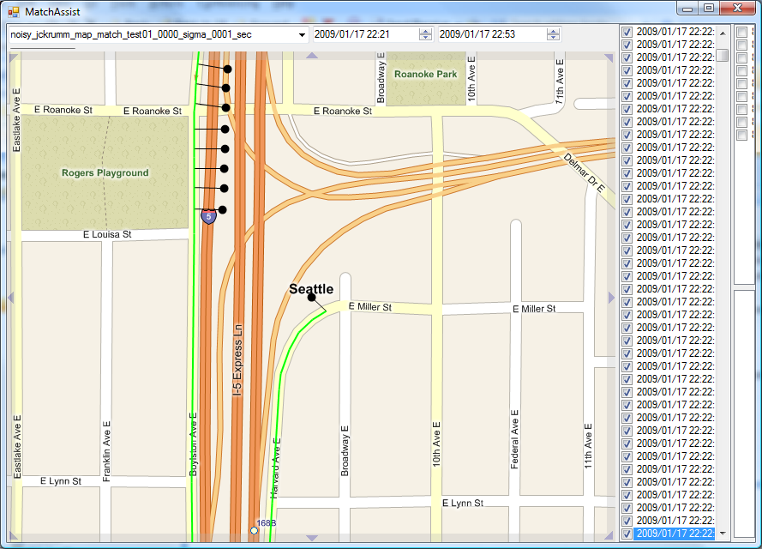
Notes:
Surprise! What’s going on here? This point is so absurd it has led the HMM quite far astray. It has concluded that you got off I-5 at the previous exit, and took surface streets to the point shown.

Slide 32
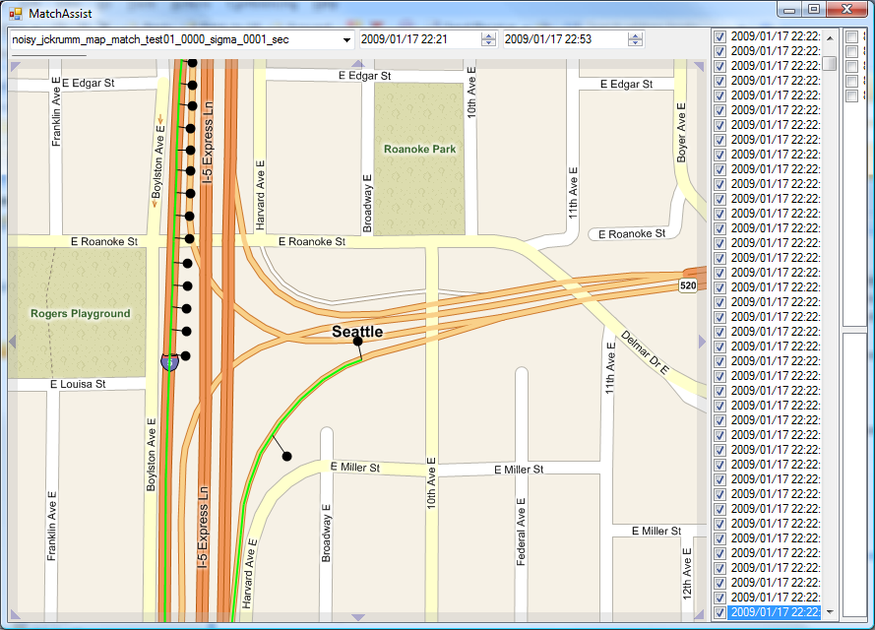
Notes:
Now it has changed its mind, and concluded that you continued down I-5 southbound, got off, and got back on I-5 northbound.

Slide 33
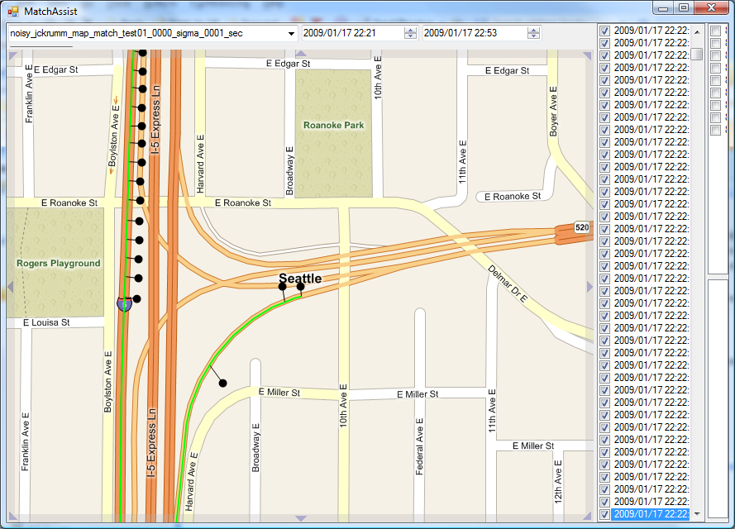
Notes:
From here on out, the points it sees are consistent with you being on 520 west, so it doesn’t change its mind again.

Slide 34
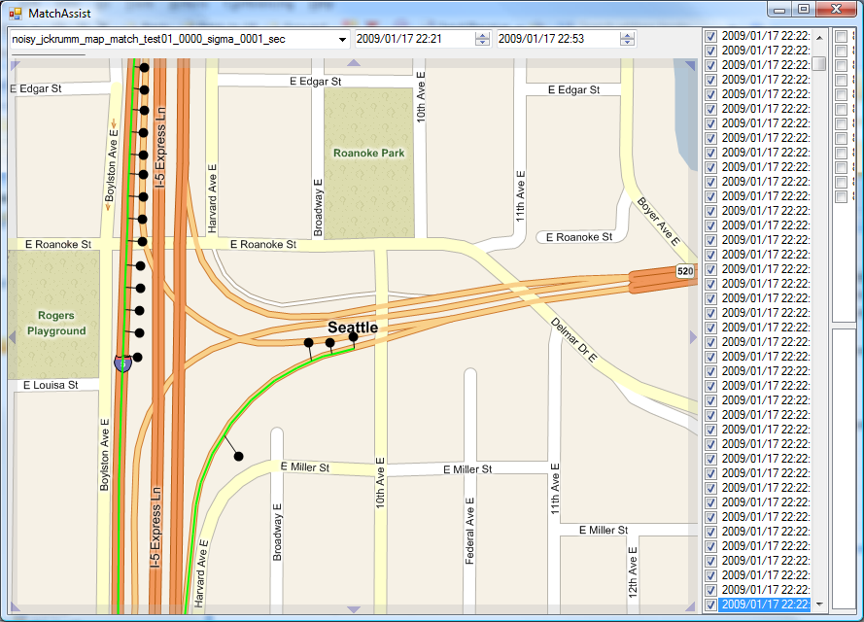

Slide 35
Match Candidate Limitation
Don’t consider roads “unreasonably” far from GPS point
Notes:
We limit the match candidates to those within a “reasonable” radius. For the purposes of our study, we used a radius of 200 meters. The largest error in our data set (before adding noise) was about 47 meters, so this is overkill for applications that are using GPS data directly. However, since we added noise with a standard deviation of up to 100 meters, it is quite possible that there are correct matches in our noisy data sets that were outside the 200 meter radius. We selected the 200 meter radius not because it was reasonable from an expected error perspective, but because it limited the number of match candidates sufficiently to allow us to complete the experiment in a reasonable amount of time. In practice, when matching on real data sets with no noise added, we tend to use values less than 50 meters. For the purposes of today’s demonstration, we will use a value of 3x sigma, or a bit over 12 meters.

Slide 36
Route Candidate Limitation
Route Distance Limit
Absolute Speed Limit
Relative Speed Limit
Notes:
Also in a theoretically perfect HMM, we would search exhaustively for the shortest path between any two match candidates, which assuming the road network is not partitioned, we could eventually find. However, once the difference between the routing distance and the Euclidian distance becomes large, further search is pointless. In our experiments, if the routing distance exceeded the Euclidian distance by 2000 meters or more, we terminate the search for a shortest path and assign a probability of zero. We also apply some other tests of reasonableness to any possible route. We don’t allow vehicles to exceed 50 m/s, which is 180 km/h, or about 112 miles per hour. We also don’t allow vehicles to exceed the posted speed limit by more than 3x.
When you remove nodes and edges from the graph, the graph may become partitioned. We can use these partitions to detect and remove the junk points. When we detect a partition in the graph, we throw out the points on either side of the partition, and see if the partition is healed. If not, we continue to throw out points on either side of the partition until the partition is healed, or until the size of the partition exceeds a time threshold and we give up.

Slide 37
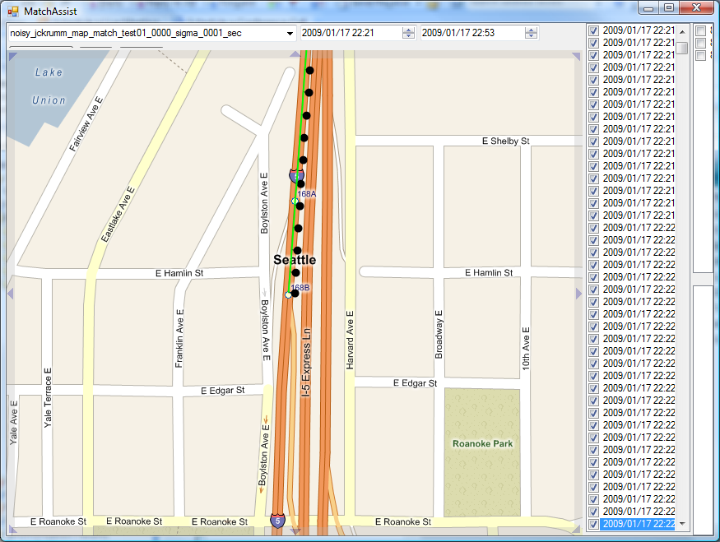
Notes:
Parameters:
match candidate limit –> 12.21
Route candidate max distance –> 2000
Route candidate max speed –> 50
Route candidate max speed ratio –> 3

Slide 38
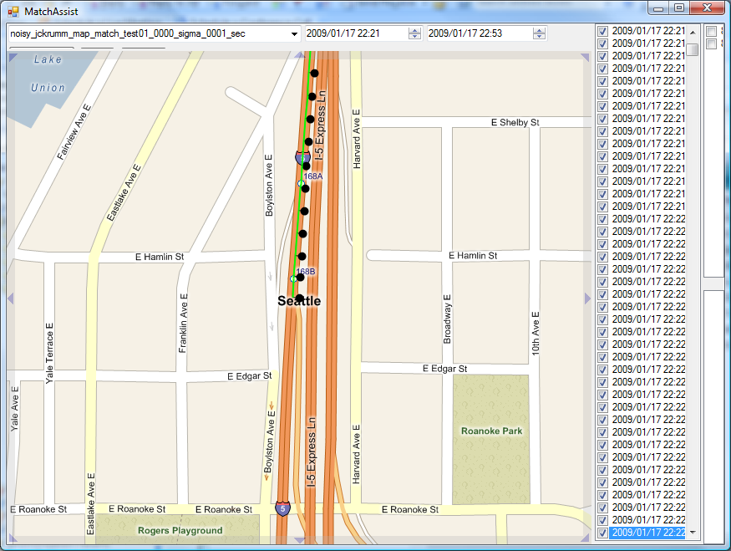

Slide 39
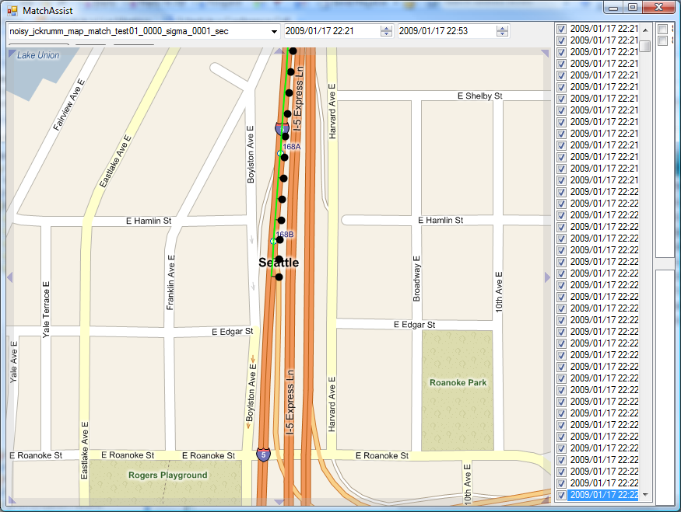

Slide 40
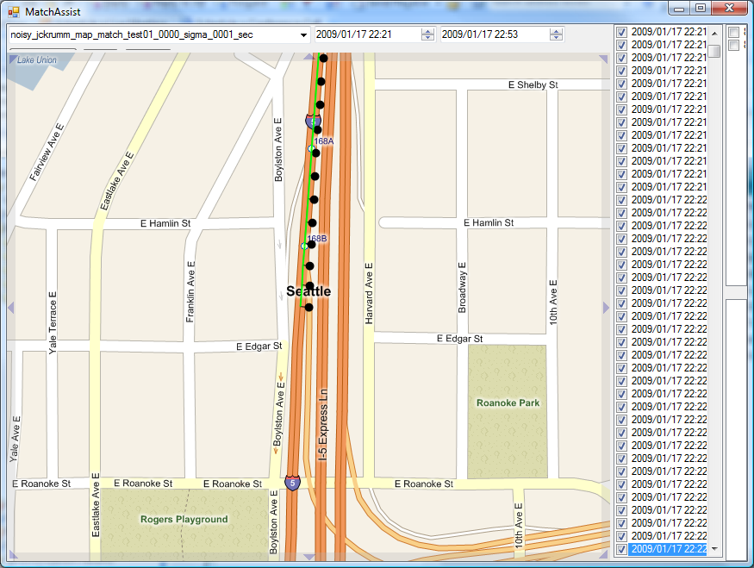

Slide 41
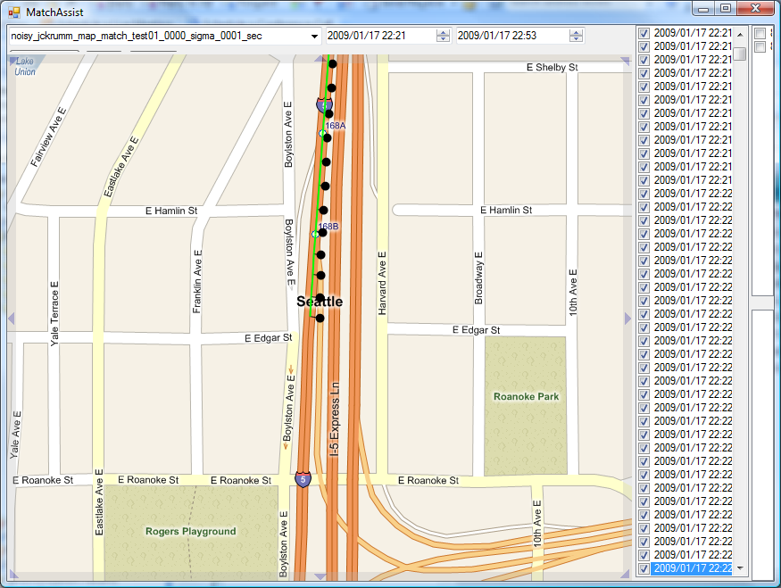

Slide 42
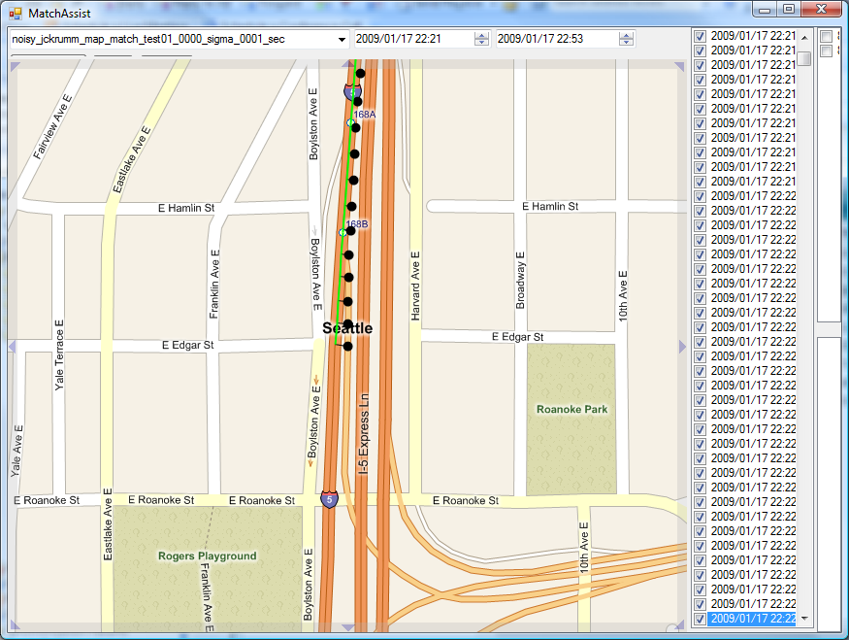

Slide 43
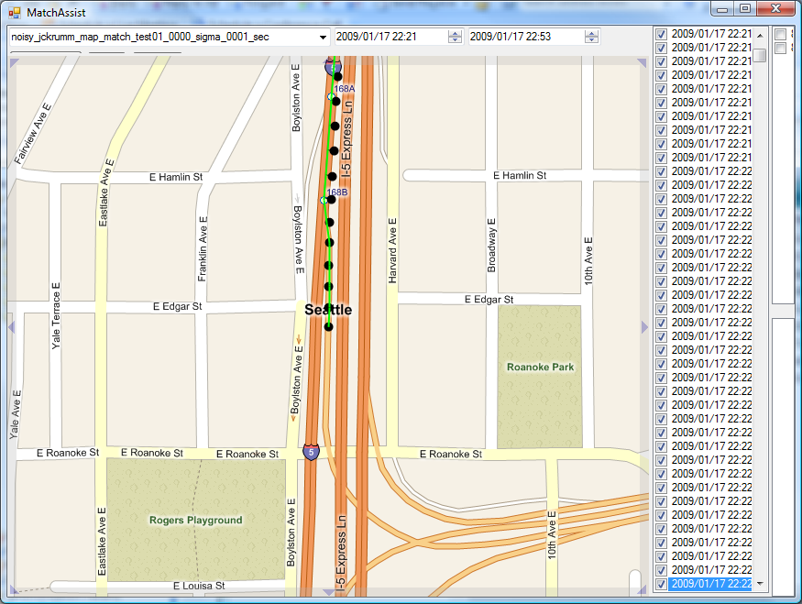

Slide 44


Slide 45
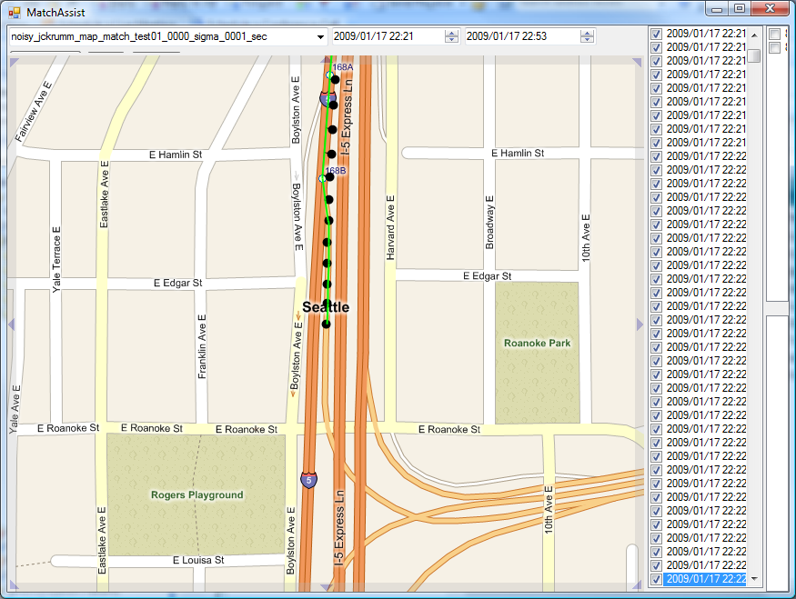

Slide 46
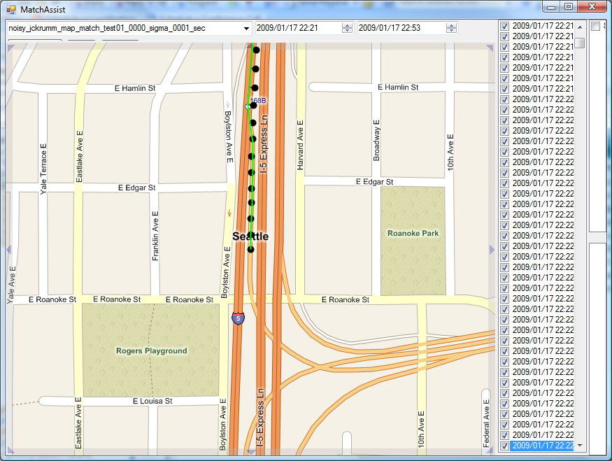

Slide 47
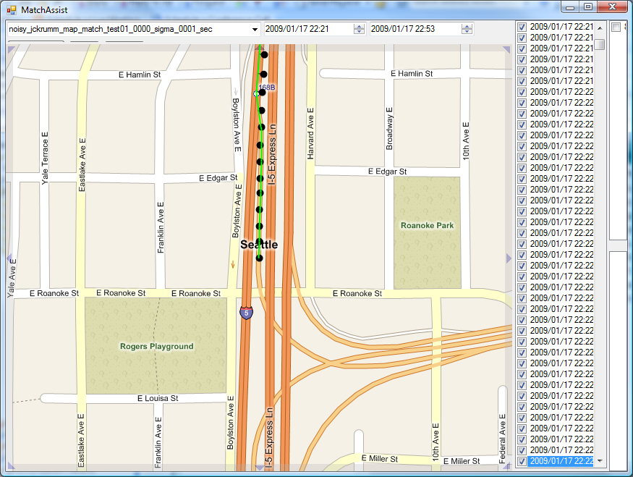

Slide 48
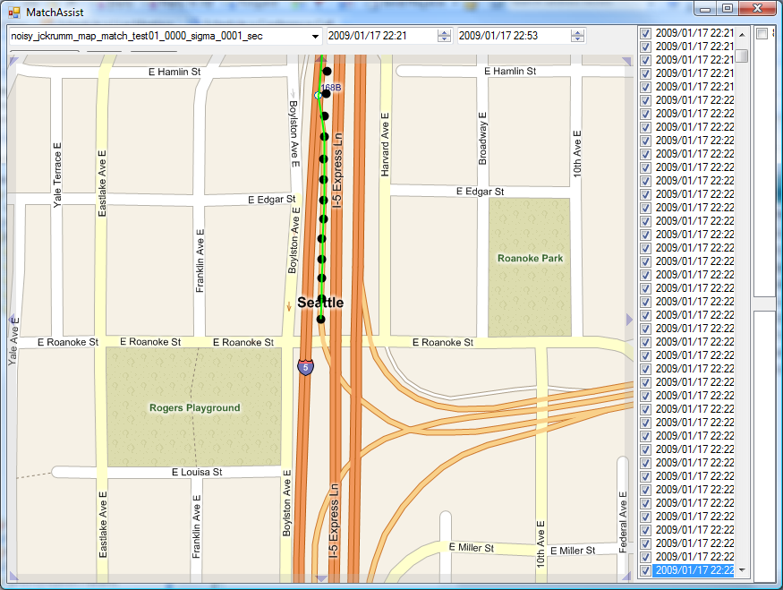

Slide 49
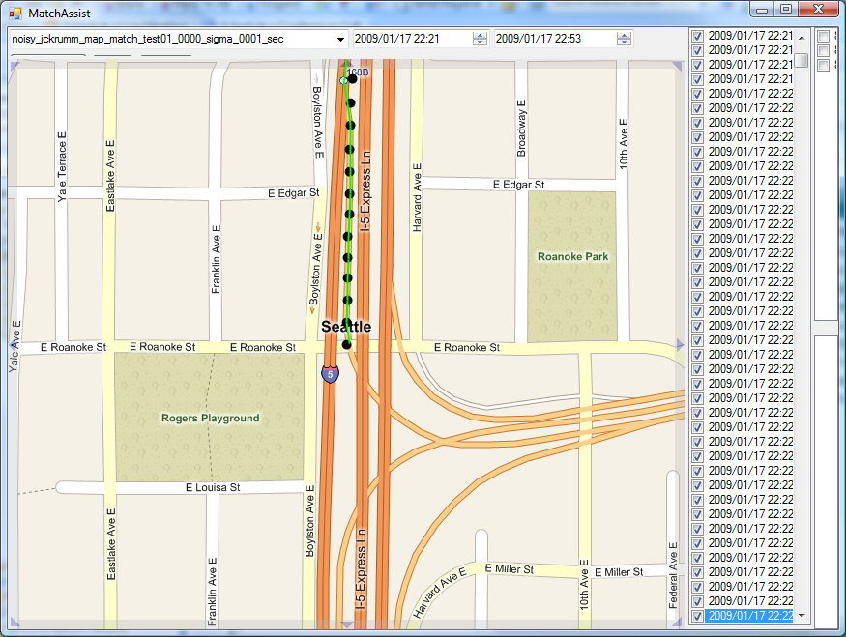

Slide 50
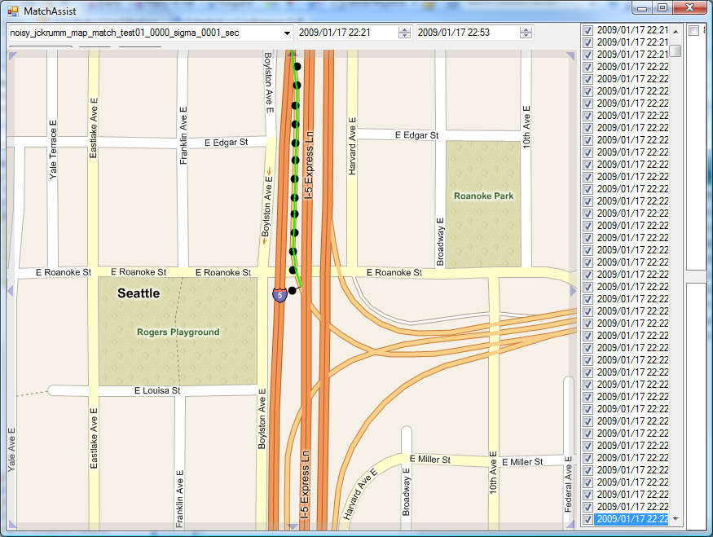

Slide 51
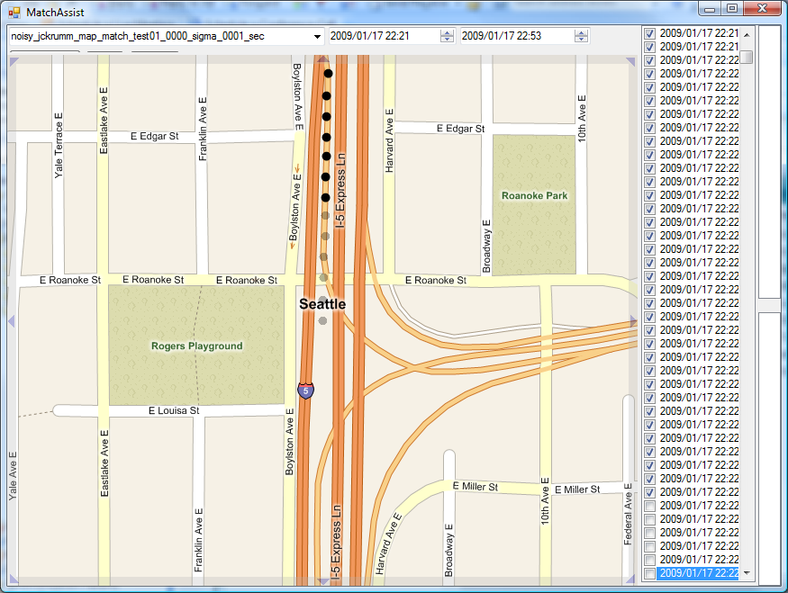
Notes:
At this point we can see that points have been thrown out due to a partition in the graph…

Slide 52
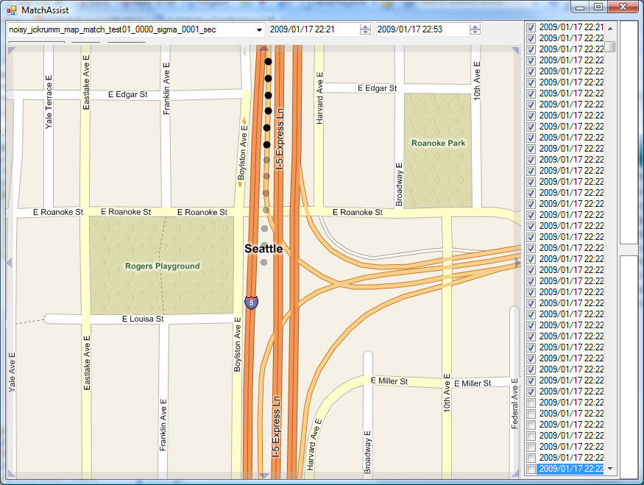

Slide 53
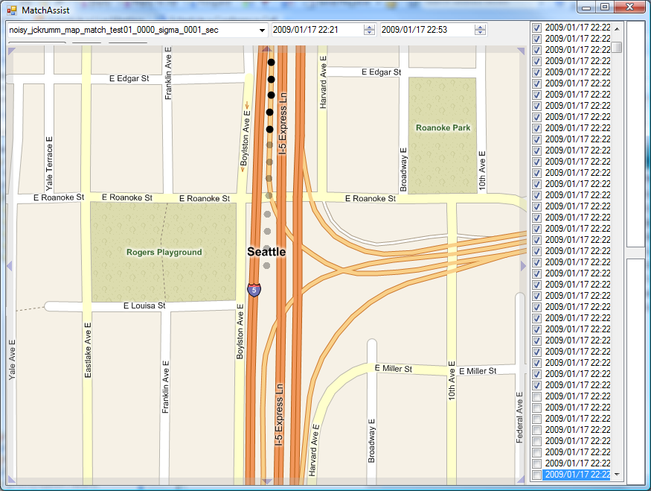

Slide 54
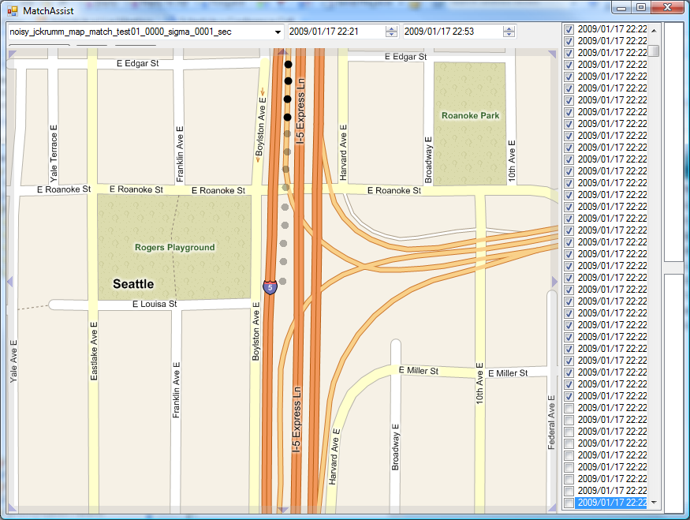

Slide 55
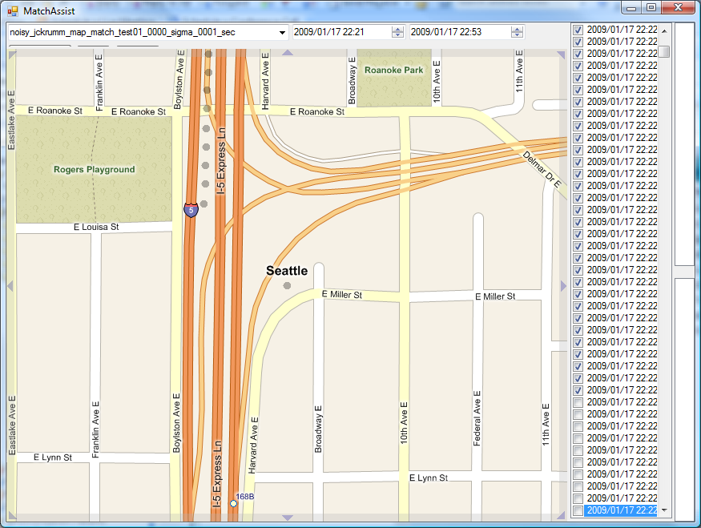

Slide 56
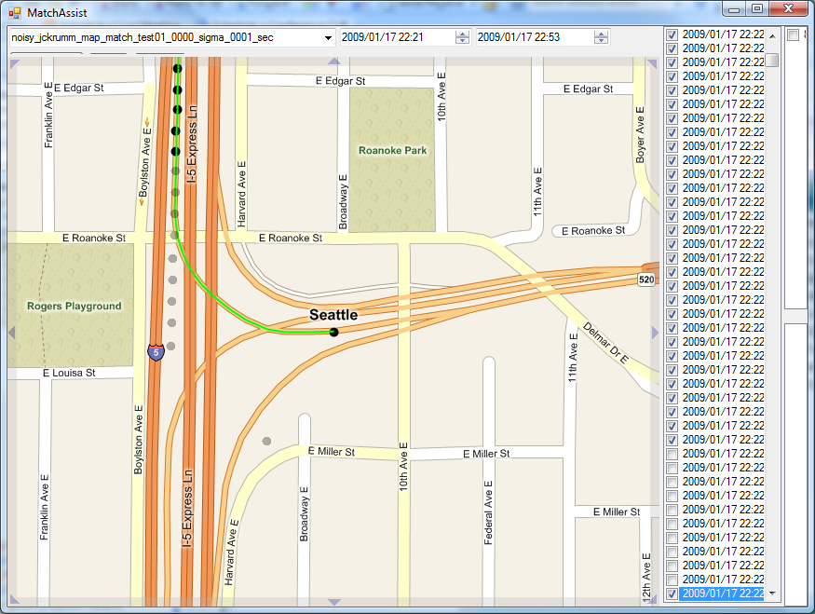
Notes:
We can see that all the junk points have been thrown out, and some good points along with them, but using the points that are left, finding the best match is now easy for the HMM to do.

Slide 57
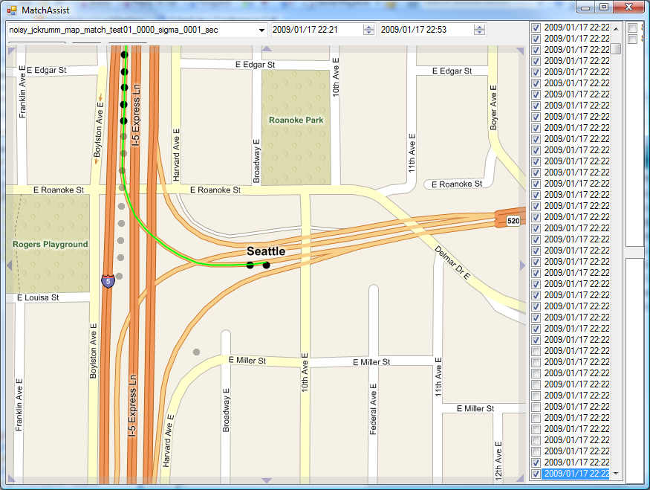

Slide 58
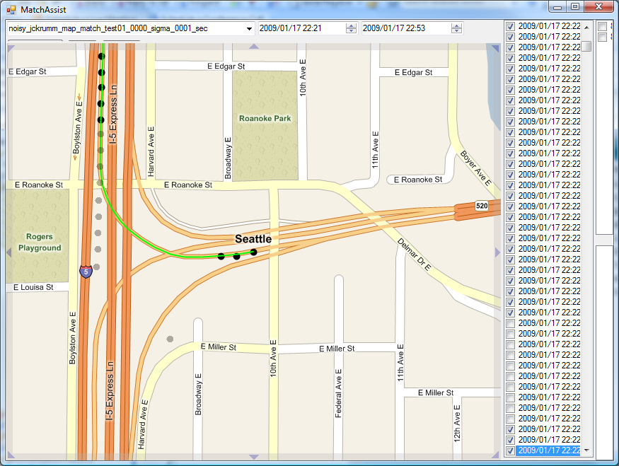

Slide 59
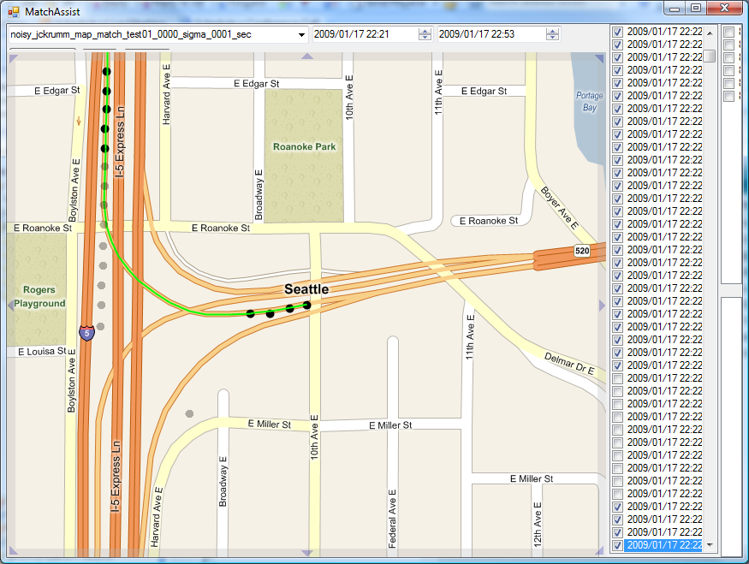

Slide 60
Robustness to Sparse Data
Notes:
We are perfect (*) up to 30 seconds.

Slide 61

Notes:
One exception to perfection…

Slide 62

Notes:
5 seconds…

Slide 63

Notes:
30 seconds – at this point we don’t have enough left to reconstruct the route. While this is an error, I don’t really count this one against the algorithm. This is an interesting case to have in our data set, but not very realistic.

Slide 64
Robustness to Sparse Data
Notes:
At 90 seconds, we have only 86 points to figure out the whole 2 hour, 6 minute route.

Slide 65

Notes:
At 90 seconds, we have only 86 points to figure out the whole 2 hour, 6 minute route.
Only three errors, ignoring the roundabout discussed earlier.

Slide 66


30 second sample period
90 second sample period

Slide 67


30 second sample period
90 second sample period

Slide 68


30 second sample period
90 second sample period
Notes:
This one is interesting, because the correct route is in some sense simpler than the shortest path. In this case, our algorithm never even considered the correct path, because it was not the shortest path between the two points. This demonstrates an important property of our current solution to this problem – it only considers one route between any two points, and it is at the mercy of the routing algorithm for what that route will be. This points to an interesting direction for future work.

Slide 69
Robustness to Noise
At 30 second sample period

Slide 70


Slide 71


30 seconds, no added noise
30 seconds, 30 meters noise

Slide 72


30 seconds, no added noise
30 seconds, 30 meters noise

Slide 73


30 seconds, no added noise
30 seconds, 30 meters noise

Slide 74


30 seconds, no added noise
30 seconds, 30 meters noise

Slide 75


30 seconds, no added noise
30 seconds, 30 meters noise

Slide 76

Data! http://research.microsoft.com/en-us/um/people/jckrumm/MapMatchingData/data.htm
Notes:
We would love to have others in this community working on map matching try their algorithms on our data. It would also be great to find common ground on methods of evaluating map matchers so we can start to compare performance in an apples to apples way.

Slide 77
Conclusions
Map Matching is Not (Always) Trivial
HMM Map Matcher works “perfectly” up to 30 second sample period
HMM Map Matcher is reasonably good up to 90 second sample period
Try our data!

Slide 78
Questions?
Hidden Markov Map Matching Through Noise and Sparseness
Paul Newson and John Krumm
Microsoft Research
ACM SIGSPATIAL ’09
November 6th, 2009

