Slide 1


Verification of concurrent object-oriented programs
K. Rustan M. Leino
RiSE, Microsoft Research, Redmond
Joint work with:
Peter Müller, ETH Zurich
Jan Smans, KU Leuven
EPFL
Lausanne, Switzerland
7 September 2009

Slide 2
Software engineering research
Goal
  Better build, maintain, and understand programs
How?
  Specifications
  Tools, tools, tools
    Program semantics
    Verification-condition generation, symbolic execution, model checking, abstract interpretation, fuzzing, test generation
    Satisfiability Modulo Theories (SMT)

Slide 3
Some specification/verification tools at Microsoft
Static Driver Verifier (SDV)
  Applied regularly to all Microsoft device drivers of the supported device models, ~300 bugs found
  Available to third parties in Windows DDK
Sage
  Applied regularly
  100s of people doing various kinds of fuzzing
HAVOC
  Has been applied to 100s of KLOC
  ~40 bugs in resource leaks, lock usage, use-after-free
PEX
  Test generation, uses Code Contracts
  Applied to various libraries components
VCC
  Being applied to Microsoft Hypervisor
…

Slide 4
Spec# programming system
[Barnett, Fähndrich, Leino, Müller, Schulte, Venter, et al.]
Research prototype
Spec# language
  C# 2.0 + non-null types + contracts
Checking:
  Static type checking
  Run-time checking
  Static verification

Slide 5
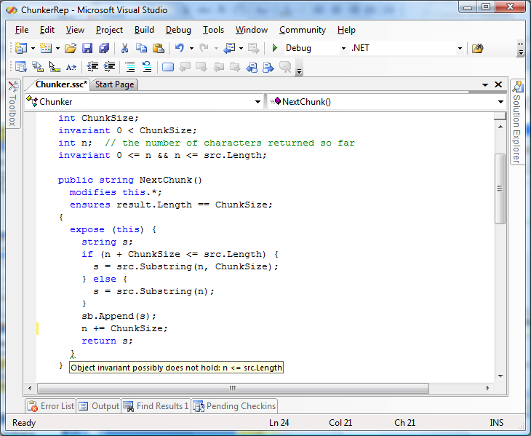
Spec# demo

Slide 6
Specifications: .NET today
StringBuilder.Append Method (Char[ ], Int32, Int32)
Appends the string representation of a specified subarray of Unicode characters to the end of this instance.
public StringBuilder Append(char[] value, int startIndex, int charCount);
Parameters
value
A character array.
startIndex
The starting position in value.
charCount
The number of characters append.
Return Value
A reference to this instance after the append operation has occurred.
Exceptions
Exception Type | Condition
ArgumentNullException | value is a null reference, and startIndex and charCount are not zero.
ArgumentOutOfRangeException | charCount is less than zero. -or- startIndex is less than zero. -or- startIndex + charCount is less than the length of value.

Slide 7
Specifications in Spec#
public StringBuilder Append(char[] value, int startIndex,
int charCount );
requires value == null ==> startIndex == 0 && charCount == 0;
requires 0 <= startIndex;
requires 0 <= charCount;
requires value != null ==>
startIndex + charCount <= value.Length;
ensures result == this;

Slide 8
Specifications with Code Contracts
(.NET 4.0)
public StringBuilder Append(char[] value, int startIndex,
int charCount )
{
Contract.Requires(value != null ||
(startIndex == 0 && charCount == 0));
Contract.Requires(0 <= startIndex);
Contract.Requires(0 <= charCount);
Contract.Requires(value == null ||
startIndex + charCount <= value.Length);
Contract.Ensures(Contracts.Result<StringBuilder>() == this);
// method implementation...
}
Note that postcondition is declared at top of method body, which is not where it should be executed.
A rewriter tool moves these.

Slide 9
Chalice
Experimental language with focus on:
  Shared-memory concurrency
  Static verification
Key features
  Memory access governed by a model of permissions
  Sharing via locks with monitor invariants
  Deadlock checking, dynamic lock re-ordering
  Channels
Other features
  Classes; Mutual exclusion and readers/writers locks;
  Fractional permissions;Two-state monitor invariants;
  Asynchronous method calls; Memory leak checking;
  Logic predicates and functions; Ghost and prophecy variables

Slide 10
Dealing with memory (the heap)
Access to a memory location requires permission
Permissions are held by activation records
Syntax for talking about permission to y: acc(y)

Slide 11
Inc
demo

Slide 12
Transfer of permissions
acc(c.y)
method Main()
{
var c := new Counter;
call c.Inc();
}
method Inc()
requires acc(y)
ensures acc(y)
{
y := y + 1;
}

Slide 13
The two halves of a call
call == fork + join
is semantically like
… but is compiled to more efficient code
call x,y := o.M(E, F);
fork tk := o.M(E, F);
join x,y := tk;

Slide 14
Well-formed specifications
A specification expression can mention a memory location only if it also entails some permission to that location
Example: acc(y) && y < 20
Without any permission to y, other threads may change y, and then y and “y < 20” would not be stable

Slide 15
Read permissions
acc(y) write permission to y
rd(y) read permission to y
At any one time, at most one thread can have write permission to a location

Slide 16
Fractional permissions
acc(y) 100% permission to y
acc(y, p) p% permission to y
rd(y) read permission to y
Write access requires 100%
Read access requires >0%
= +
≈
acc(y)
acc(y,69)
acc(y,31)
rd(y)
acc(y, ε)

Slide 17
Passing permissions to threads
class Fib {
var x: int;
var y: int;
var z: int;
method Main()
{
var c := new Fib;
fork c.A();
fork c.B();
}
}
method A()
requires rd(x) && acc(y)
{
y := x + 21;
}
method B()
requires rd(x) && acc(z)
{
z := x + 34;
}

Slide 18
Shared state
What if two threads want write access to the same location?
method A() …
{
y := y + 21;
}
class Fib {
var y: int;
method Main()
{
var c := new Fib;
fork c.A();
fork c.B();
}
}
?
acc(c.y)
method B() …
{
y := y + 34;
}

Slide 19
Monitors
class Fib {
var y: int; invariant acc(y);
method Main()
{
var c := new Fib;
share c;
fork c.A();
fork c.B();
}
}
method A() …
{
acquire this;
y := y + 21;
release this;
}
acc(c.y)
method B() …
{
acquire this;
y := y + 34;
release this;
}
acc(y)

Slide 20
Monitor invariants
Like other specifications, can hold both permissions and conditions
Example: invariant acc(y) && 0 <= y
acc(y)

Slide 21
Shared Counter
demo

Slide 22
Locks and permissions
The concepts
  holding a lock, and
  having permissions
are orthogonal to one another
In particular:
  Holding a lock does not imply any right to read or modify shared variables
Their connection is:
  Acquiring a lock obtains some permissions
  Releasing a lock gives up some permissions

Slide 23
Preventing deadlocks
A deadlock is the situation where a nonempty set (cycle) of threads each waits for a resource (e.g., lock) that is held by another thread in the set
Deadlocks are prevented by making sure no such cycle can ever occur
  The program partially order locks
  The program is checked to acquire locks in strict ascending order

Slide 24
Wait order
Wait order is a dense partial order
(Mu, <<) with a bottom element ⊥
<< is the strict version of <<
The wait level of an object o is stored in a mutable ghost field o.mu
Accessing o.mu requires appropriate permissions, as for other fields

Slide 25
Example: Avoiding deadlocks
method M()
{
acquire a;
acquire b;
…
}
method N()
{
acquire b;
acquire a;
…
}
With these preconditions, both methods verify
The conjunction of the preconditions is false, so the methods can never be invoked at the same time
requires rd(a.mu)
requires rd(b.mu)
requires rd(a.mu)
requires rd(b.mu)
requires maxlock << a.mu
requires a.mu << b.mu
requires maxlock << b.mu
requires b.mu << a.mu

Slide 26
Setting the wait order
Recall, the wait level of an object o is stored in the ghost field o.mu
Initially, the .mu field is ⊥
The .mu field is set by the share statement:
picks some wait level strictly between
L and H, and sets o.mu to that level
Provided L << H and neither denotes an extreme element, such a wait level exists, since the order is dense
share o between L and H;

Slide 27
Dining Philosophers
demo

Slide 28
Changing the wait order
When is:
allowed?
When o.mu is writable!
… and the thread holds o
Note, means
(∀l∈Held • l.mu << X), so uttering maxlock has the effect of reading many .mu fields
We either need rd(maxlock), or
reorder o between L and H;
maxlock << X

Slide 29
Verified Software Initiative
Hoare, Joshi, Leavens, Misra, Naumann, Shankar, Woodcock, et al.
“We envision a world in which computer programs are always the most reliable component of any system or device that contains them” [Hoare & Misra]

Slide 30
Boogie – a verification tool bus
[Barnett, Jacobs, Leino, Moskal, Rümmer, et al.]
Spec#
C with HAVOC specifications
C with VCC specifications
Dafny
Chalice
Your language here
Boogie
Boogie-to-Boogie transformations:
Inference engines
Program transformations
Logic optimizers
Your prover here
Simplify
Z3
SMT Lib
Isabelle/HOL

Slide 31
Chalice summary
Permissions guide what memory locations are allowed to be accessed
Activation records and monitors can hold permissions
Permissions can be transferred between activation records and monitors
Locks grant mutually exclusive access to monitors

Slide 32
Try it for yourself
Chalice (and Boogie) available as open source:
http://boogie.codeplex.com
Spec# and VCC also available as open source under academic license:
http://specsharp.codeplex.com
http://vcc.codeplex.com

Slide 33
extra slides

Slide 34
Hand over hand locking
demo
:List
current
tail
head
:Node
:Node
:Node
:Node

Slide 35
Hand-over-hand locking: the idea
:Node
:Node
:Node
:Node
40%
method Update(p: Node)
requires acc(p.data,40) …
ensures acc(p.data,40) …
{
acquire p;
while (p.next != null) … {
var nx := p.next;
acquire nx;
nx.data := nx.data + 1;
release p;
p := nx;
}
release p;
}
100%
40%
p
tail
invariant
acc(data,60) && … &&
(next != null ==>
acc(next.data,40) &&
data <= next.data);

Slide 36
Hand-over-hand locking: the idea
:Node
:Node
:Node
:Node
100%
40%
method Update(p: Node)
requires acc(p.data,40) …
ensures acc(p.data,40) …
{
acquire p;
while (p.next != null) … {
var nx := p.next;
acquire nx;
nx.data := nx.data + 1;
release p;
p := nx;
}
release p;
}
100%
40%
p
nx
tail
invariant
acc(data,60) && … &&
(next != null ==>
acc(next.data,40) &&
data <= next.data);

Slide 37
Hand-over-hand locking: the idea
:Node
:Node
:Node
:Node
40%
method Update(p: Node)
requires acc(p.data,40) …
ensures acc(p.data,40) …
{
acquire p;
while (p.next != null) … {
var nx := p.next;
acquire nx;
nx.data := nx.data + 1;
release p;
p := nx;
}
release p;
}
100%
60%
100%
40%
p
nx
tail
invariant
acc(data,60) && … &&
(next != null ==>
acc(next.data,40) &&
data <= next.data);

Slide 38
Hand-over-hand locking: the idea
:Node
:Node
:Node
:Node
40%
60%
method Update(p: Node)
requires acc(p.data,40) …
ensures acc(p.data,40) …
{
acquire p;
while (p.next != null) … {
var nx := p.next;
acquire nx;
nx.data := nx.data + 1;
release p;
p := nx;
}
release p;
}
40%
p
nx
tail
invariant
acc(data,60) && … &&
(next != null ==>
acc(next.data,40) &&
data <= next.data);

Slide 39
Hand-over-hand locking: the idea
:Node
:Node
:Node
:Node
40%
60%
method Update(p: Node)
requires acc(p.data,40) …
ensures acc(p.data,40) …
{
acquire p;
while (p.next != null) … {
var nx := p.next;
acquire nx;
nx.data := nx.data + 1;
release p;
p := nx;
}
release p;
}
40%
p
tail
invariant
acc(data,60) && … &&
(next != null ==>
acc(next.data,40) &&
data <= next.data);

Slide 40
Hand-over-hand locking: the idea
:Node
:Node
:Node
:Node
40%
method Update(p: Node)
requires acc(p.data,40) …
ensures acc(p.data,40) …
{
acquire p;
while (p.next != null) … {
var nx := p.next;
acquire nx;
nx.data := nx.data + 1;
release p;
p := nx;
}
release p;
}
60%
40%
p
tail
invariant
acc(data,60) && … &&
(next != null ==>
acc(next.data,40) &&
data <= next.data);

Slide 41
Hand-over-hand locking: the idea
:Node
:Node
:Node
:Node
40%
method Update(p: Node)
requires acc(p.data,40) …
ensures acc(p.data,40) …
{
acquire p;
while (p.next != null) … {
var nx := p.next;
acquire nx;
nx.data := nx.data + 1;
release p;
p := nx;
}
release p;
}
60%
p
tail
invariant
acc(data,60) && … &&
(next != null ==>
acc(next.data,40) &&
data <= next.data);

