Slide 1
Fun with code, tests, and verification
K. Rustan M. Leino
Research in Software Engineering (RiSE)
Microsoft Research, Redmond
Caltech
Pasadena, CA
12 November 2009

Slide 2
Software engineering research
Goal
  Better build, maintain, and understand programs
How do we do it?
  Specifications
  Tools, tools, tools
    Program semantics
    Verification-condition generation, symbolic execution, model checking, abstract interpretation, fuzzing, test generation
    Satisfiability Modulo Theories (SMT)

Slide 3
Some specification/verification tools at Microsoft
Static Driver Verifier (SDV)
  Applied regularly to all Microsoft device drivers of the supported device models, ~300 bugs found
  Available to third parties in Windows DDK
Sage
  Applied regularly
  100s of people doing various kinds of fuzzing
HAVOC
  Has been applied to 100s of KLOC
  ~40 bugs in resource leaks, lock usage, use-after-free
Pex
  Test generation, uses Code Contracts
  Applied to various libraries components
VCC
  Being applied to Microsoft Hypervisor
…

Slide 4
Spec# programming system
[Barnett, Fähndrich, Leino, Müller, Schulte, Venter, et al.]
Research prototype
Spec# language
  C# 2.0 + non-null types + contracts
Checking:
  Static type checking
  Run-time checking
  Static verification

Slide 5
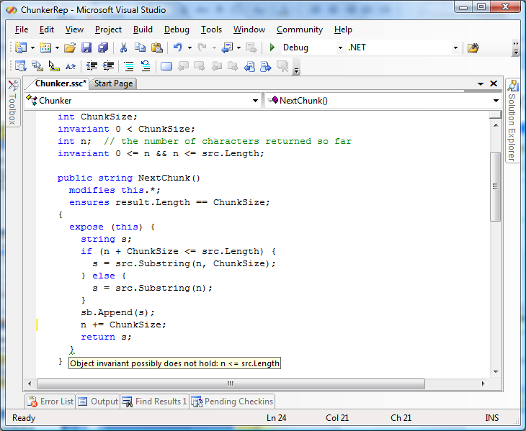
Chunker
demo
Spec#

Slide 6
Reasoning about programs
Hoare triple { P } S { Q } says that
  every terminating execution trace of
  program S that starts in a state satisfying P
    does not go wrong, and
    terminates in a state satisfying Q

Slide 7

Assignments
Q[E/x]
y is even
x < 99
9*y*y + 15*y = 721
{ } x := E { Q }
Examples:
{ } x := y { x is even }
{ } x := x + 1 { x < 100 }
{ }
x := 3*y
{ x*x + 5*x = 721 }

Slide 8
Loops
To prove:
{ P } while B do S end { Q }
find a loop invariant J and prove:
invariant holds initially:
P ⇒ J
invariant is maintained:
{ J ∧ B } S { J }
invariant is strong enough to establish postcondition:
J ∧ ¬B ⇒ Q

Slide 9
Cubes
demo
Spec#

Slide 10
Chalice
[Leino, Müller, Smans]
Experimental language with focus on:
  Shared-memory concurrency
  Static verification
Key features
  Memory access governed by a model of permissions
  Sharing via locks with monitor invariants
  Deadlock checking, dynamic lock re-ordering
  Channels
Other features
  Classes; Mutual exclusion and readers/writers locks;
  Fractional permissions;Two-state monitor invariants;
  Asynchronous method calls; Memory leak checking;
  Logic predicates and functions; Ghost and prophecy variables

Slide 11
Inc
demo
Chalice

Slide 12
Transfer of permissions
acc(c.y)
method Main()
{
var c := new Counter;
call c.Inc();
}
method Inc()
requires acc(y)
ensures acc(y)
{
y := y + 1;
}

Slide 13
Shared state
What if two threads want write access to the same location?
method A() …
{
y := y + 21;
}
class Fib {
var y: int;
method Main()
{
var c := new Fib;
fork c.A();
fork c.B();
}
}
?
acc(c.y)
method B() …
{
y := y + 34;
}

Slide 14
Monitors
class Fib {
var y: int; invariant acc(y);
method Main()
{
var c := new Fib;
share c;
fork c.A();
fork c.B();
}
}
method A() …
{
acquire this;
y := y + 21;
release this;
}
acc(c.y)
method B() …
{
acquire this;
y := y + 34;
release this;
}
acc(y)

Slide 15
Monitor invariants
Like other specifications, can hold both permissions and conditions
Example: invariant acc(y) && 0 <= y
acc(y)

Slide 16
Boogie – a verification platform
[Barnett, Jacobs, Leino, Moskal, Rümmer, et al.]
Spec#
C with HAVOC specifications
C with VCC specifications
Dafny
Chalice
Boogie
Simplify
Z3
SMT Lib
Isabelle/HOL

Slide 17
Encoding object-oriented programs in Boogie
demo
Boogie

Slide 18
Specifications: .NET today
StringBuilder.Append Method (Char[ ], Int32, Int32)
Appends the string representation of a specified subarray of Unicode characters to the end of this instance.
public StringBuilder Append(char[] value, int startIndex, int charCount);
Parameters
value
A character array.
startIndex
The starting position in value.
charCount
The number of characters append.
Return Value
A reference to this instance after the append operation has occurred.
Exceptions
Exception Type | Condition
ArgumentNullException | value is a null reference, and startIndex and charCount are not zero.
ArgumentOutOfRangeException | charCount is less than zero. -or- startIndex is less than zero. -or- startIndex + charCount is less than the length of value.

Slide 19
Specifications in Spec#
public StringBuilder Append(char[] value, int startIndex,
int charCount );
requires value == null ==> startIndex == 0 && charCount == 0;
requires 0 <= startIndex;
requires 0 <= charCount;
requires value != null ==>
startIndex + charCount <= value.Length;
ensures result == this;

Slide 20
Specifications with Code Contracts
[Barnett, Fähndrich, Grunkemeyer, Logozzo, et al.]
(.NET 4.0)
public StringBuilder Append(char[] value, int startIndex,
int charCount )
{
Contract.Requires(value != null ||
(startIndex == 0 && charCount == 0));
Contract.Requires(0 <= startIndex);
Contract.Requires(0 <= charCount);
Contract.Requires(value == null ||
startIndex + charCount <= value.Length);
Contract.Ensures(Contracts.Result<StringBuilder>() == this);
// method implementation...
}
Note that postcondition is declared at top of method body, which is not where it should be executed.
A rewriter tool moves these.

Slide 21
TrimSuffix
demo
Code Contracts and Pex [Tillman & de Halleux]

Slide 22
Try it for yourself
Spec# (open source):
http://specsharp.codeplex.com
VCC (open source):
http://vcc.codeplex.com
Boogie, Chalice, Dafny (open source):
http://boogie.codeplex.com
Code Contracts:
http://research.microsoft.com/contracts
Pex: http://research.microsoft.com/pex
RiSE: http://research.microsoft.com/rise

