Slide 1
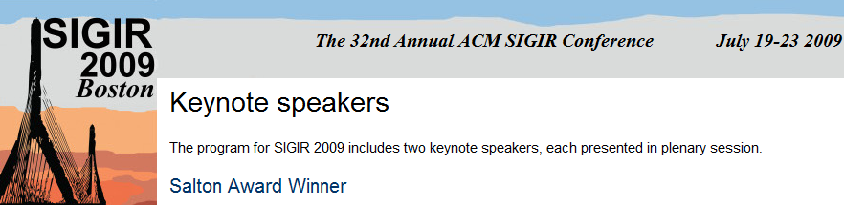
An Interdisciplinary Perspective on IR
Salton Award Lecture
Susan Dumais
Microsoft Research

Slide 2
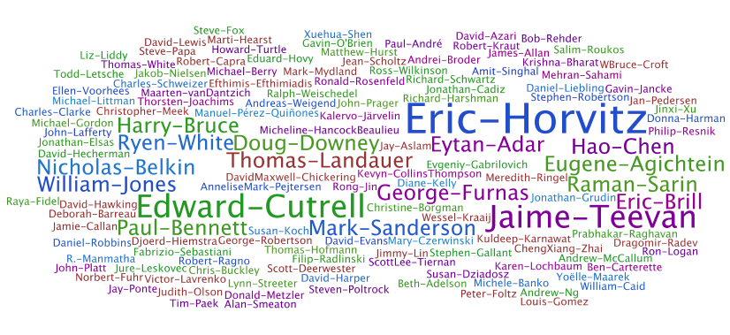
Thanks!
Salton Award Committee
Many great colleagues
  1979-1997, Bell Labs/Bellcore
  1997-present, Microsoft Research
  Many other collaborators …
Tremendous honor
Salton number = 2 or 3
  Michael Lesk: SMART @ Harvard (early 1960’s)
  CHI 1995 Panel: “Searching & browsing: Can we find a synergy”?
Notes:
Salton legacy - representations and retrieval models, test collections and metrics, and students
Wordle.net

Slide 3
Overview
Personal reflections
  My research is interdisciplinary, at the intersection of IR and HCI
  User-centric vs. system-centric
  Empirical vs. theoretical
  Evaluation via many methods
    Test collections, field work, prototypes, deployment experiences, lab studies, etc.
My background
Common themes
  Understanding user, domain, and task contexts
Future challenges
  Dynamics, data and more

Slide 4

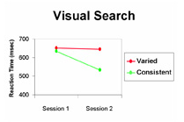

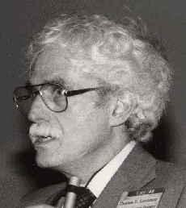
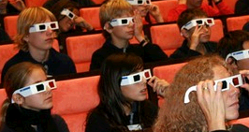
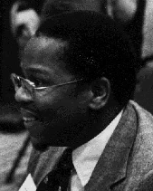
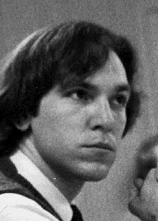





Background
Mathematics and Psychology
HCI group at Bell Labs, 1979
Introduction to IR, 1980-82
  The problem(s) …
    Human factors in database access
    Describing categories of objects for menu retrieval
    Verbal disagreement/Statistical semantics/Vocabulary problem
  Some solutions & applications …
    Rich aliasing / Adaptive indexing / Latent semantic indexing
  Closing the loop back to psychology …
    A solution to Plato’s problem [Psychological Review, 1997]

Slide 5
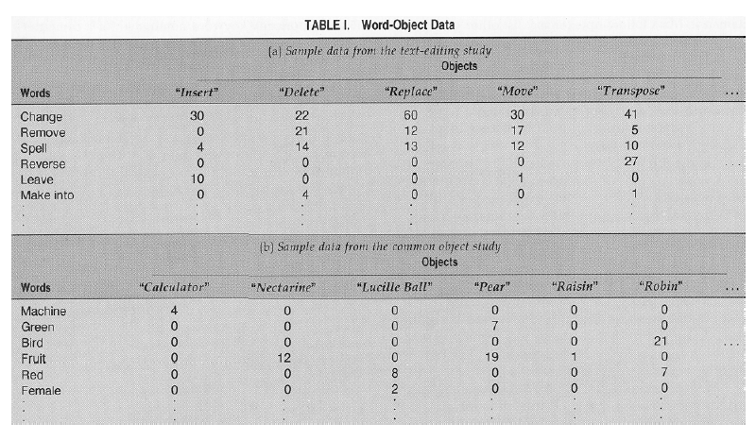
From Verbal Disagreement to LSI
Observed: Mismatch between the way that people want to retrieve information from a computer and the way that systems designers describe that information
  The trouble with UNIX
  Command names, menu and category descriptors, keywords
Studied: How people describe objects and operations
  Text editing operations, systems functionality, common objects, recipes, classified ads, etc.
  Demo:
  Data:
On a piece of paper write the name you would give to a program that tells users about interesting activities occurring in Boston this weekend.
(Try to think of a name that will be as obvious as possible; one that other people would think of.)
SIGIR 2009
Notes:
5

Slide 6
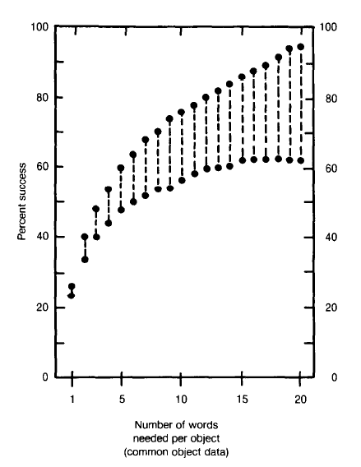
From Verbal Disagreement to LSI
Findings:
  Tremendous diversity in the name that people use to describe the same objects or actions (aka, “the long tail”)
    Single keyword: 0.07 – 0.18 “repeat rate”
    Single normative keyword: 0.16 - 0.36
    Three aliases: 0.38 – 0.67
    Infinite aliasing:
Interestingly, we have referred to this problem as: verbal disagreement, vocabulary mismatch, statistical semantics

Slide 7
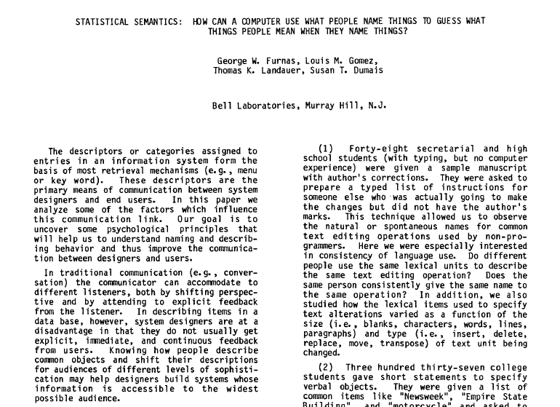

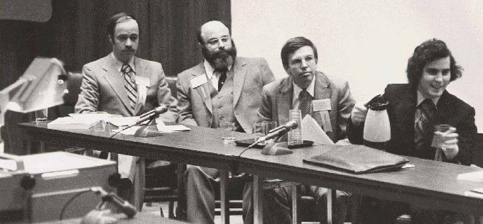
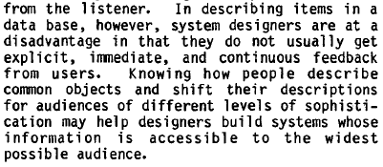
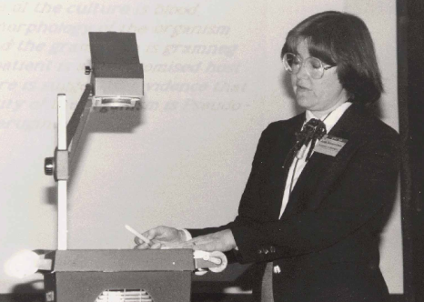
From Verbal Disagreement to LSI
CHI 1982 Paper … 0th CHI Conference
Photos from
B. Shneiderman
Notes:
0st CHI Meeting (3rd SIGIR Meeting)
“In describing items in a database, system designers are at a disadvantage in that they do not usually get explicit, immediate, and continuous feedback from users. Knowing how people describe objects and shift their descriptions for audiences of different levels of sophistication may help designers build systems whose information is accessible to the widest possible audience”.

Slide 8

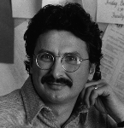
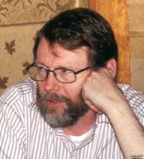


From Verbal Disagreement to LSI
Some solutions: … with a lot of help from our friends
Rich aliasing [Gomez et al. 1990]
  Allow alternative words for the same item
  “Natural” in the world of full-text indexing, but less so for keyword indexing or command naming
Adaptive indexing [Furnas 1985]
  Associate (failed) user queries to destination objects
  Add these queries as new entries in term-document matrix
  Quickly reduces failure rate for common requests/tasks
Latent Semantic Indexing [Dumais et al. 1988; Deerwester et al. 1990]
  Model relationships among words, using dimension reduction
  Especially useful when query and documents are short
  Baker, Borko/Bernick, Ossario (1962-1966); Kohl (SIGIR 1978, p.1)
SIGIR 2009
Notes:
GOMEZ, L. M., LOCHBAUM, C. C., AND LANDAUER, T. K. All the right words: Finding what you
want as a function of richness of indexing vocabulary. JASIS, 41(8), 1990, 547-559.
FURNAS, G. W. Experience with an adaptive indexing scheme. In Proceedings of CHI’85 Human
Factors in Computing, 1985, pp. 131-135.
DEERWESTER, S. DUMAIS, S.T., FURNAS, G.W., LANDAUER, T.K., AND HARSHMAN, R. Indexing by Latent Semantic Analysis, JASIS, 4(), 1990, 391-407.
DUMAIS, S.T., FURNAS, G.W., LANDAUER, T.K., DEERWESTER, S. AND HARSHMAN, R. Using Latent Semantic Analysis to improve access to textual information. Proceedings of CHI’88 Human Factors in Computing, 1988, 281-285.
8

Slide 9
From Verbal Disagreement to LSI
Many applications and algorithms of LSI
  Bell Labs directory of services, expert finding, reviewer assignment, handwritten notes, data evidence analysis, measurement of knowledge, literature-based discovery, IR & IF test collections
Rich aliasing and Adaptive indexing in Web era
  Full text indexing (rich aliases from authors)
  Anchor text or Tags (rich aliases from other users)
  Historical query-click data (adaptive indexing, with implicit measures)
SIGIR 2009
Notes:
9

Slide 10
Common Themes
  The last 10-20 years … amazing time to be involved in IR
  TREC and related evaluations
    TREC-1 in 1992
  Search is everywhere – desktop, enterprise, Web
  Web search
    Big advances in scale, diversity of content and users, quality of results (for some tasks), etc.
SIGIR community has a lot to be proud of
But … many search tasks are still quite hard
    Need to represent and leverage richer contextual information about users, domains, and task environments in which search occurs

Slide 11





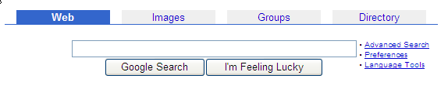


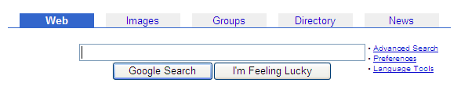
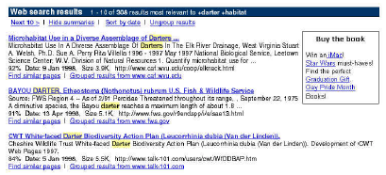
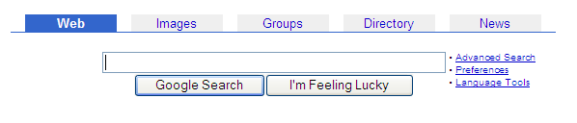

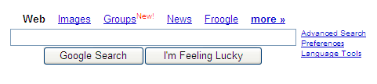


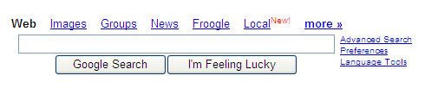

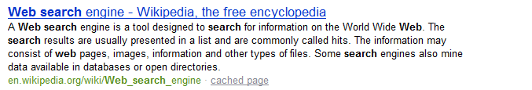
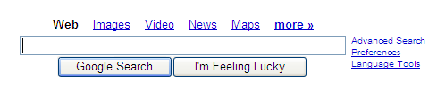

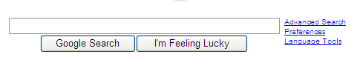

Web Search at 15
What’s available
How it’s accessed
Number of pages indexed
  7/94 Lycos – 54,000 pages
  95 – 10^6 millions
  97 – 10^7
  98 – 10^8
  01 – 10^9 billions
  05 – 10^10 …
Types of content
  Web pages, newsgroups
  Images, videos, maps
  News, blogs, spaces
  Shopping, local, desktop
  Books, papers, many formats
  Health, finance, travel …

Slide 12

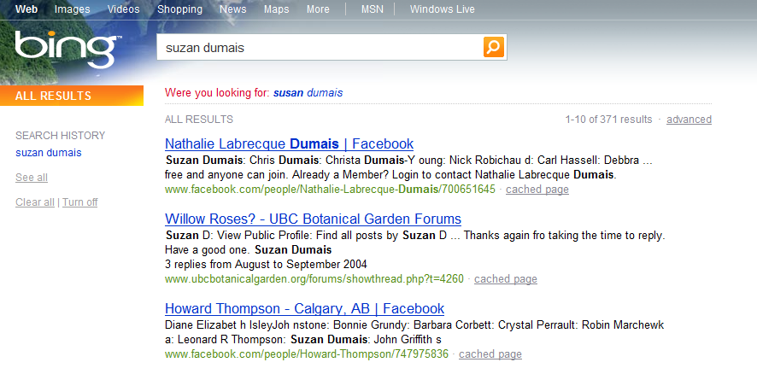
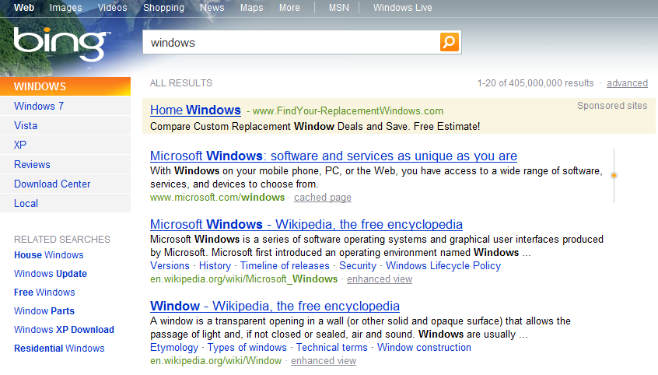
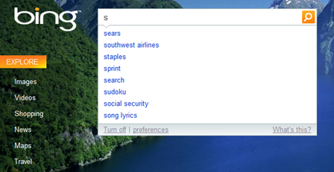
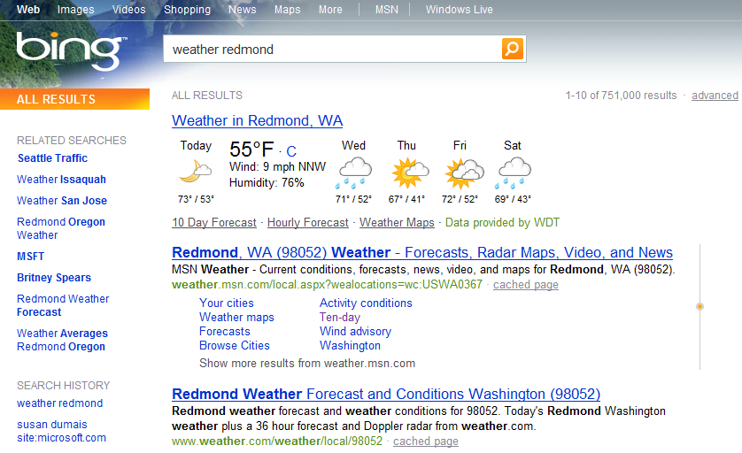

Support for Searchers
The search box
Spelling suggestions
Query suggestions
Auto complete
Inline answers
Richer snippets
But, we can do better
… by understanding context
Search in the future will look nothing like today's simple search engine interfaces, [Susan Dumais] said, adding, "If in 10 years we are still using a rectangular box and a list of results, I should be fired.“ [Mar 7, 2007, NYTimes, John Markoff]
Notes:
Mar 7, 2007 -- NYTimes, John Markoff
Search in the future will look nothing like today's simple search engine interfaces, [Susan Dumais] said, adding, "If in 10 years we are still using a rectangular box and a list of results, I should be fired."

Slide 13
Search Today
Search and Context
User Context
Query Words
Query Words
Ranked List
Ranked List
Document Context
Task/Use Context

Slide 14
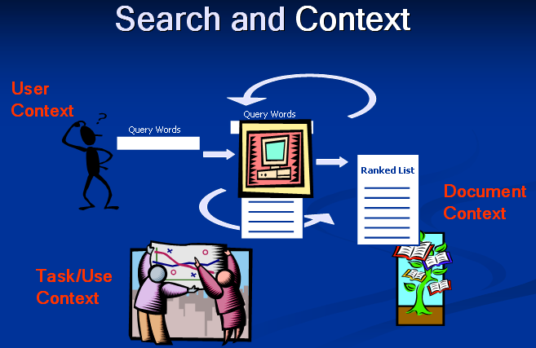
Inter-Relationships among Documents
Categorization and Metadata
Reuters, spam, landmarks, web categories …
Domain-specific features, time
Interfaces and Interaction
Stuff I’ve Seen, Phlat, Timelines, SWISH
Tight coupling of browsing and search
Systems/Prototypes
New capabilities and experiences
Algorithms and prototypes
Deploy, evaluate and iterate
Redundancy
Temporal Dynamics
Modeling Users
Short vs. long term
Individual vs. group
Implicit vs. explicit
Evaluation
Many methods, scales
Individual components and their combinations
Using User Models
Stuff I’ve Seen (re-finding)
Personalized Search
News Junkie (novelty)
User Behavior in Ranking
Domain Expertise at Web-scale

Slide 15
User Modeling
Modeling searcher’s interests and activities over time
  Iterative and interactive nature of search
  Within and across sessions
Example applications
  Re-finding (e.g., Stuff I’ve Seen, Web) [Dumais et al. 2003]
  Personalization (e.g., PSearch) [Teevan et al. 2005]
  Novelty (e.g., News Junkie) [Gabrilovich et al. 2004]
  Domain expertise at Web-scale [White & Dumais 2009]
  User behavior for Web ranking [Agichtein et al. 2006]
Evaluation via explicit judgments, questionnaires, client-side instrumentation, and large-scale search logs, lab and field studies, etc.
Notes:
Dumais, S. T., Cutrell, E., Cadiz, J. J., Jancke, G., Sarin, R. and Robbins, D. (2003). Stuff I’ve Seen: A system for personal information retrieval and re-use. In Proceedings of SIGIR’2003.
Teevan, J., Dumais, S. T. and Horvitz, E. (2005). Personalizing search via automated analysis of interests and activities. In Proceedings of SIGIR 2005, 449-456.
Gabrilovich, E., Dumais, S. and Horvitz, E. NewsJunkie: Providing personalized newsfeeds via analysis of information novelty. In Proceedings of WWW’2004, 482-490.
White, R., Dumais, S. and Teevan, J. (2009). Characterizing the influence of domain expertise on web search behavior. In Proceedings of WSDM 2009, 132-141.
Agichtein, E., Brill, E., Dumais, S. T. and Ragno, R. (2006). Learning user interaction models for predicting web search preferences. In Proceedings of SIGIR 2006, 3-10.
Agichtein, E., Brill, E., and Dumais, S. T. (2006). Improving web search ranking by incorporating user behavior. In Proceedings of SIGIR 2006, 19-26.

Slide 16
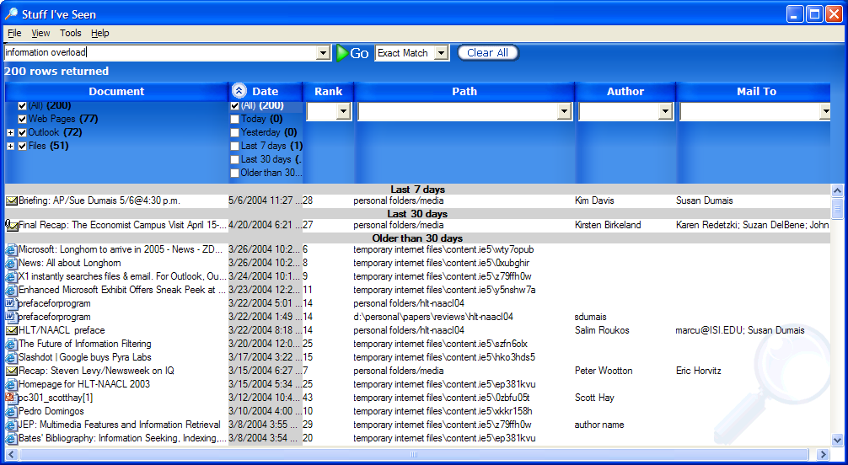
Re-Finding on the Desktop
Stuff I’ve Seen (SIS) [Dumais et al. 2003]:
  Unified access to many types of info
  (e.g., files, email, calendar, contacts, web pages, rss, im)
  Index of content and metadata (e.g., time, author, title, size, usage)
  Rich UI possibilities, because it’s your stuff and client application
  Demo:
Analysis:
  Deployed different versions
    Query syntax,
    Result previews
    Ranking defaults (time, best-match)
  Questionnaires, Free-form feedback,
  Log data, Lab experiments
Stuff I’ve Seen
Notes:
Dumais, S. T., Cutrell, E., Cadiz, J. J., Jancke, G., Sarin, R. and Robbins, D. (2003). Stuff I’ve Seen: A system for personal information retrieval and re-use. In Proceedings of SIGIR’2003.

Slide 17
Re-Finding on the Desktop
Research Results:
  Short queries
    Few advanced operators in initial query (<10%)
    Many advanced operators via specification in UI (~50%) - filter; sort
  Date by far the most common sort attribute (vs. best-match)
    Importance of time, people, episodes in human memory
    Few searches for “best match”; many other criteria
  Need for “abstractions” – date, people, kind
  Rich client-side interface
    Support fast iteration/refinement
    Fast filter-sort-scroll vs. next-next-next
Interesting reviews from SIGIR☺
Practice: XP and Vista desktop search

Slide 18
Re-Finding on the Web
Data from Teevan et al., SIGIR 2007
 |  | Repeat Click | New Click
Repeat Query | 33% | 29% | 4%
New Query | 67% | 10% | 57%
 |  | 39% | 61%
Total = 43%
Big opportunity to support re-finding on Web
Models to combine Web rank w/ personal history of interaction
Interfaces to support finding and re-finding
Repeat Query | 33%
New Query | 67%
50-80% page visits are re-visits
30-50% of queries are re-finding queries
Notes:
18
Teevan, J., E. Adar, R. Jones, and M. A. Potts. Information re-retrieval: Repeat queries in Yahoo's logs. SIGIR ’07, 2007, 151-158.

Slide 19

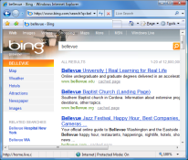
Personalization
Today: People get the same results, independent of current session, previous search history, etc.
PSearch [Teevan et al. 2005]: Uses rich client-side model of a user to personalize search results
sigir 2009
User profile:
* Content
* Interaction history
Notes:
19
19

Slide 20
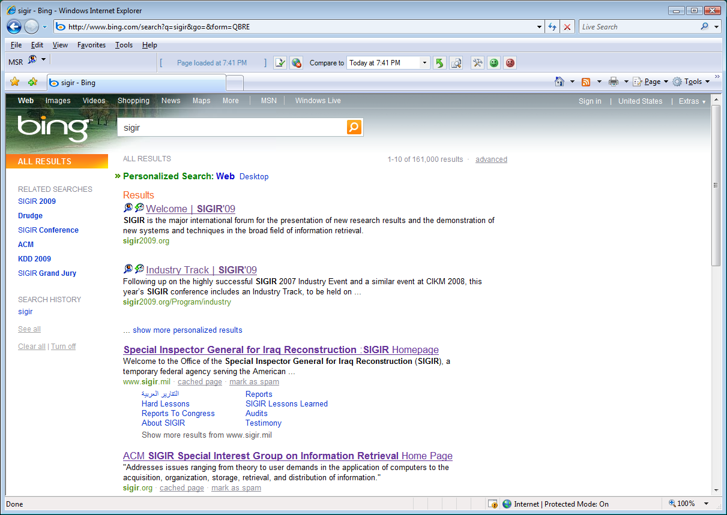
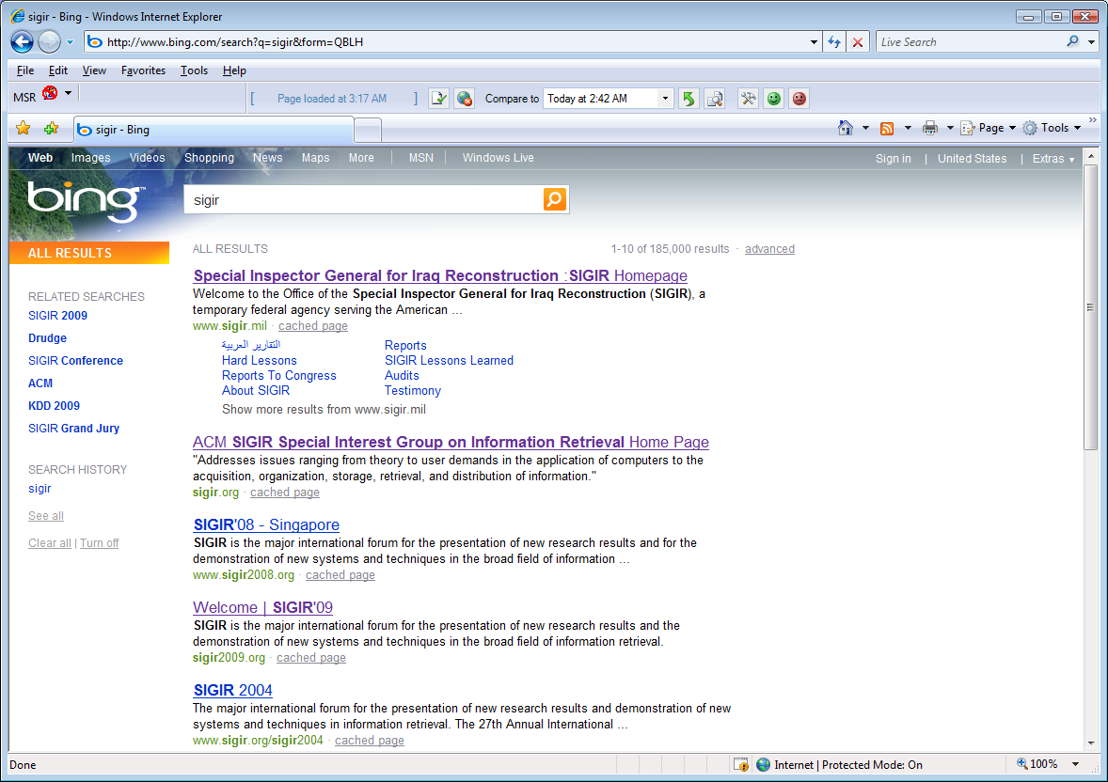
PSearch “Demo”
Query: SIGIR

Slide 21
Personalization
Building a User Profile
  Type of information
    Content: Past queries, web pages, desktop
    Behavior: Visited pages, explicit feedback
  Time frame: Short term, long term
  Who: Individual, group
  Where the profile resides:
    Local: Richer profile, improved privacy [but, increasingly rich public data]
    Server: Richer communities, portability
Using the User Profile
  Ranking
  Query support
  Result presentation
PSearch
Notes:
21
21

Slide 22
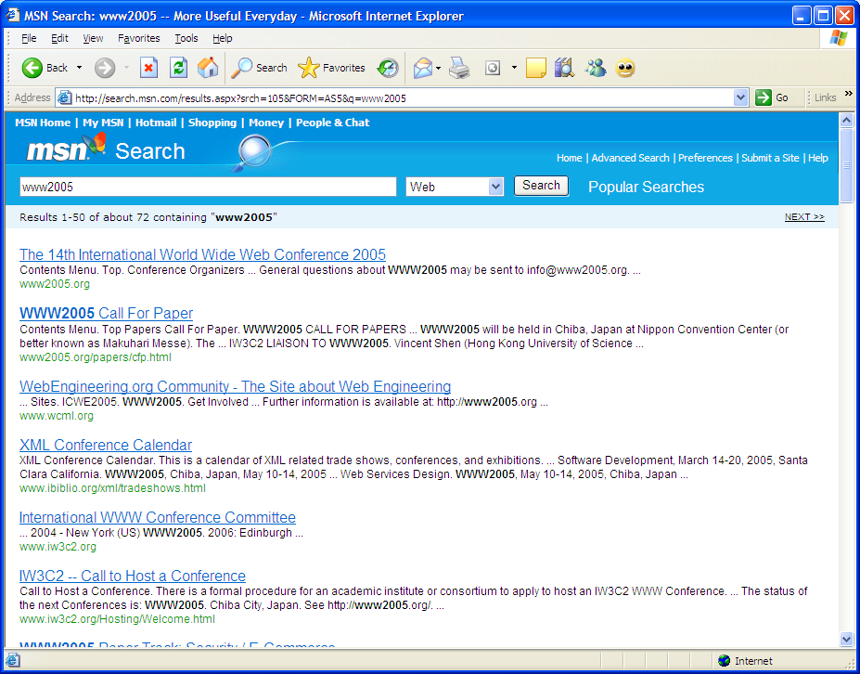
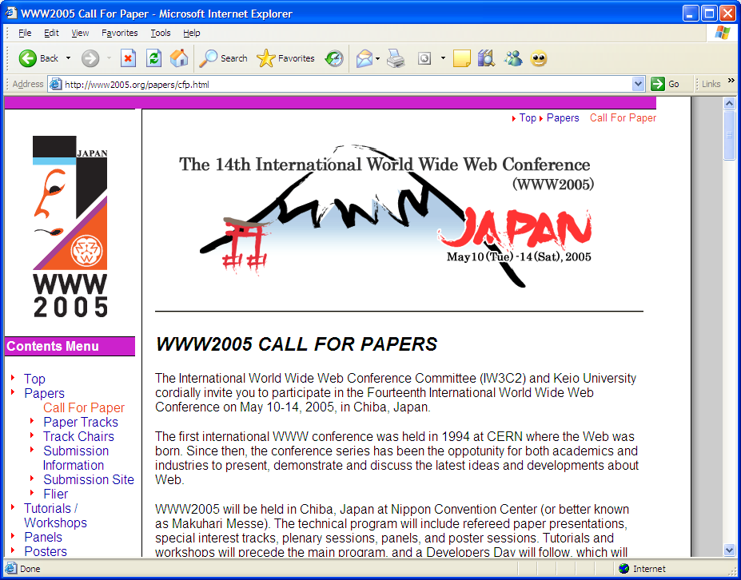
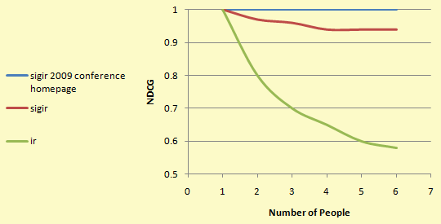
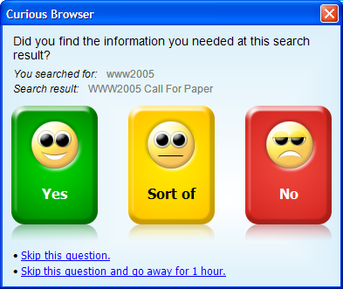
Personalization
Ranking algorithm [Teevan et al. 2007]
  Linear combination of scores from: content match, history of interaction, Web ranks
When to personalize? [Teevan et al. 2008, in press]
  Personalization works well for some queries, but not others
  Models for predicting when to personalize using features the query and query-user
Evaluating personalized search [Fox 2005; Teevan et al. in press]
  What’s relevant for you
  Explicit judgments (offline and in situ)
  Implicit “judgments” from behavioral interaction
  Linking explicit and implicit (e.g., Curious Browser)
Curious Browser Study (~4k)
* 45% w/ just click
* 75% w/ click + dwell + session
SIGIR 2009
Notes:
Teevan, J., Dumais, S. T. and Horvitz, E. (2005). Personalizing search via automated analysis of interests and activities. In Proceedings of SIGIR 2005, 449-456.
Teevan, J., Dumais, S. and Liebling, D. (2008). To personalize or not to personalize: Modeling queries with variation in user intent. In Proceedings of SIGIR 2008, 163-170.
Teevan, J., Dumais, S. and Horvitz, E. (2009). Potential for personalization. To appear in: ACM:TOCHI Special Issue on data mining for understanding user needs.
Fox, S. Karnawat, K., Mydland, M., Dumais, S. and White, T. (2005). Evaluating implicit measures to improve the search experience!. ACM:TOIS, 23(2), 147-168.

Slide 23
Personalization and Privacy
PSearch
  Local profile, local computation
  Nothing sent to the server except the original query
  Need profile and web content in same place to rank
When information is stored in the cloud
  Send query and user profile, or store user profile in cloud
  Transparency
  Control
Other approaches we are exploring
  Matching an individual to a group
  Light weight profiles (e.g., queries in a session)
  Public or semi-public profiles (e.g., Tweets, Facebook status, blogs)

Slide 24
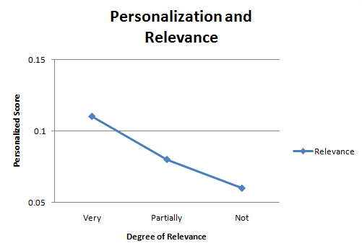
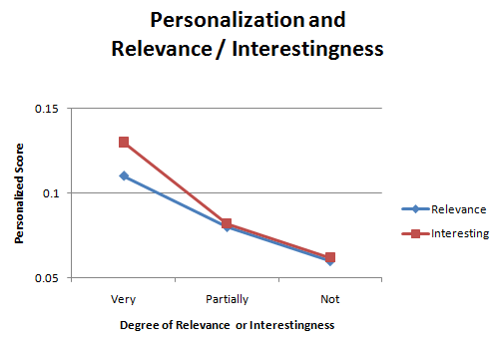
End of Serendipity?
Does great search and personalization mean the end of serendipity?
No, actually better potential for serendipity
Relevance vs. interestingness
  Personalization finds more relevant results
  Personalization finds more interesting results
  Many not relevant results are interesting
Need to be “ready” for serendipity
Notes:
Andre, P., Teevan, J. and Dumais, S. (2009). From X-rays to silly putty via uranus: Serendipity and its role in web search. In Proceedings of Proceedings of CHI 2009, 2033-2036.
Andre, P., schrafel, mc, Teevan, J. and Dumais, S. (2009). Discovery is never by chance: Designing for (un)serendipity. Creativity and Cognition 2009, 392-401.

Slide 25
Categorization and Metadata
Algorithms and applications
  Reuters, Web - fast SVM algorithm [Dumais et al. 1998, 2000]
  Junk email [Sahami et al. 1998]
    Domain-specific feature engineering
    Constantly changing content (both ham and spam)
Using metadata for ranking [Bennett et al.]
Using metadata in UX
  Tight coupling search & browse – e.g., SIS, Phlat [Dumais et al. 2003]
  Faceted-metadata in many verticals -> Web? [Teevan et al. 2008]
  Information theoretic models of search/navigation [Downey et al. 2008]
Leveraging relations among documents
Notes:
Dumais, S., Heckerman, D., Platt, J. and Sahami, M. Inductive learning algorithms and representations for text categorization. Proceedings of ACM-CIKM’98, Nov. 1998, 148-155.
Sahami, M., Dumais, S., Heckerman, D., Horvitz, E. A Bayesian approach to filtering junk e-mail. AAAI 98 Workshop on Learning for Text Classification.
Dumais, S. T., Cutrell, E., Cadiz, J. J., Jancke, G., Sarin, R. and Robbins, D. (2003). Stuff I’ve Seen: A system for personal information retrieval and re-use. In Proceedings of SIGIR’2003.
Cutrell, E., Robbins, D., Dumais, S. T. and Sarin, R. (2006). Fast, flexible filtering with PHLAT – Personal search and organization made easy. In Proceedings of CHI 2006, 261-270. [Best Paper Finalist]
Chen, H. and Dumais, S. T. (2000) Bringing order to the web: Automatically categorizing search results.
Proceedings of CHI’00, 145-152.
Dumais, S.T. and Chen, H. Hierarchical classification of web content. Proceedings of SIGIR’2000, 256-263.
Teevan, J., Dumais, S. T. and Gutt, Z. (2008). Challenges for supporting faceted search in large, heterogeneous corpora like the web. In Proceedings of HCIR 2008, Human Computer Interaction and Information Retrieval Workshop.
Downey, D., Dumais, S. Liebling, D. and Horvitz, E. (2008). Understanding the relationship between searchers’ queries and information goals. In Proceedings of CIKM 2008, 449-458.

Slide 26
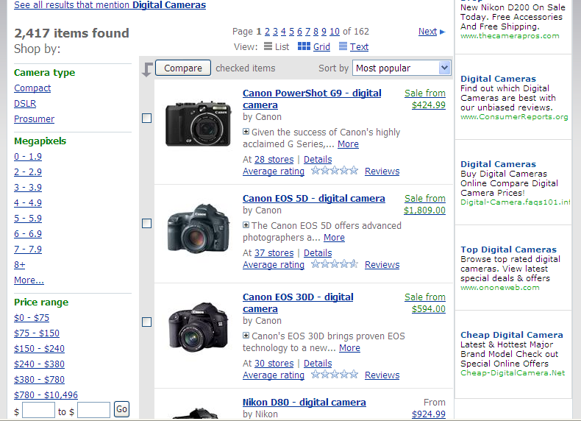
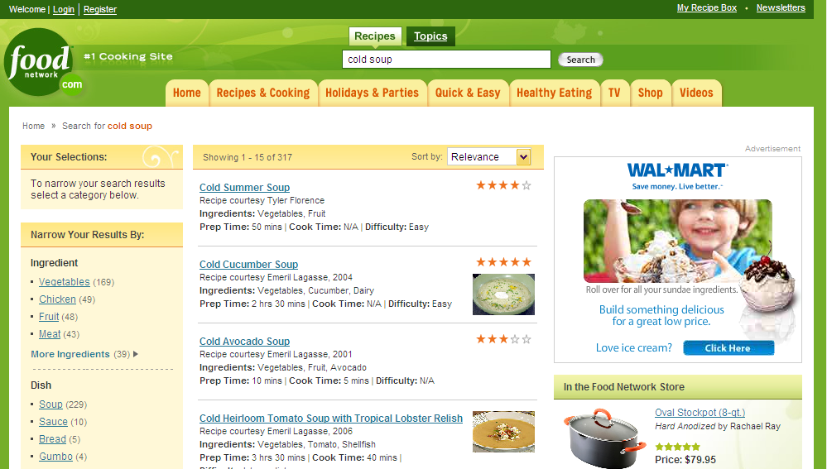
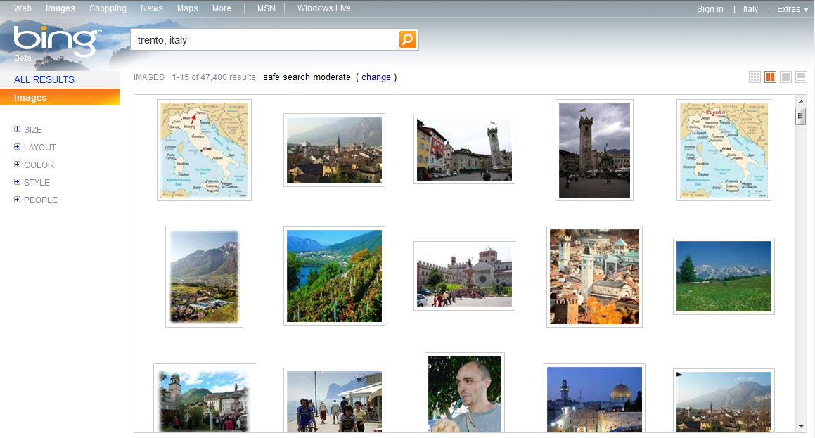
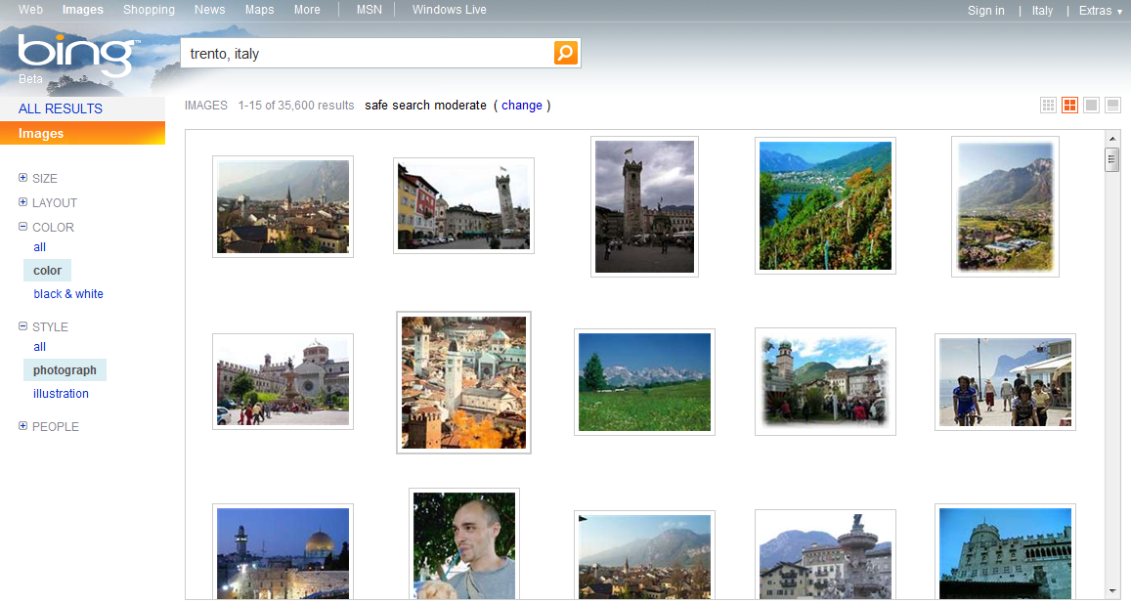
Metadata on the Web
Many queries contain implicit metadata
  thomas edison image portrait
  latest lasik techniques, canada
  good nursing programs in baltimore
  cheap digital camera
  overview of active directory domains
  …
Limited support for users to articulate this
UMAP, June 24 2009
Notes:
26
Teevan, J., Dumais, S. T. and Gutt, Z. (2008). Challenges for supporting faceted search in large, heterogeneous corpora like the web. In Proceedings of HCIR 2008, Human Computer Interaction and Information Retrieval Workshop.

Slide 27
Future Challenges
Dynamic information environments [Adar et al., Elsas et al.]
  Content changes (e.g., news, blogs, lifelogs … much more general)
  People re-visit, re-query, re-find
  IR opportunities … crawling, doc and user representation, ranking, etc.
  Interesting historically and socially
Data/Evaluation
  Data as valuable resource
  Large-scale log data
  Operational systems and a “Living Laboratory”
  IR opportunities … representations, ranking, etc.
Thinking outside the traditional IR boxes
  Better understanding of users and application domains
  Collaborations across disciplinary boundaries
Notes:
Information Dynamics:
Content change patterns - Adar, E., Teevan, J., Dumais, S. T. and Elsas, J. L. (2009). The Web Changes Everything: Understanding the Dynamics of Web Content. In Proceedings of WSDM 2009, 282-291. [Best Student Paper Award]
Revisitation patterns - Adar, E., Teevan, J. and Dumais, S. (2008). Large scale analysis of web revisitation patterns. In Proceedings of CHI 2008, 1197-1206. [Best Paper Award].
Relations between change and revisitation - Adar, E., Teevan, J. and Dumais, S. (2009). Resonance on the Web: Web dynamics and revisistation patterns. In Proceedings of Proceedings of CHI 2009, 1381-1390.
Retrieval models that incorporate time - Elsas, J. and Dumais, S. Leveraging temporal dynamics of document content in relevance ranking. In submission …

Slide 28
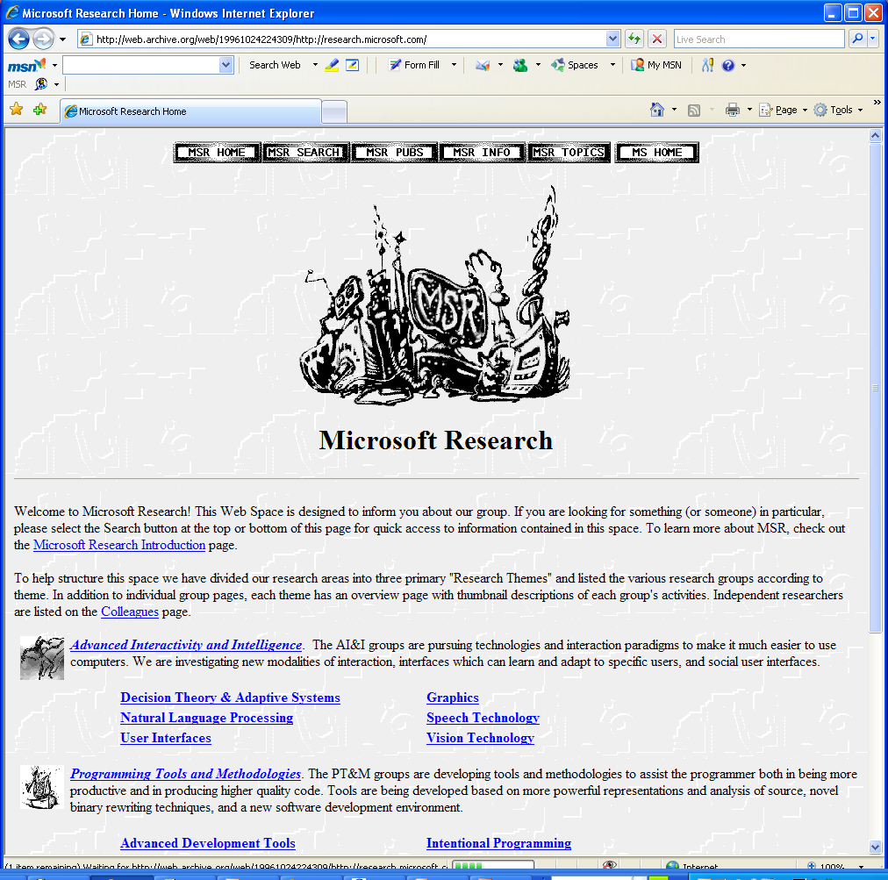
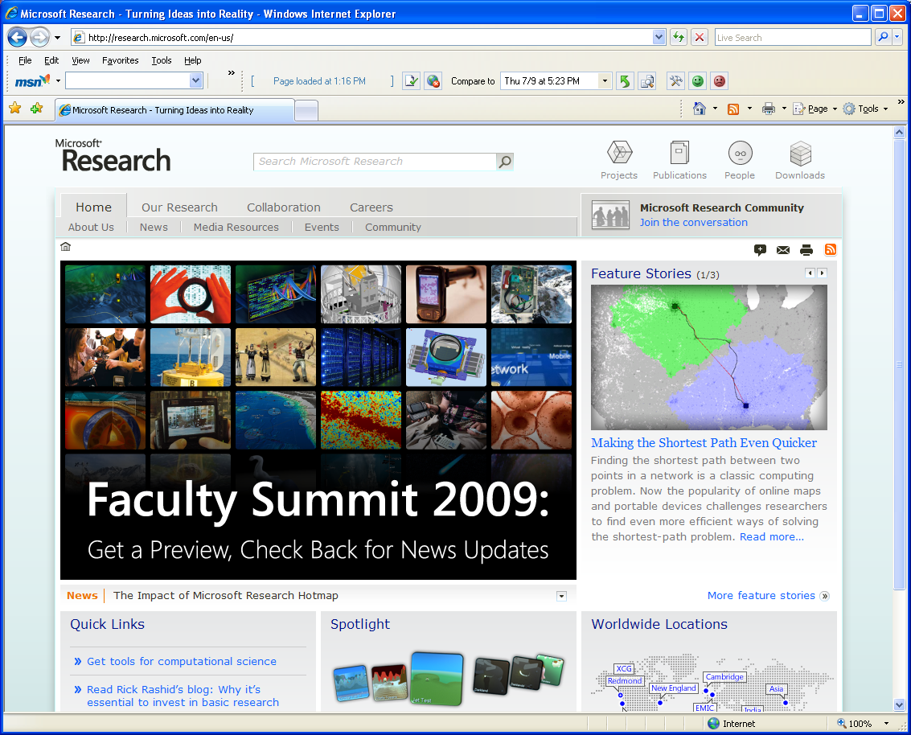
Information Dynamics
Microsoft Research Homepage
1996
2009
Notes:
28
28

Slide 29
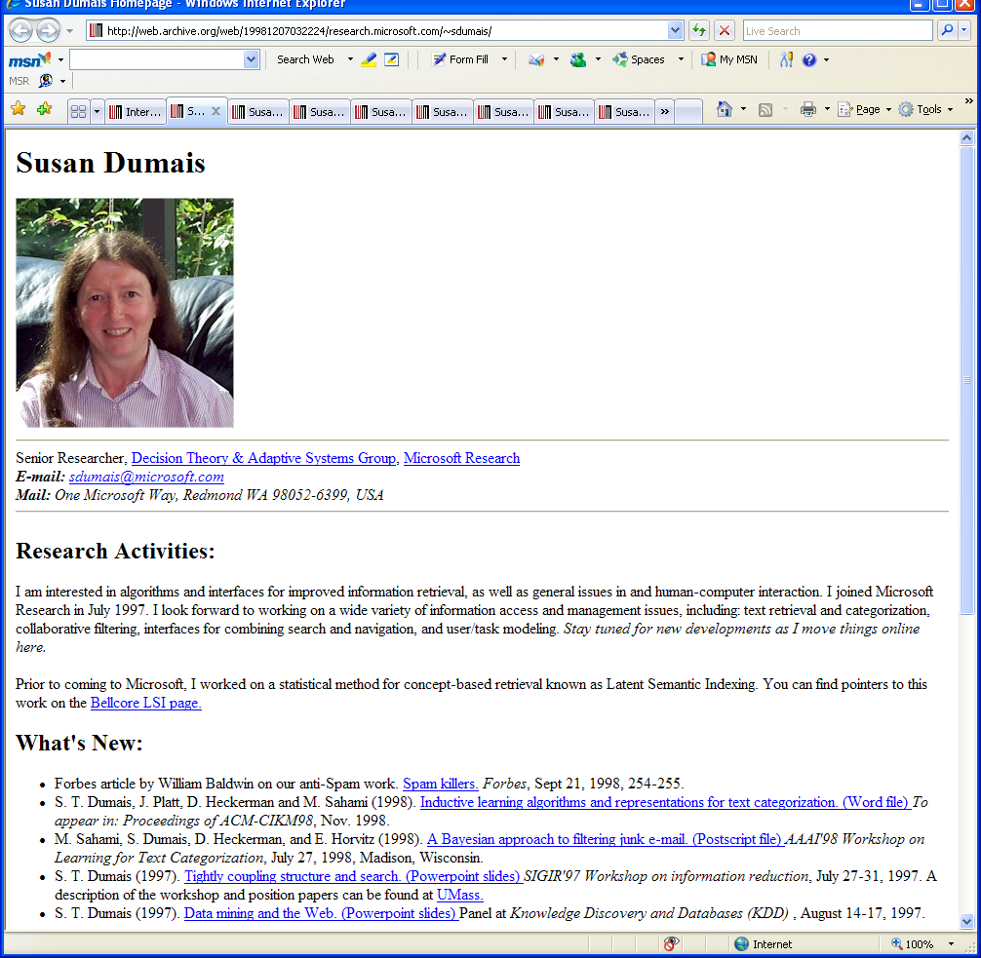
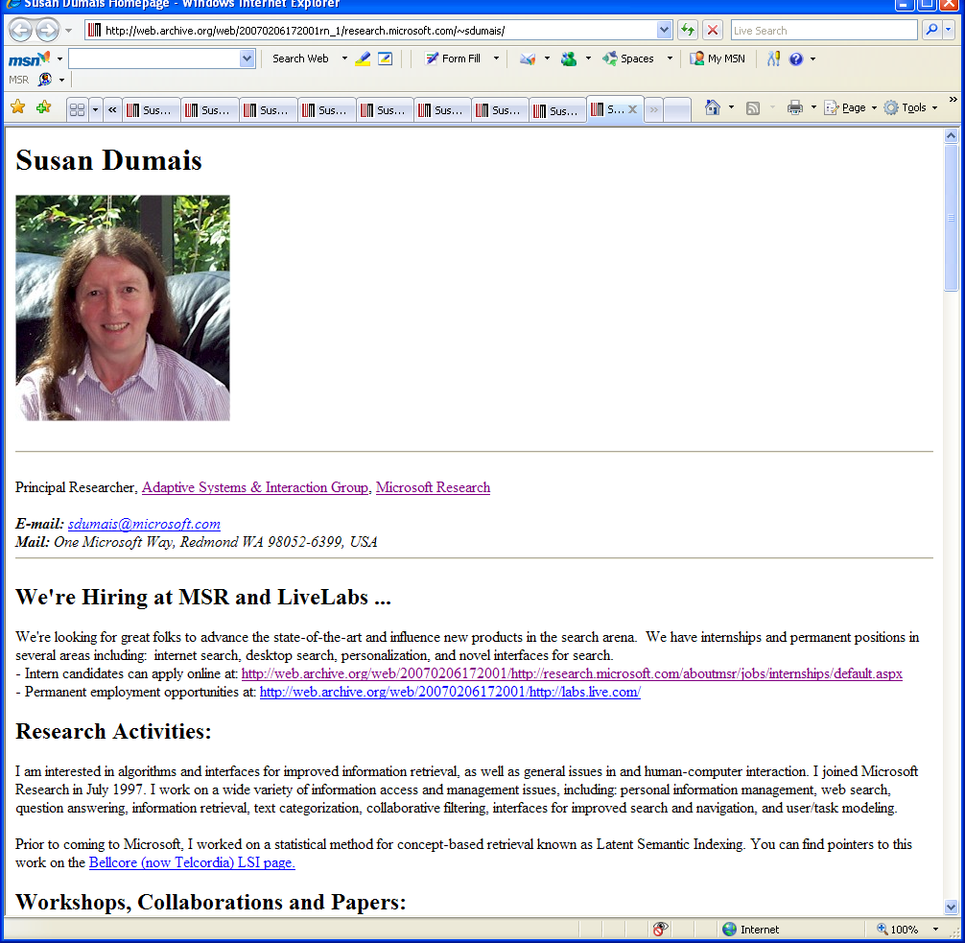
Information Dynamics
My Homepage
2008
1998
1998
2008
Notes:
29
29

Slide 30
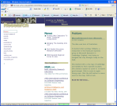

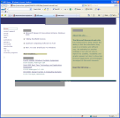
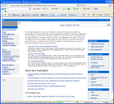





Information Dynamics
Content Changes
1996 1997 1998 1999 2000 2001 2002 2003 2004 2005 2006 2007 2008 2009
1996 1997 1998 1999 2000 2001 2002 2003 2004 2005 2006 2007 2008 2009
User Visitation/ReVisitation
Today’s Browse and Search Experiences
But, ignores …
Notes:
30
30

Slide 31



Dynamics and Search
Welcome – Please join us in Boston | SIGIR’09
The SIGIR 2009 conference opens in just over a week in Boston, Massachusetts, at the Sheraton Boston Hotel and Northeastern University. The conference is chock full of exciting ...
New content: Please join your colleagues by starting the conference with a free continental breakfast in the Sheraton Hotel, Back Bay A&B, from 7:00am to 8:20am on Monday July 20.
sigir2009.org
Sept Oct Nov Dec
Time
SIGIR 2009
Improved crawl policy (common use)
Improved ranking using temporal IR models [Elsas and Dumais]
  Queries have different temporal patterns
  Pages have different rates of change
    Document priors (using temporal vs. link structure)
  Terms have different longevity
    Some are always on the page; some transient
Show change in snippets
More general browser support [Teevan et al. 2009]
Notes:
31
31
31
Retrieval models that incorporate time
Document prior based on change patterns
Differential weighting based on “term longevity” (and divergence from norm)
Also, crawl policy, results presentation
Elsas, J. and Dumais, S. Leveraging temporal dynamics of document content in relevance ranking. In submission …
Teevan, J., Dumais, S., Liebling, D. and Hughes, R. (2009). Changing the Way People View Changes on the Web. In Proceedings of UIST 2009.

Slide 32
Data and Evaluation
Data as a critical resource
Shared IR data resources typically consist of
  Static collection of documents and queries
  Judgments of Q-Doc in isolation
  Judgments with limited context (just the current query)
  Judges (who are usually not the searcher)
  … and these resources often shape the questions we ask
Search is an inherently interactive and iterative process, so user interaction data, is an especially important resource for the IR community
  Large-scale log data
  Operational system as an experimental platform
SIGIR 2009

Slide 33
Data and Evaluation
Large-scale log data
  Understanding how user interact with existing systems
    What they are trying to do; Where they are failing; etc.
  Implications for: models, and interactive systems
  Lemur Query Log Toolbar – developing a community resource !
Operational systems as an experimental platform
  Can also conduct controlled experiments in situ
    Interleave results from different methods [Radlinski & Joachims 2005]
    A/B testing -- Data vs. the “hippo” [Kohavi 2008]
  Important in: linking offline and interactive results, understanding effect sizes, relations among results (and other page components), etc.
  Can we build such a “Living Laboratory”?
Replicability in the face of changing content, users, queries
SIGIR 2009
Notes:
Kohavi, R. (2008) Practical Guide to Controlled Experiments on the Web: Listen to Your Customers not to the HiPPO. Industry Day presentation, CIKM 2008. http://exp-platform.com/hippo.aspx
Filip Radlinski and Thorsten Joachims (2005). Query chains: Learning to rank from implicit feedback. In Proceedings of KDD 2005,

Slide 34

Opportunities
Continued improvements in representation and ranking
Think outside the traditional IR boxes !!!
  Develop a better understanding of users, and their tasks
  Design and evaluate interactive systems to support this
Importance of
  New data resources
  Interdisciplinary perspective
SIGIR 2009

Slide 35


Thanks (again)!
Bell Labs
MSR, CLUES (Context, Learning and User Experience In Search)
SIGIR 2009

