Slide 1
Making CHASE Mainstream
Robert DeLine
Microsoft Research
CHASE Workshop, ICSE 2009

Slide 2
What is CHASE?
CHASE studies software development…
as though software were created by people…
working together.
CHASE studies those aspects of software development about which people cannot be usefully abstracted away.

Slide 3





















People and their Roles
user needs
• design rationale
test
spec
pm
customers
dev

Slide 4
user needs
• design rationale
test
spec
pm
dev

Slide 5

user needs
• design rationale
• program understanding
• visualization
• bug assignment
information seeking
• knowledge sharing
• interruption + multitasking
• onboarding
test
spec
pm
dev

Slide 6
user needs
• design rationale
• program understanding
• visualization
• bug assignment
information seeking
• knowledge sharing
• interruption + multitasking
• onboarding
test
spec
pm
dev

Slide 7



user needs
• design rationale
• program understanding
• visualization
• bug assignment
information seeking
• knowledge sharing
• interruption + multitasking
• onboarding
coordination
• awareness
• social networking
• expert finding
• distributed work
bug repro + diagnostics
• workflow + productivity
operations

Slide 8
Enabling conditions for “mainstream”
Need big open problems
Need adoption paths for practitioners
Research methods need to scale out to many researchers
Need to build bridges to established SE research areas
Java, Eclipse, Bugzilla, CVS, Mylyn

Slide 9

Studying development teams
The direct approach
surveys
interviews
observations
“Archaeology”
data mining
modeling
Research repositories
archive raw data
reuse across studies
Boundaries
Precision
Accuracy?
Boundaries
Data fitness
Boundaries
Overfishing

Slide 10
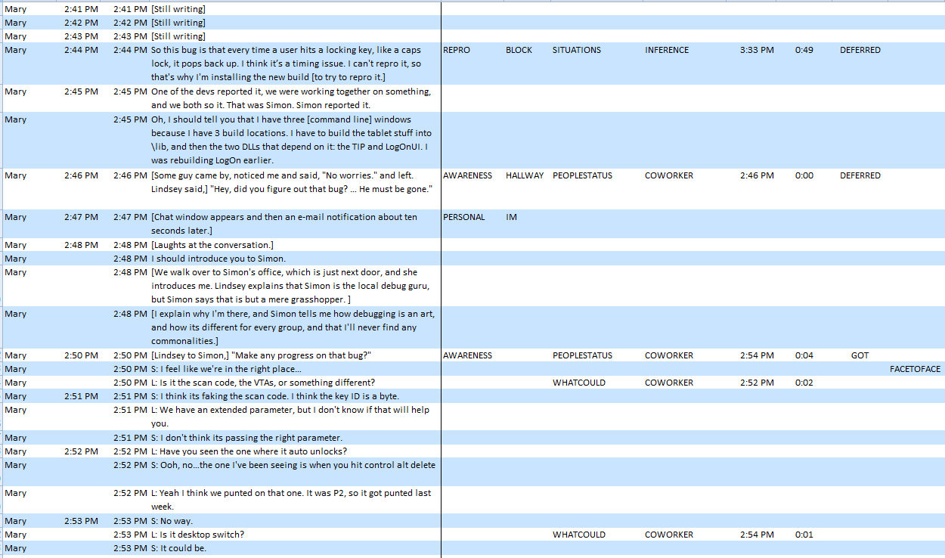
Example: Ko et al ICSE 07 transcripts

Slide 11
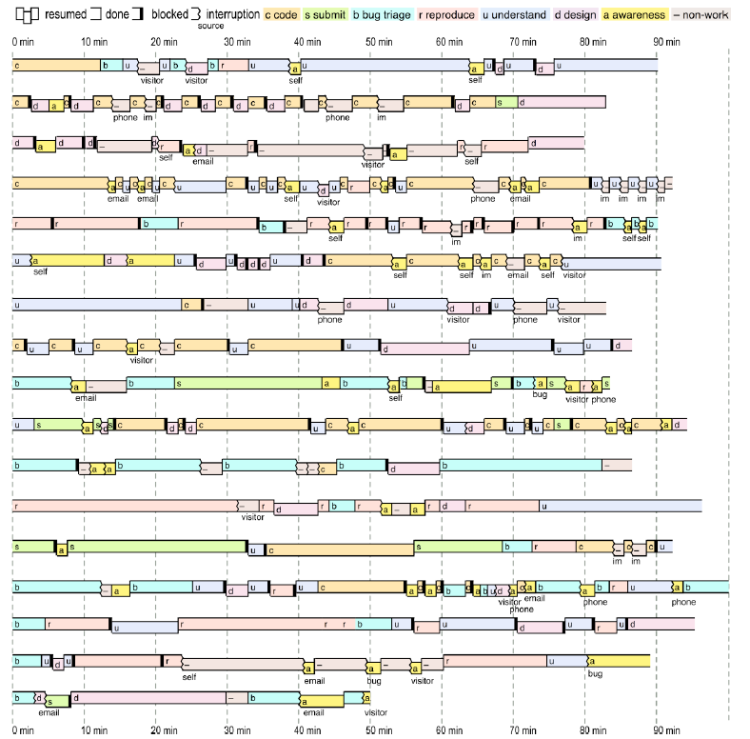
Example: Ko et al ICSE 07 transcripts

Slide 12
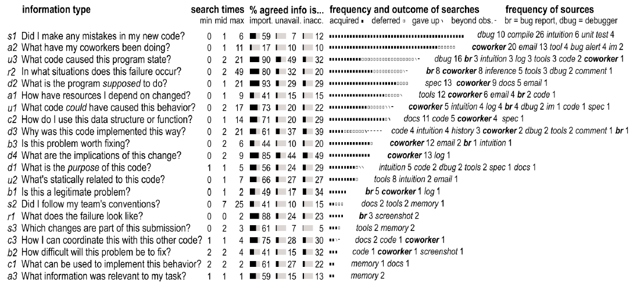
Example: Ko et al ICSE 07 transcripts

Slide 13
Example: Ko et al ICSE 07 transcripts
What code caused this program state? 61% unsatisfied, max 21 min
Why was the code implemented this way? 44%, 21 min
In what situations does this failure occur? 41%, 49 min
What code could have caused this behavior? 36%, 17 min
How have the resources I depend on changed? 24%, 9 min
What is the program supposed to do? 15%, 21 min
What have my coworkers been doing? 14%, 11 min

Slide 14
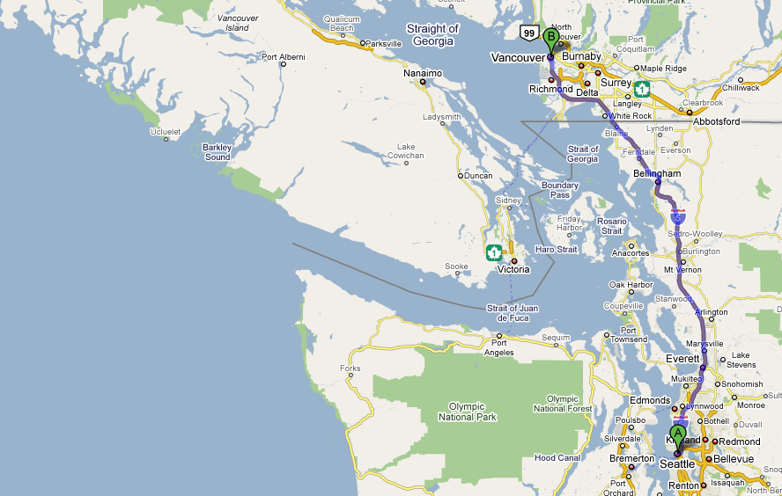
An execution “route finder”
Intended usage scenario
Select starting and ending lines of code
Step through the execution, like in a debugger
“Drag the route” to change the execution path
Code Canvas is the front end
Has layers for displaying trace and program state
Zooms from system architecture down to code
Pex is the back end
Systematically explores execution traces
Uses symbolic reasoning to find new paths
Uses dynamic analysis to avoid decidability limits
Can repro a complete execution trace

Slide 15
Enabling conditions for “mainstream”
Need big open problems
Need adoption paths for practitioners
Research methods need to scale out to many researchers
Need to build bridges to established SE research areas
WHAT ELSE?

Slide 16
Software Engineering Research
GOALS IMPROVE QUALITY Find defects in designs Find defects in code Promote architectures/designs Improve performance Allocate test resources Isolate defects Eliminate sources of defects IMPROVE FUNCTIONALITY Find defects in specs Improve reqts gathering Improve bug tracking IMPROVE TIME TO MARKET Reuse components Reuse design patterns Improve cost estimation Improve productivity Improve code understanding Spread team knowledge Improve coordination | METHODS prog. lang. design type systems theorem proving spec. notations modeling notations static analysis dynamic analysis code optimization runtime optimization data mining statistical models process improvement design/arch. notations architectural design system design dev. tool design dev. environment design pattern languages visualization theory building | EVALUATIONS formal theorems case studies on specs/code benchmarks demonstrations/prototypes case studies on team artifacts case studies on teams controlled experiments

