Slide 1
How Can Microsoft help Geneticists?
Mayana Zatz
Professor of Genetics
Director- Human Genome research Center
University of São Paulo, São Paulo, Brazil

Slide 2
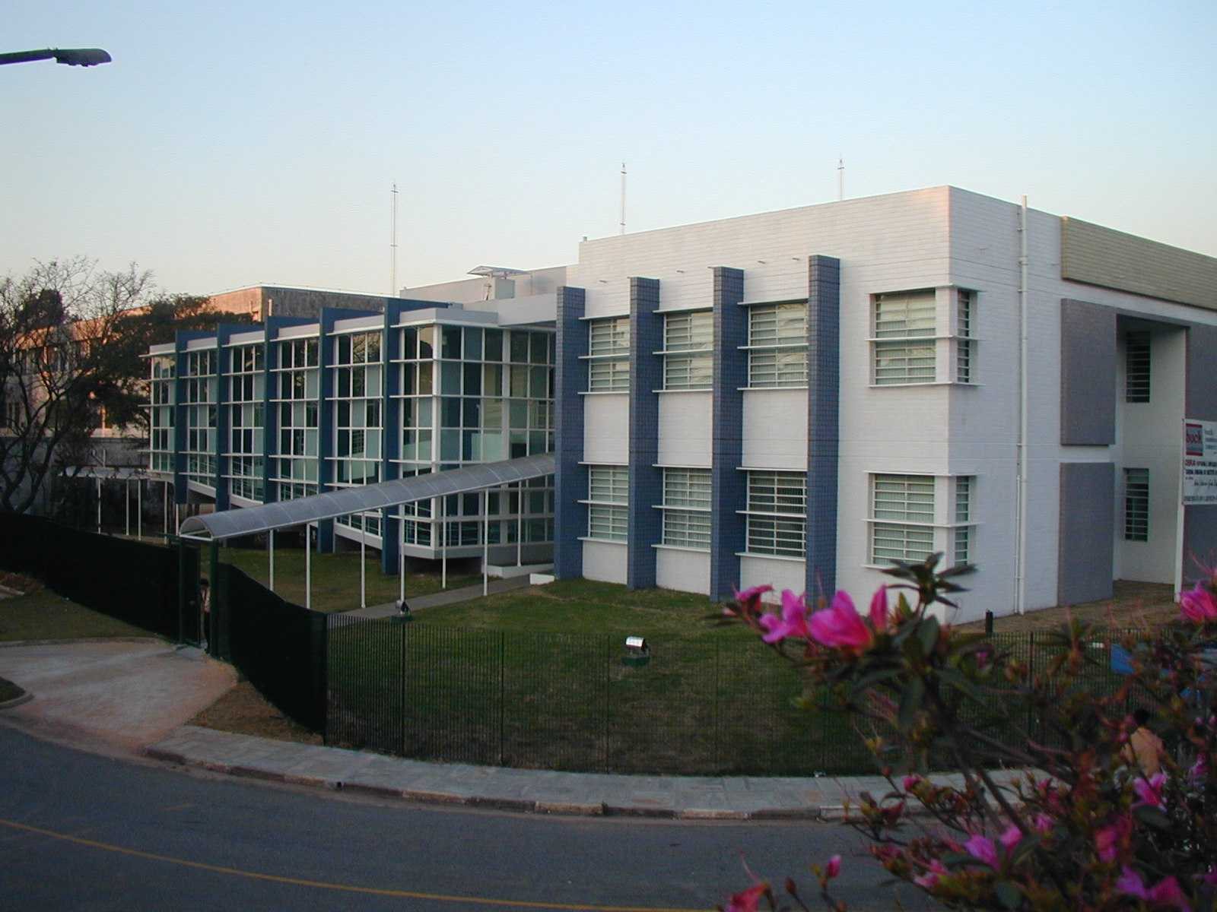
Human genome research center aims
Basic research
Technology transfer
Education

Slide 3

A two-ways road
Patients
originating
New researches

Slide 4
A two-ways road
Patients
originating
helping
New researches

Slide 5
Our Main Research Aims
I – Investigation of genetic factors underlying human diseases
II – Development of therapeutic approaches to genetic diseases

Slide 6
Where we need computing help ?
Pedigree building
Stem-cell researches
The future understanding of our genome

Slide 7
Gene mapping and identification

Slide 8
14 genes: 7 identified and 7 mapped
Neuromuscular disorders
1) LGMD2F F delta sarcoglycan
2) LGMD2G F telethonin
3) ALS8 F VAP-B
4) X- linked SMA ???
5) SPOAN ???
6) LGMD1G ???
X-linked mental retardation
7) AHDS syndrome MCT8
8) UBE2A F ubiquitin conjugating enzyme
Developmental disorders
9) Knobloch syndrome F colagen XVIII
10) Craniometaphisaria dysplasia ??
11) Auricular-condilar syndrome ???
12) Ectrodactily
13) FGF3/FG4 F identified by chromosome analysis
14) Non syndromic Deafness

Slide 9
Pedigree building

Slide 10
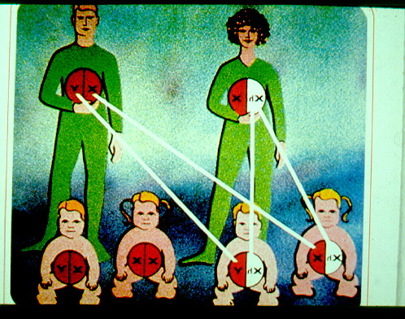
John
Mary
Mary
John
XY
XX
F
Tom
Katy
Bob
Meg
XX
XX
XY
XY
Tom
Katy
Bob
Meg

Slide 11
It can be more complicated
I have ten sibs: Bob, Phil, Josh, Caty etc......
My mother has 7 brothers and 6 sisters through my grandfather first marriage
Then my grandfather married again and had 2 sons and 3 daughters
He also had a “lover” with whom he had 3 sons
Now let´s talk about my father relatives......
My father and my mother are first-degree cousins once removed
I had several cousins affected by spastic paraplegia
What is the chance that I have an affected child????

Slide 12
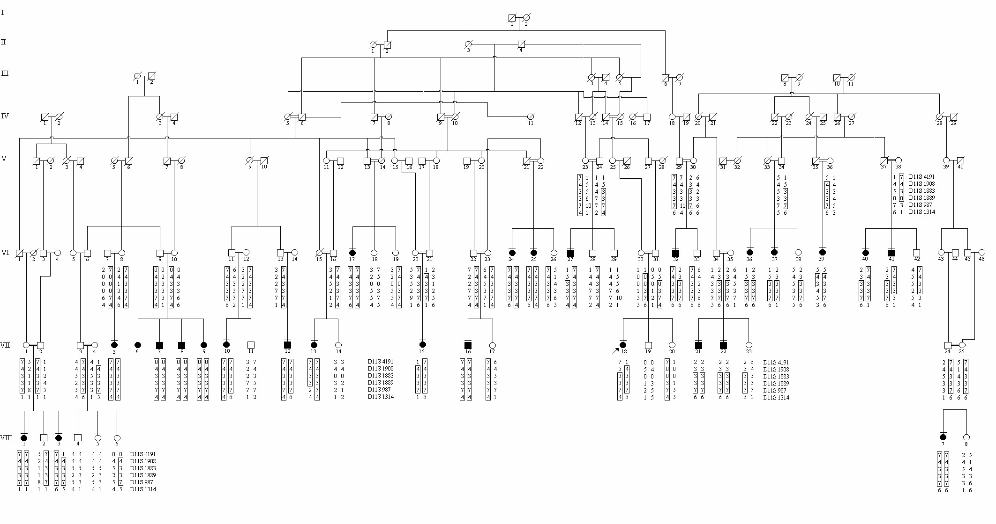
This is just part of a pedigree.....
SPOAN-Spastic Paraplegia, Optic Atrophy, Neuropathy

Slide 13
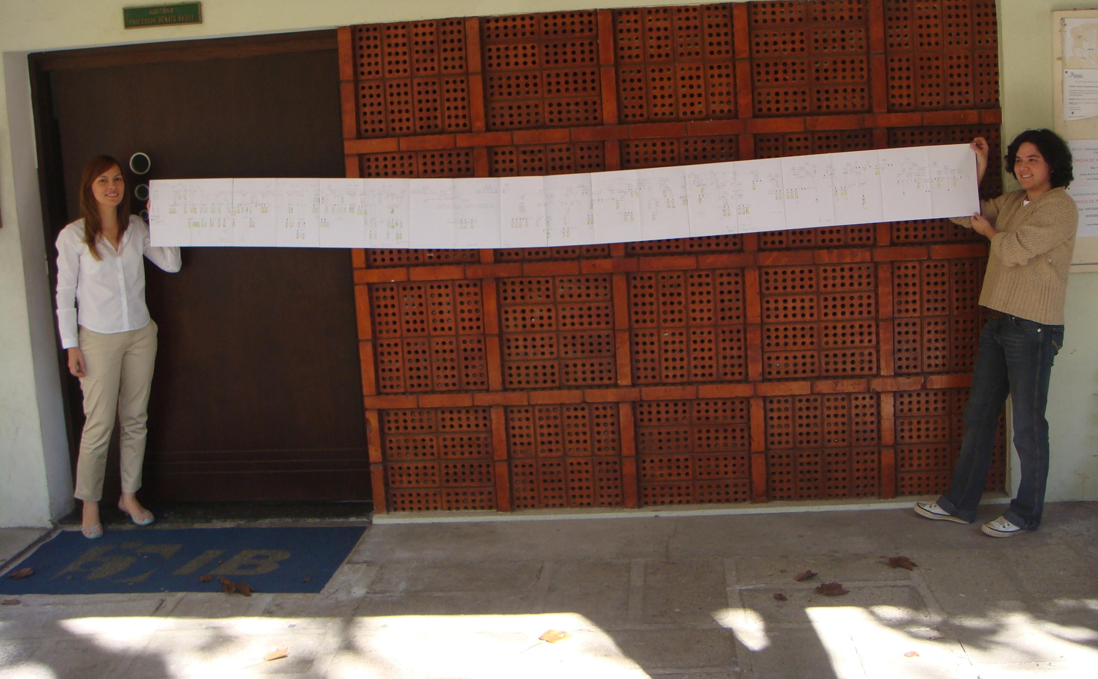

Slide 14
What are the available programs to build genealogies?
Cyrillic and Progeny
We need a more FRIENDLY program............

Slide 15
STEM-CELLS

Slide 16
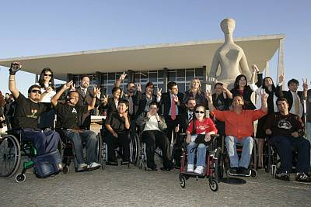
Stem-cells bill allowing researches with embryonic stem-cells
Just approved by the Brazilian Supreme Court

Slide 17
We are currently invesytigating the potential of adult stem cells from different sources to regenerate bone and muscle

Slide 18
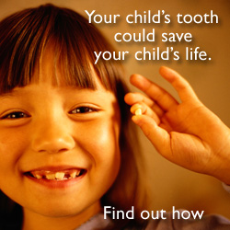
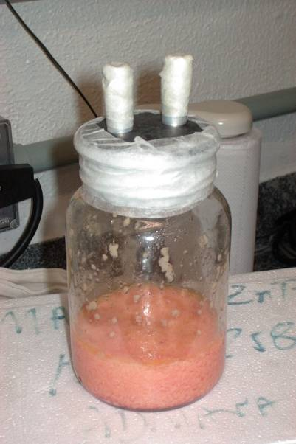
Sources of adult stem-cells
Dental pulp
Umbilical cord
All biological wastes .....
Lipo aspirates

Slide 19
STEM-CELLS INJECTIONS IN ANIMAL MODELS
How to evaluate results of “in vivo”experiments?

Slide 20
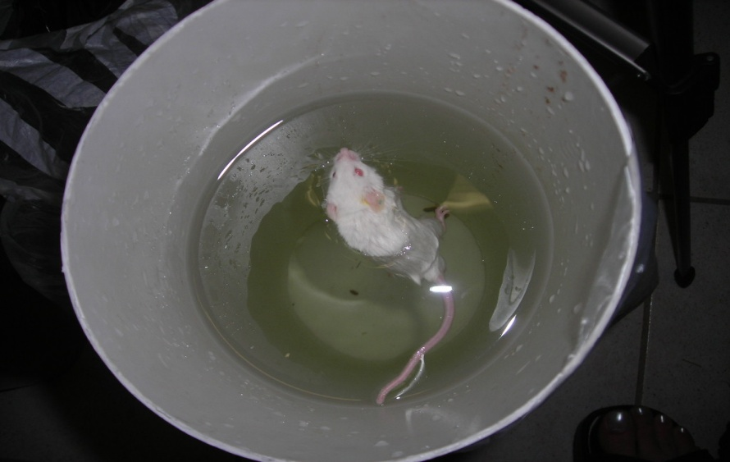
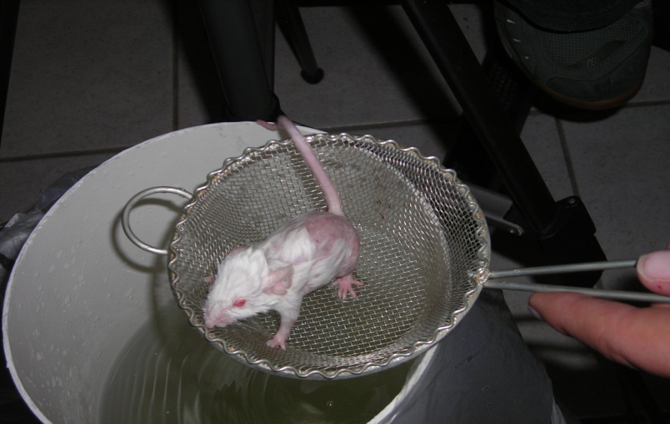
Stem-cells injections in SJL mice: a model for limb-girdle muscular dystrophy
TIMING
Swimming test- How long they can resist?

Slide 21
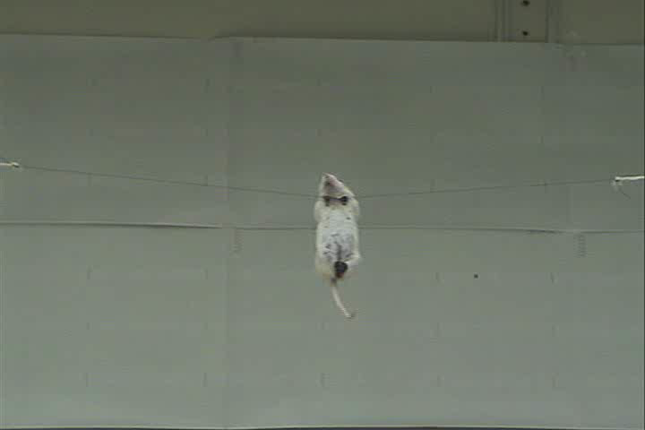
Non-injected rope test

Slide 22
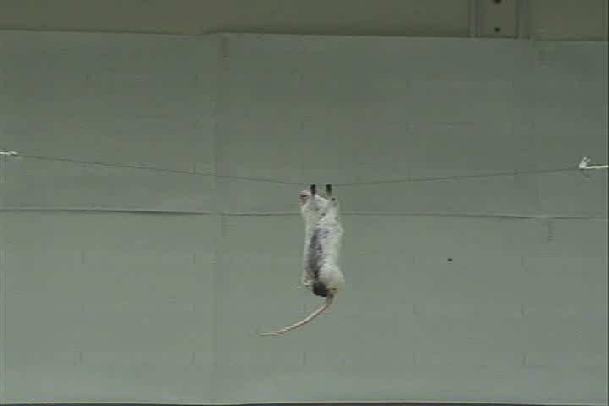
Injected
Rope test

Slide 23
How to measure movement?

Slide 24
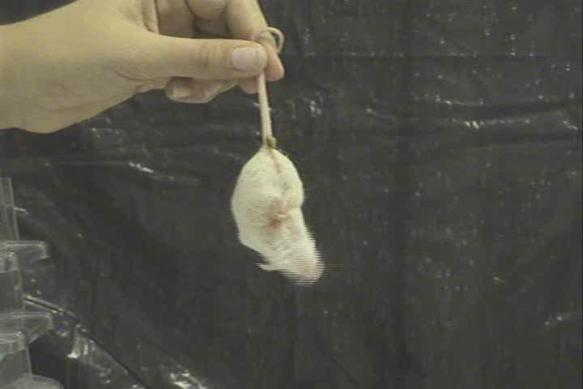
Non injected

Slide 25
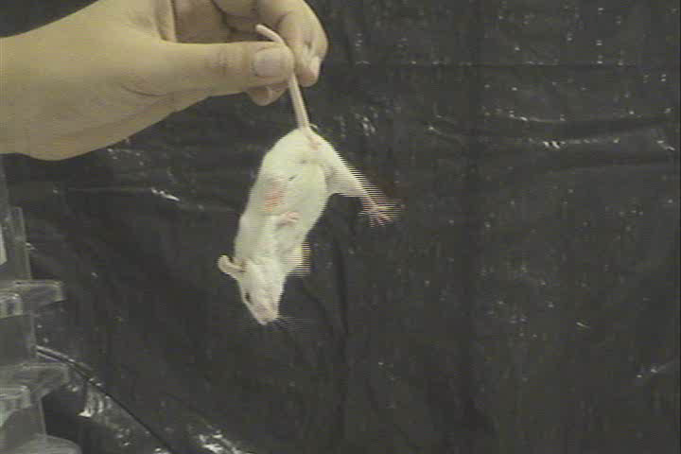
Injected
Vieira et al., 2008- Stem-cells, JUNE 26

Slide 26
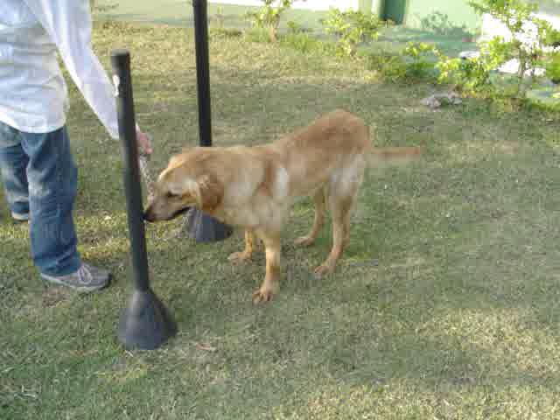
Stem-cells injections from dental-pulp in golden-retriever muscular dystrophy dogs
Chokito at 18 months

Slide 27
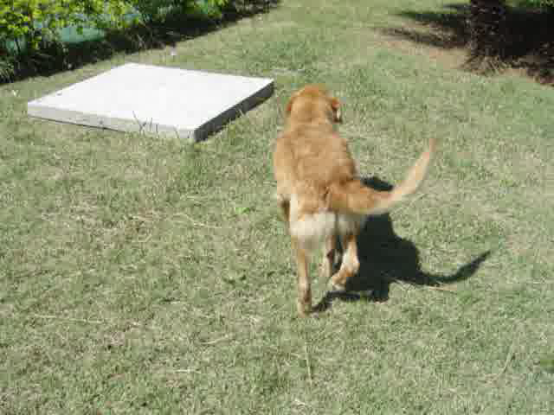
Chokito 8 months later- 26 months
How to compare?
Kerkis et al. J. Translational Medicine, July 2008

Slide 28
THE FUTURE
Interpreting our genome

Slide 29
CONSUMER GENOMICS
My genome:Myself
New York times: November 17, 2007
23andMe
deCODE Genetics
Navigenics

Slide 30
Some examples
SNP Location Genotype Associated with
Rs662799 AP AA Tendency to gain weight with fatty foods
Rs6920220 6q23 GG Low risk of rheumatoid arthritis
Rs17070145 KIBRA CC Relatively poor verbal memory
Rs 1801260 CLOCK AA Early rising
Rs 1953558 0R11H7P CC Sensitivity to smell of sweat
Rs17822931 ABCC11 CC Wet earwax
Rs4613903 TAS2R38 CG Ability to taste certain bitter flavors
Rs174575 FADS2 CC Higher I.Q. if breast fed for 9 months

Slide 31
Do I need a genetic test to know if:
I have tendency to gain weight?
I am sensible to the smell of sweat?
I have wet or dry earwax?
If I am an early rising?
What about the FADS2 gene?

Slide 32
The FADS2 gene
Breastfeeding effects on the IQ
Caspi A et al.
Breastfed children attain higher IQ scores if breastfed for 9 months than children not breastfed, presumably because of the fatty acids uniquely available in breast milk

Slide 33
Potencial problems.....
If you have this SNP but you were not breastfed? Are you going to blame your Mom for your lower IQ?
If you were breastfed less than 9 months? How will this affect your I.Q.?
If you find out that your baby does not have this SNP, are you going to waste your time breast feeding him (or her)?

Slide 34
New England Journal of Medicine
Consumer Genomics
is still
Recreacional genomics
But
but

Slide 35
Do we want to know if we have an increased risk for ?
Alzheimer
Heart conditions
Diabetes
Stroke
Cancer
Or other potentially treatable disorders?

Slide 36
Sequencing the entire genome

Slide 37
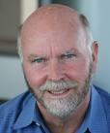
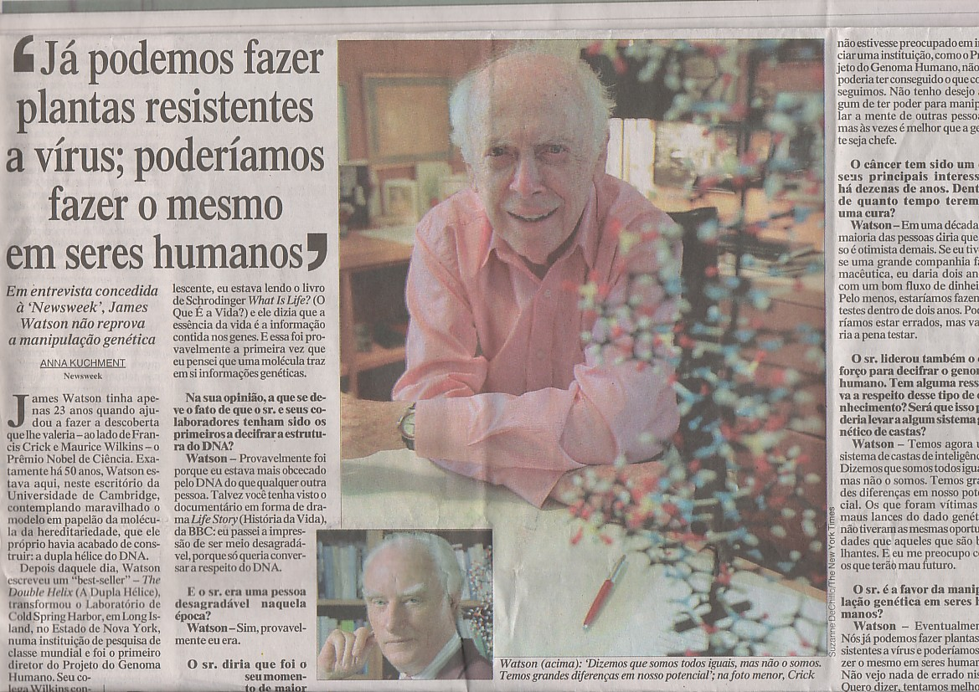
Still too expensive
Craig Venter
James Watson
One million DOLLARS

Slide 38
How to interpret the data?
How to predict?

Slide 39
Genotype:phenotype correlation studies
Same mutation: different clinical courses

Slide 40

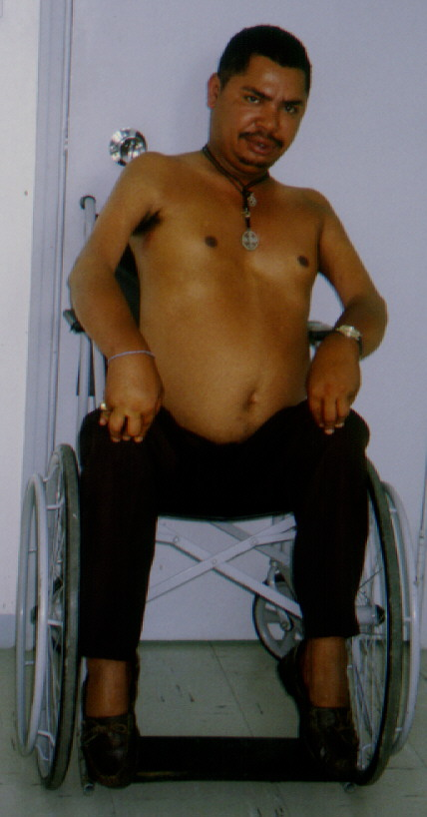
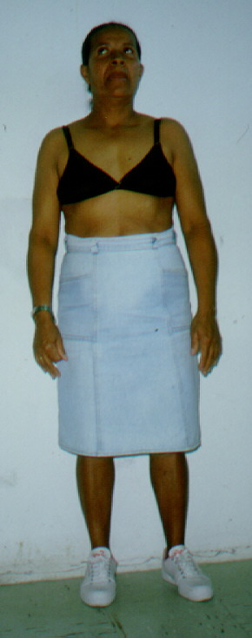
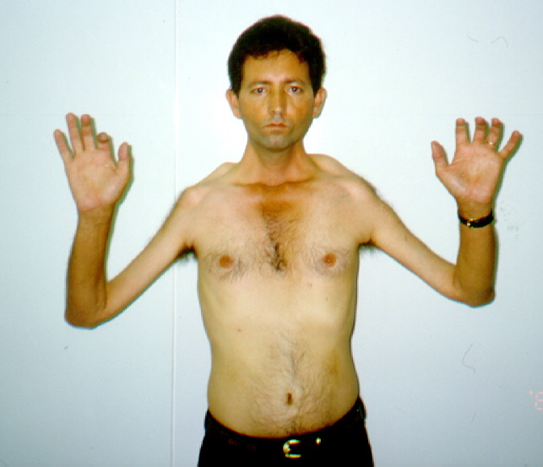
Facio-scapulohumeral muscular dystrophy
Same mutation: different clinical course???
Mechanism ???
P
mother
kb
24
Classical form
Adult onset
9.5
Probe P13E-11

Slide 41
What is expected within the next 10 years?
Sequencing our genome for U$ 1000,00
How to interpret the gigantic amount of informations?
This is the future

Slide 42
What will be needed?
Testing thousands of individuals from different ethnic groups
Compare young and old people with the same mutations and SNPs and have reliable data on health related problems
Compile data in gigantic data base
Friendly softwares accessable by “non computer scientists”
Like myself

Slide 43
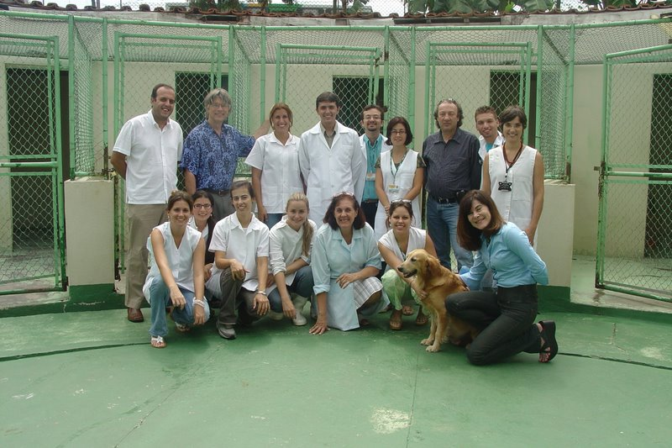
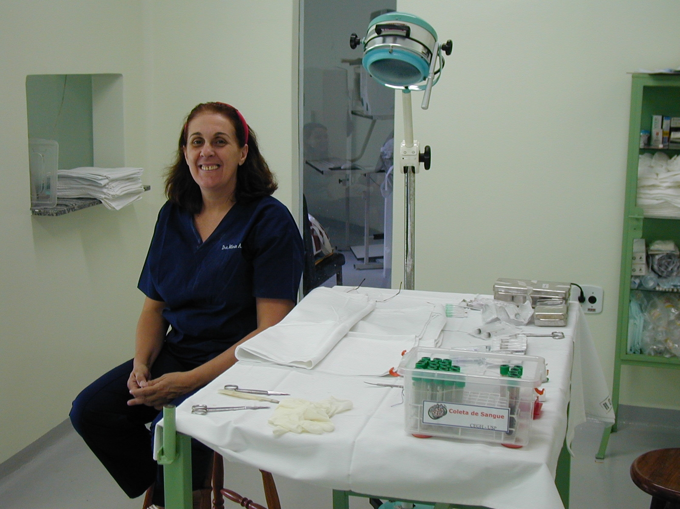
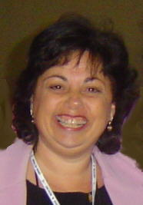
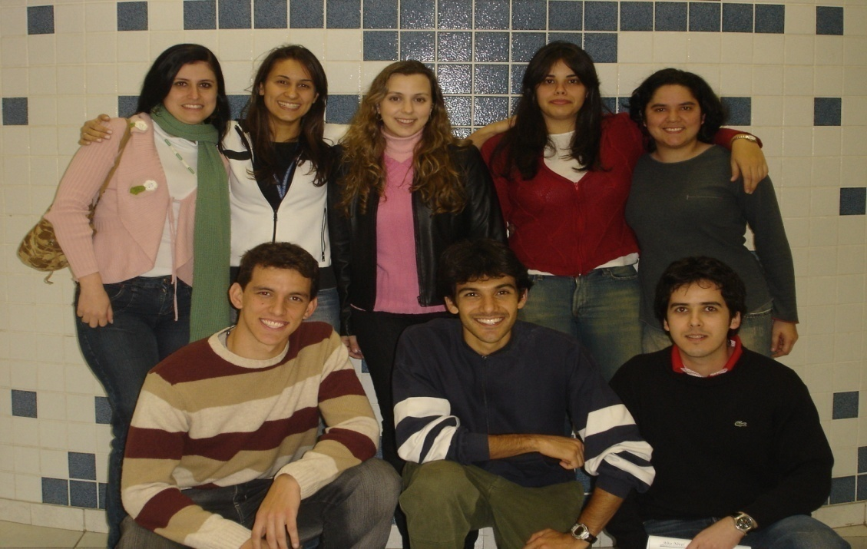
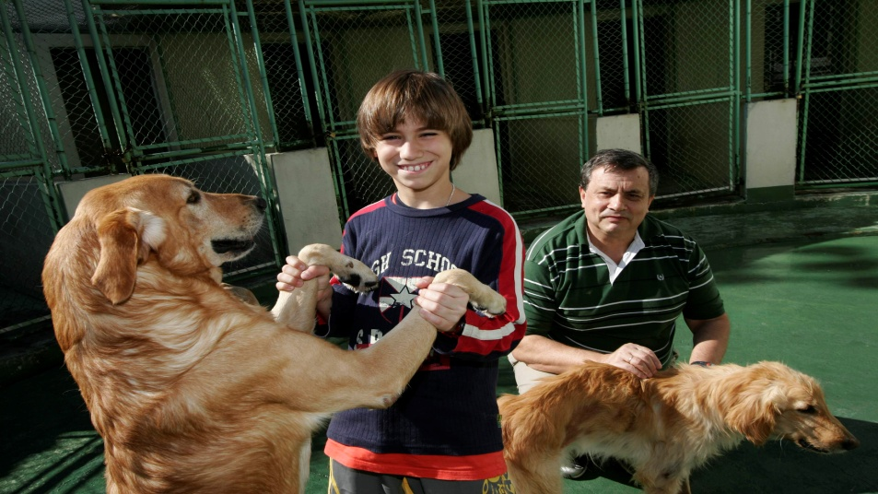
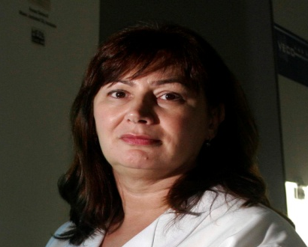
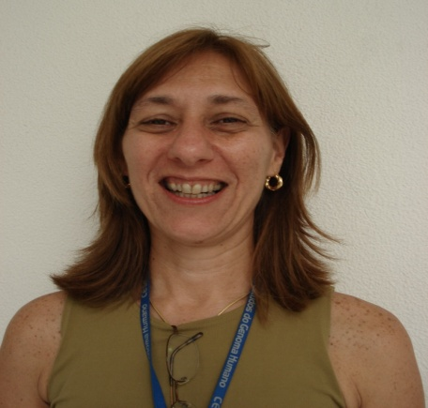
My team: vet school
IPEN
Dr. Paolo Bartolini
Dra. Nanci do Nascimento
Dr. Patrick Jack Spencer
Dra. Cibele Nunes Peroni
Dr. C Roberto Jorge Soares
Miriam Fussae Suzuki
Angelica
Mariz
Irina
Rita
Genome Center

Slide 44
THANK YOU VERY MUCH

