Slide 1
eScience for All: Not If, But When
Jeannette M. Wing
Assistant Director, NSF CISE
President’s Professor of Computer Science, CMU

Slide 2
By and For Whom: Scientists
What
  Facilities, instruments, data, software, cyber-infrastructure (CI)
How
  Policy: Open, shared access
  Technology: Virtual organizations
Why: Discovery and Learning
  No Choice
    Global (borderless) nature of science, expense of equipment, remote location of instruments, multiple “eyes” for validation of observations, …
  Collaboration
  Science diplomacy

Slide 3
By and For Whom: Citizens
What
  Facilities, instruments, data, software (?), cyber-infrastructure (CI)
How
  Open, shared access: read (everything), write (some things)
  Virtual organizations
Why
  Learning
  Discovery

Slide 4
Issues for Scientists
Technical
  Interoperability: need to support federation across heterogeneous X
    X = Data, S/W, CI -- within and across disciplines
  Veracity of data and scientific claims
Non-Technical
  Ownership
  Credit
  Publication

Slide 5
Issues for Scientists with Citizen Participation
Technical
  Interoperability: need to support federation across heterogeneous X
    X = Data, S/W, CI -- within and across disciplines
  Veracity and volume of data and scientific claims
Non-Technical
  Ownership
  Credit
  Publication

Slide 6
examples

Slide 7
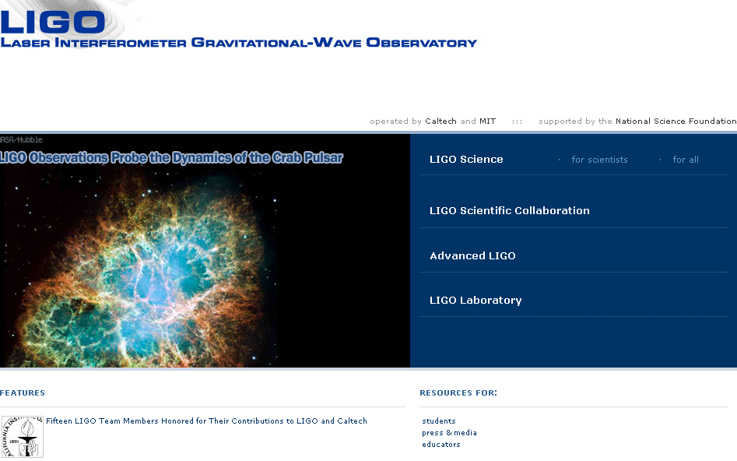

Slide 8
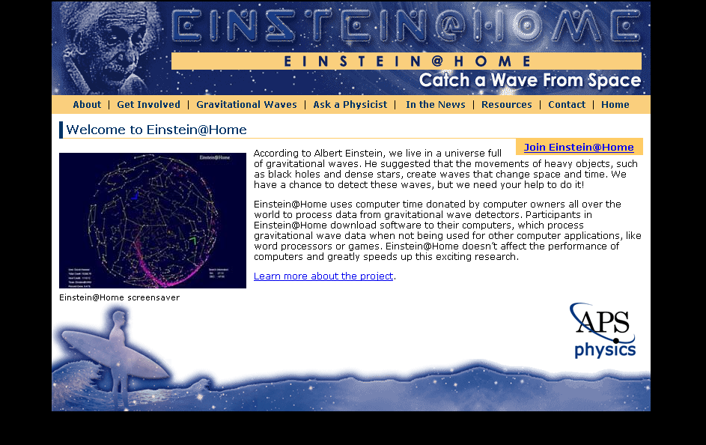

Slide 9
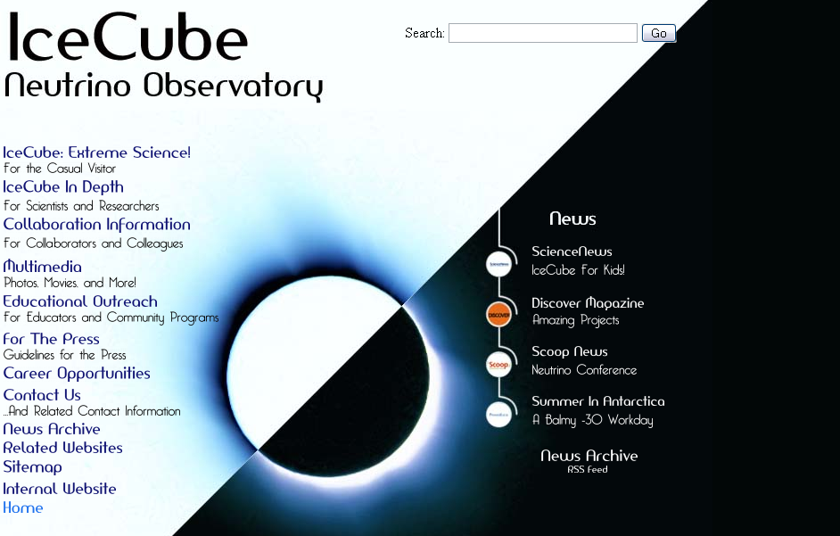
Examples

Slide 10
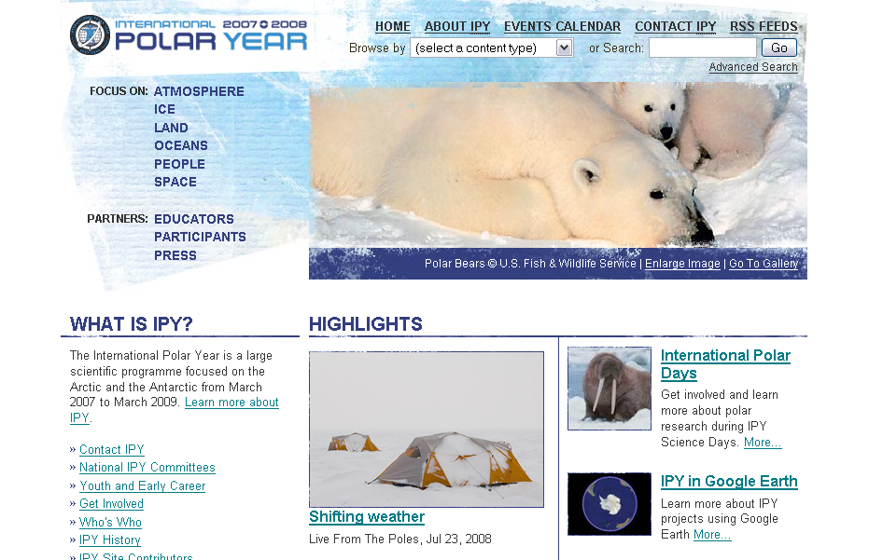

Slide 11
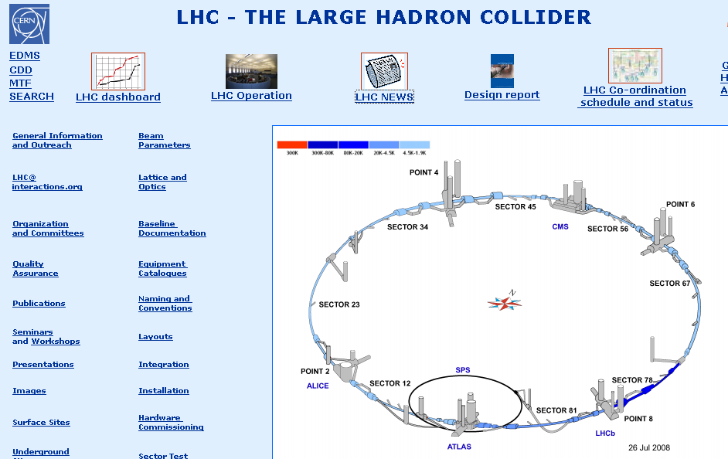

Slide 12
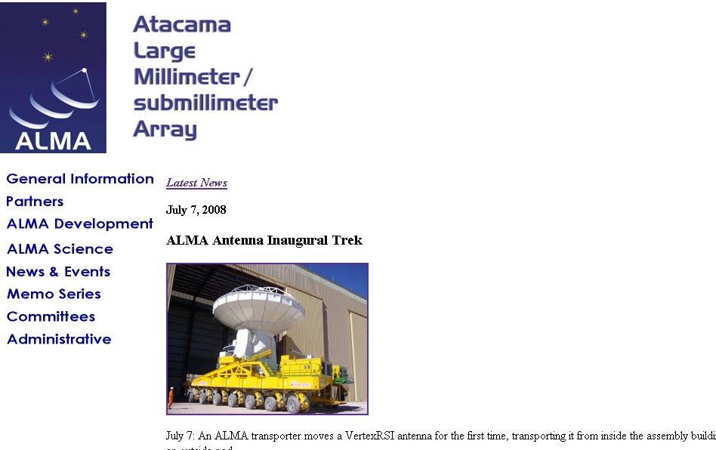

Slide 13
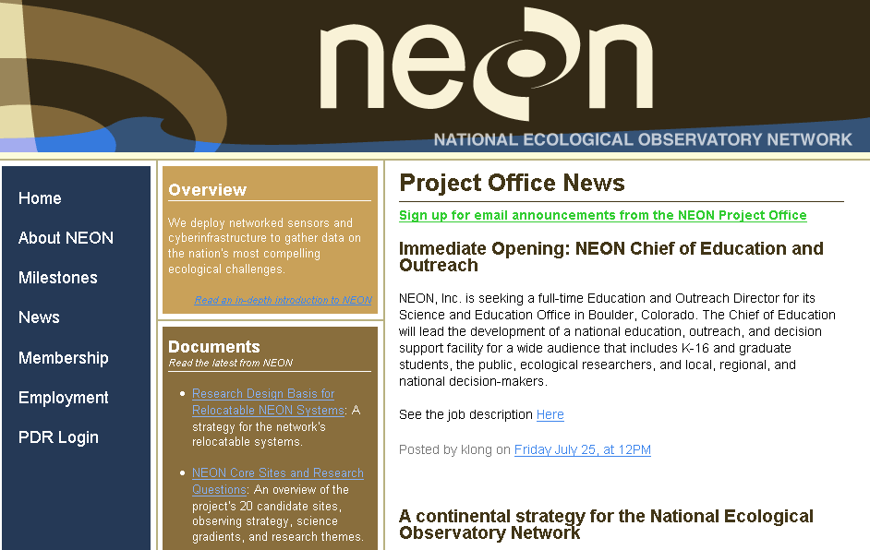

Slide 14
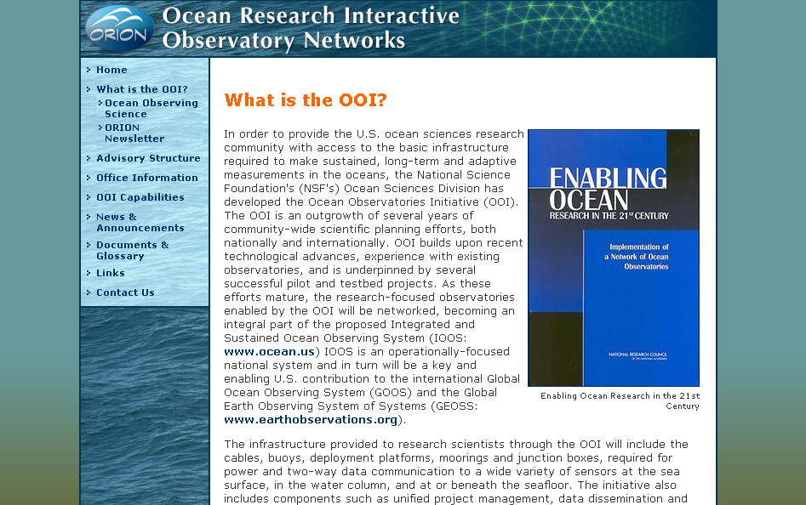

Slide 15
Looking Ahead
Citizens will be participating in science
  They already are in Learning, and increasingly in Discovery
  There are no intrinsic technical barriers, but lots of non-technical issues
Science trend toward openness means growing opportunities
  Contrarian viewpoint: Does openness imply BETTER science?
  Some think not
Multiple dimensions
  Access: Closed/Restricted/Tiered/Open
  Police/Monitor/Enforce: Master/Central Committee/Distributed
  …
Different models: LIGO, Wikipedia, ArXiv, Open Source, …

Slide 16
CDI: Cyber-Enabled Discovery and Innovation
Computational Thinking for Science and Engineering
Paradigm shift
  Not just our metal tools (transistors and wires) but also our mental tools (abstractions and methods)
It’s about partnerships and transformative research
  To innovate in/innovatively use computational thinking; and
  To advance more than one science/engineering discipline.
Three dimensions
  From Data to Knowledge
  Understanding Complexity in Natural, Built, and Social Systems
  Virtual Organizations

