Slide 1
Pushing and Pulling Information from the Mexican Dataspace
Genoveva Vargas Solar
Ph.D.
Mexican Society of Computer Science
Notes:
7/29/2008 2:58 PM
© 2007 Microsoft Corporation. All rights reserved. Microsoft, Windows, Windows Vista and other product names are or may be registered trademarks and/or trademarks in the U.S. and/or other countries.
The information herein is for informational purposes only and represents the current view of Microsoft Corporation as of the date of this presentation. Because Microsoft must respond to changing market conditions, it should not be interpreted to be a commitment on the part of Microsoft, and Microsoft cannot guarantee the accuracy of any information provided after the date of this presentation.
MICROSOFT MAKES NO WARRANTIES, EXPRESS, IMPLIED OR STATUTORY, AS TO THE INFORMATION IN THIS PRESENTATION.
1

Slide 2
Mexican Arena
Some figures
550 Computer Scientists with Ph.D. in CS working in academia
Research Centres in Computer Science
  Public: CINVESTAV, CIC, IIMAS-UNAM, INAOE, CICESE, IPICyT, …
  Private: CENTIA, ITAM, ITESM, LANIA …
  International: LAFMI (02-06), LAFMIA (French Mexican Laboratory of Informatics and Automatic Control UMI 3571)
  Mission: research and education of graduate students, innovation and technology transfer
Financial sources
  National Council of Science and Technology (CONACyT)
    National programs for science
    International: NSF-CONACyT, CYTED, ANR, European Community (FP6-7)
  Government and industrial partners
    Regional, target contracts with government offices
    Microsoft, Softtek, Gedas, Schlumberger …
Notes:
7/29/2008 2:58 PM
© 2007 Microsoft Corporation. All rights reserved. Microsoft, Windows, Windows Vista and other product names are or may be registered trademarks and/or trademarks in the U.S. and/or other countries.
The information herein is for informational purposes only and represents the current view of Microsoft Corporation as of the date of this presentation. Because Microsoft must respond to changing market conditions, it should not be interpreted to be a commitment on the part of Microsoft, and Microsoft cannot guarantee the accuracy of any information provided after the date of this presentation.
MICROSOFT MAKES NO WARRANTIES, EXPRESS, IMPLIED OR STATUTORY, AS TO THE INFORMATION IN THIS PRESENTATION.
2

Slide 3
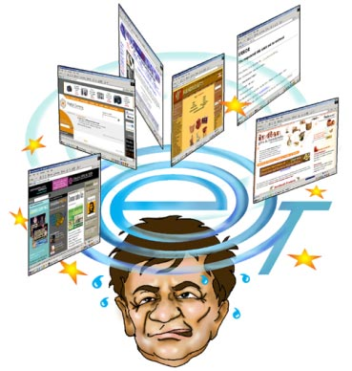
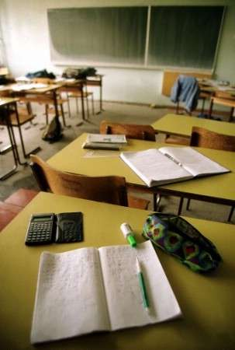
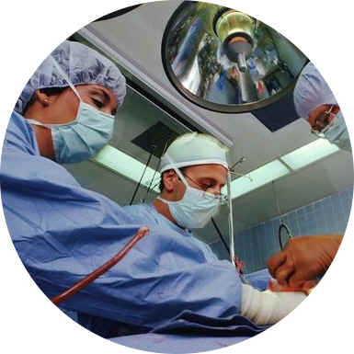




Target issues
Leitmotif: Computing resources at service of people
Government
Education
User interface
Environment
Application
Health
Access
Leisure
Economy
Storage
Science
Security
Data
Notes:
7/29/2008 2:58 PM
© 2007 Microsoft Corporation. All rights reserved. Microsoft, Windows, Windows Vista and other product names are or may be registered trademarks and/or trademarks in the U.S. and/or other countries.
The information herein is for informational purposes only and represents the current view of Microsoft Corporation as of the date of this presentation. Because Microsoft must respond to changing market conditions, it should not be interpreted to be a commitment on the part of Microsoft, and Microsoft cannot guarantee the accuracy of any information provided after the date of this presentation.
MICROSOFT MAKES NO WARRANTIES, EXPRESS, IMPLIED OR STATUTORY, AS TO THE INFORMATION IN THIS PRESENTATION.
3

Slide 4
Exploiting a Data-Space
Gives access to streams and continuous data produced, processed and consumed by heterogeneous procesing entities
  Stream producer: data flows stemming from the environment
    Environmental variables observation: video, temperature, hummidity, traffic on the network, stock options evolution
  Continuous producer: processed data produced periodically at given intervals of time
    Traffic conditions every hour, stock options at the beginning and at the end of the stock market session
  Stream consumer: consumes filtered streams
    Information about traffic condition in a given geographic area
  Continuous consumer: consumes data periodically
    Closest bus stops from my current position
Exploiting data space data according to
  resources availability, connectivity,
  QoS and producers/consumers requirements
Notes:
7/29/2008 2:58 PM
© 2007 Microsoft Corporation. All rights reserved. Microsoft, Windows, Windows Vista and other product names are or may be registered trademarks and/or trademarks in the U.S. and/or other countries.
The information herein is for informational purposes only and represents the current view of Microsoft Corporation as of the date of this presentation. Because Microsoft must respond to changing market conditions, it should not be interpreted to be a commitment on the part of Microsoft, and Microsoft cannot guarantee the accuracy of any information provided after the date of this presentation.
MICROSOFT MAKES NO WARRANTIES, EXPRESS, IMPLIED OR STATUTORY, AS TO THE INFORMATION IN THIS PRESENTATION.
4

Slide 5
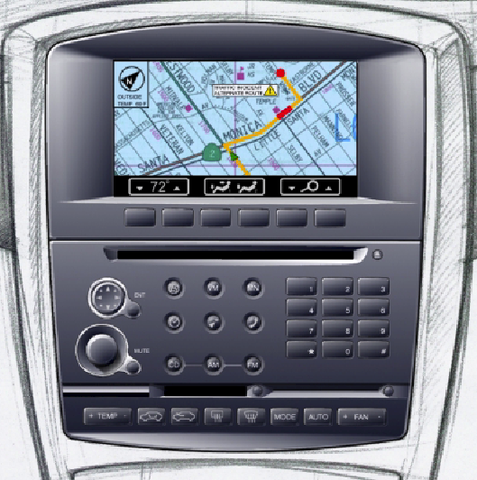
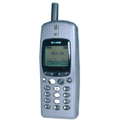

Services Oriented Dynamic Data Space
Data space view
Management: autonomy and adaptability
Coordination: dynamic services mashups

Slide 6
Mexican Data Space
Geographic Services and Data integration
ITESM-UNAM-INAOE-UV (Popocatepetl volcano)
Algorithmic (parallel computing and data mining)
Biology virtual lab (Bio-databases integration)
Health
Biology
Astrophysics
Disaster Mgmt
Ambient systems for seniors quality of life
(CICESE, Geriatric Institute IMSS)
Mexican Virtual Observatory
Millimetric Telescope, INAOE- U. Cambridge
Data bases and IR, middleware
(UDLAP, UAM-Iztapalapa, IIMAS, UNAM, LANIA)
Heterogeneous networks integration
ITAM, ITESM, UNAM, CICESE

Slide 7
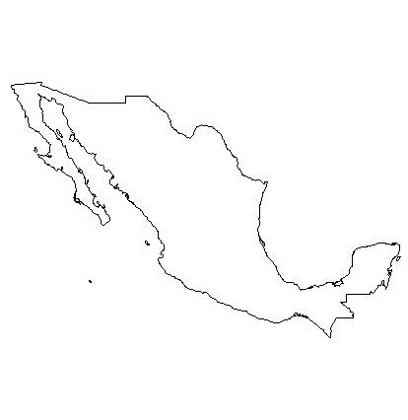
Mexican Research Agenda
Interface human-computer:
Modelling, usability, mobility
National network for the development of
cyber-health (CICESE)
Cyber-security of supporting individuals
and organizations (ITESM)
Software engineering:
Methodologies, environments, applications
Data and information management:
Grid, multimedia processing, super computing
Laboratory of information
technologies (CIMAT)
Laboratory of research and development of
software for telecommunications (INAOE)
Telecommunications:
Internet2 (IPV6), sensors, ad hoc, integration
Notes:
7/29/2008 2:58 PM
© 2007 Microsoft Corporation. All rights reserved. Microsoft, Windows, Windows Vista and other product names are or may be registered trademarks and/or trademarks in the U.S. and/or other countries.
The information herein is for informational purposes only and represents the current view of Microsoft Corporation as of the date of this presentation. Because Microsoft must respond to changing market conditions, it should not be interpreted to be a commitment on the part of Microsoft, and Microsoft cannot guarantee the accuracy of any information provided after the date of this presentation.
MICROSOFT MAKES NO WARRANTIES, EXPRESS, IMPLIED OR STATUTORY, AS TO THE INFORMATION IN THIS PRESENTATION.
7

Slide 8
Mexico in the LA Data-Space
Sustainable development: universal problems
Data, information and knowledge exploitation in largely distributed spaces: with particular LA expertise
LA research and innovation producer for tackling
  Education, health, government, environment, leisure, security …
  Develop excellence poles in the region
Strategies for pulling and pushing know-how and expertise
from the Latin-American data-space
Notes:
7/29/2008 2:58 PM
© 2007 Microsoft Corporation. All rights reserved. Microsoft, Windows, Windows Vista and other product names are or may be registered trademarks and/or trademarks in the U.S. and/or other countries.
The information herein is for informational purposes only and represents the current view of Microsoft Corporation as of the date of this presentation. Because Microsoft must respond to changing market conditions, it should not be interpreted to be a commitment on the part of Microsoft, and Microsoft cannot guarantee the accuracy of any information provided after the date of this presentation.
MICROSOFT MAKES NO WARRANTIES, EXPRESS, IMPLIED OR STATUTORY, AS TO THE INFORMATION IN THIS PRESENTATION.
8

Slide 9


50th Aniversary of
Computer Science in Mexico
announcing
Contact: G. Vargas-Solar, Genoveva.Vargas@imag.fr
Mexican Society of Computer Science
Notes:
7/29/2008 2:58 PM
© 2007 Microsoft Corporation. All rights reserved. Microsoft, Windows, Windows Vista and other product names are or may be registered trademarks and/or trademarks in the U.S. and/or other countries.
The information herein is for informational purposes only and represents the current view of Microsoft Corporation as of the date of this presentation. Because Microsoft must respond to changing market conditions, it should not be interpreted to be a commitment on the part of Microsoft, and Microsoft cannot guarantee the accuracy of any information provided after the date of this presentation.
MICROSOFT MAKES NO WARRANTIES, EXPRESS, IMPLIED OR STATUTORY, AS TO THE INFORMATION IN THIS PRESENTATION.
9

