Slide 1
Universal Parallel Computing Research Centers (UPCRC)
Dan Reed
Scalable and Multicore Computing Strategist
Managing Director, Data Center Futures
Microsoft

Slide 2

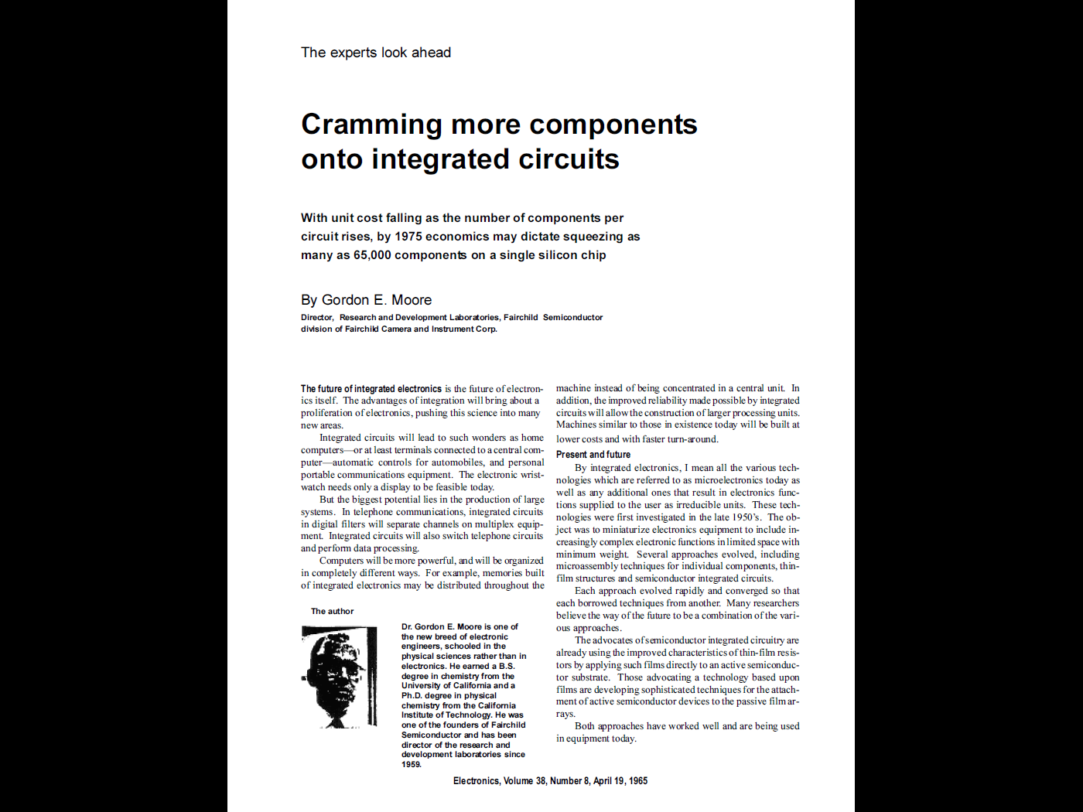
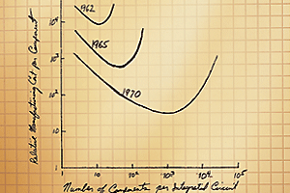
Moore’s “Law” and the Performance Dividend

Slide 3


The Brave New World
Faster Processors
New Software Features
Slower Programs
24 GHz
1 Core
1 Core
12 GHz
1 Core
Free Lunch For Traditional Software
Operations per second for serial code
2 Cores
6 GHz
1 Core
4 Cores
8 Cores
3 GHz
2 Cores
3 GHz
4 Cores
3 GHz
8 Cores
3 GHz
1 Core
Additional operations per second if code can take advantage of concurrency
No Free Lunch For Traditional Software
(Without highly concurrent software, it won’t get any faster!)

Slide 4
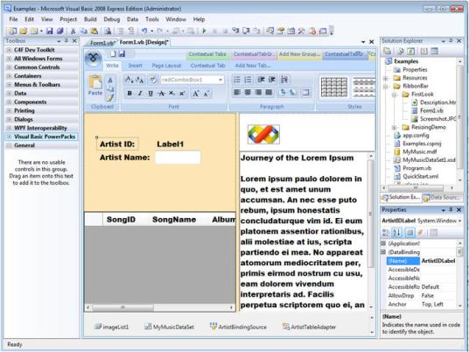
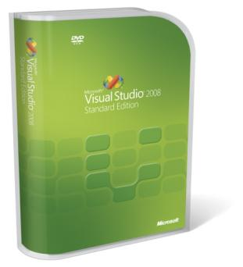
Software Developer Groups and Expectations
Three developer groups
  Heroes
  Mainstream
  Entry/Novice
Each with differing needs
Heroes
  “Neurosurgery? No problem!
  Hand me that screwdriver.”
Mainstream
  Experienced developer
Entry/novice
  The occasional developer

Slide 5




Breaking Through The Brick Wall
Industry Giants Try to Break Computing’s Dead End
NY Times March 19, 2008 John Markoff
Intel and Microsoft said Tuesday that they planned to finance two groups of university researchers to start over and design a new generation of computing systems intended to break the industry out of a technological cul-de-sac that threatens to end decades of performance increases in computers.
~$35M (U.S.) in funding over five years (Microsoft/Intel/universities)

Slide 6
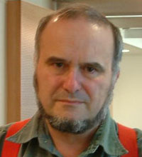
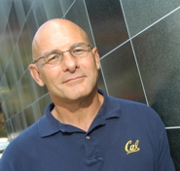
Today's Speakers
Marc Snir (University of Illinois at Urbana-Champaign)
  Michael Faiman and Saburo Muroga Professor
  Director, Illinois Informatics Institute
David Patterson (University of California at Berkeley)
  E. H. and M.E. Pardee Chair
  Director, Parallel Computing Laboratory (Par Lab)

Slide 7

© 2008 Microsoft Corporation. All rights reserved. Microsoft, Windows, Windows Vista and other product names are or may be registered trademarks and/or trademarks in the U.S. and/or other countries. The information herein is for informational purposes only and represents the current view of Microsoft Corporation as of the date of this presentation. Because Microsoft must respond to changing market conditions, it should not be interpreted to be a commitment on the part of Microsoft, and Microsoft cannot guarantee the accuracy of any information provided after the date of this presentation. MICROSOFT MAKES NO WARRANTIES, EXPRESS, IMPLIED OR STATUTORY, AS TO THE INFORMATION IN THIS PRESENTATION.

