Slide 2
Exter nal Research Overview
Tony Hey
Corporate Vice President
External Research
Microsoft Research

Slide 3



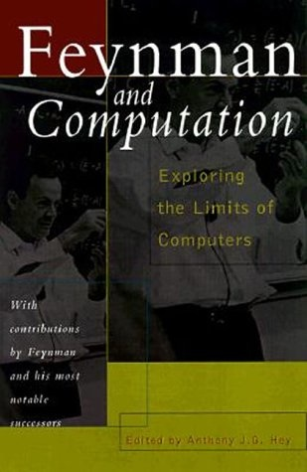
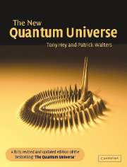

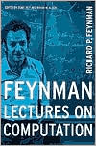







Tony Hey – An Introduction
Commander of the British Empire
Notes:
1970: D.Phil. in Theoretical Physics, Oxford, UK
Research at Caltech, CERN, MIT and IBM Research
1974 -1985: Professor in Physics at Southampton
1985 – 1999: Professor of Parallel Computing in Electronics and Computer Science at Southampton
1994 – 1999: Head of Electronics and Computer Science
1999 – 2001: Dean of Engineering
1996 – 2001: Director of Southampton Innovations Ltd.
2001 – 2005: Director of UK e-Science Program for the UK Office of Science and Technology
2005 – present: Corporate Vice President for Microsoft External Research

Slide 4

Microsoft External Research
Division within Microsoft Research focused on partnerships between academia, industry and government to advance computer science, education, and research in fields that rely heavily upon advanced computing
Focus on the research process and its role in the innovation ecosystem, including support for open access, open tools, open technology, and interoperability
Development of advanced technologies and services to support every stage of the research process

Slide 5
Worldwide External Research "Themes"
Core Computer Science
Earth, Energy and
Environment
Health & Wellbeing
Education & Scholarly Communications
Advanced Research Tools and Services

Slide 6
Collaborating On Computing And Scientific Research
In the next five years, there will be more scientific data collected than in the whole of human history!
Advanced computing research technology exploring
  The Universe
  Our World
  Ourselves
Addressing the most urgent computer science
research challenges

Slide 7

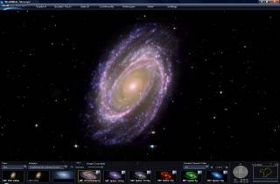
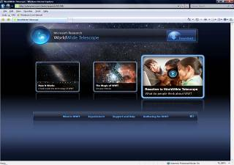
World Wide Telescope
Seamless Rich Social Media Virtual Sky
Web application for science and education
Participants
Alyssa Goodman; Harvard University
Alex Szalay; Johns Hopkins University
Curtis Wong, Jonathan Fay; Microsoft Research
Goals
Integration of data sets and one-click contextual access
Easy access and use
In just over a little more than two months, a million users have downloaded, installed and launched the application (2,206,497 unique sessions)
We invite you to experience it! www.worldwidetelescope.org
WWT application
WWT Download website

Slide 8
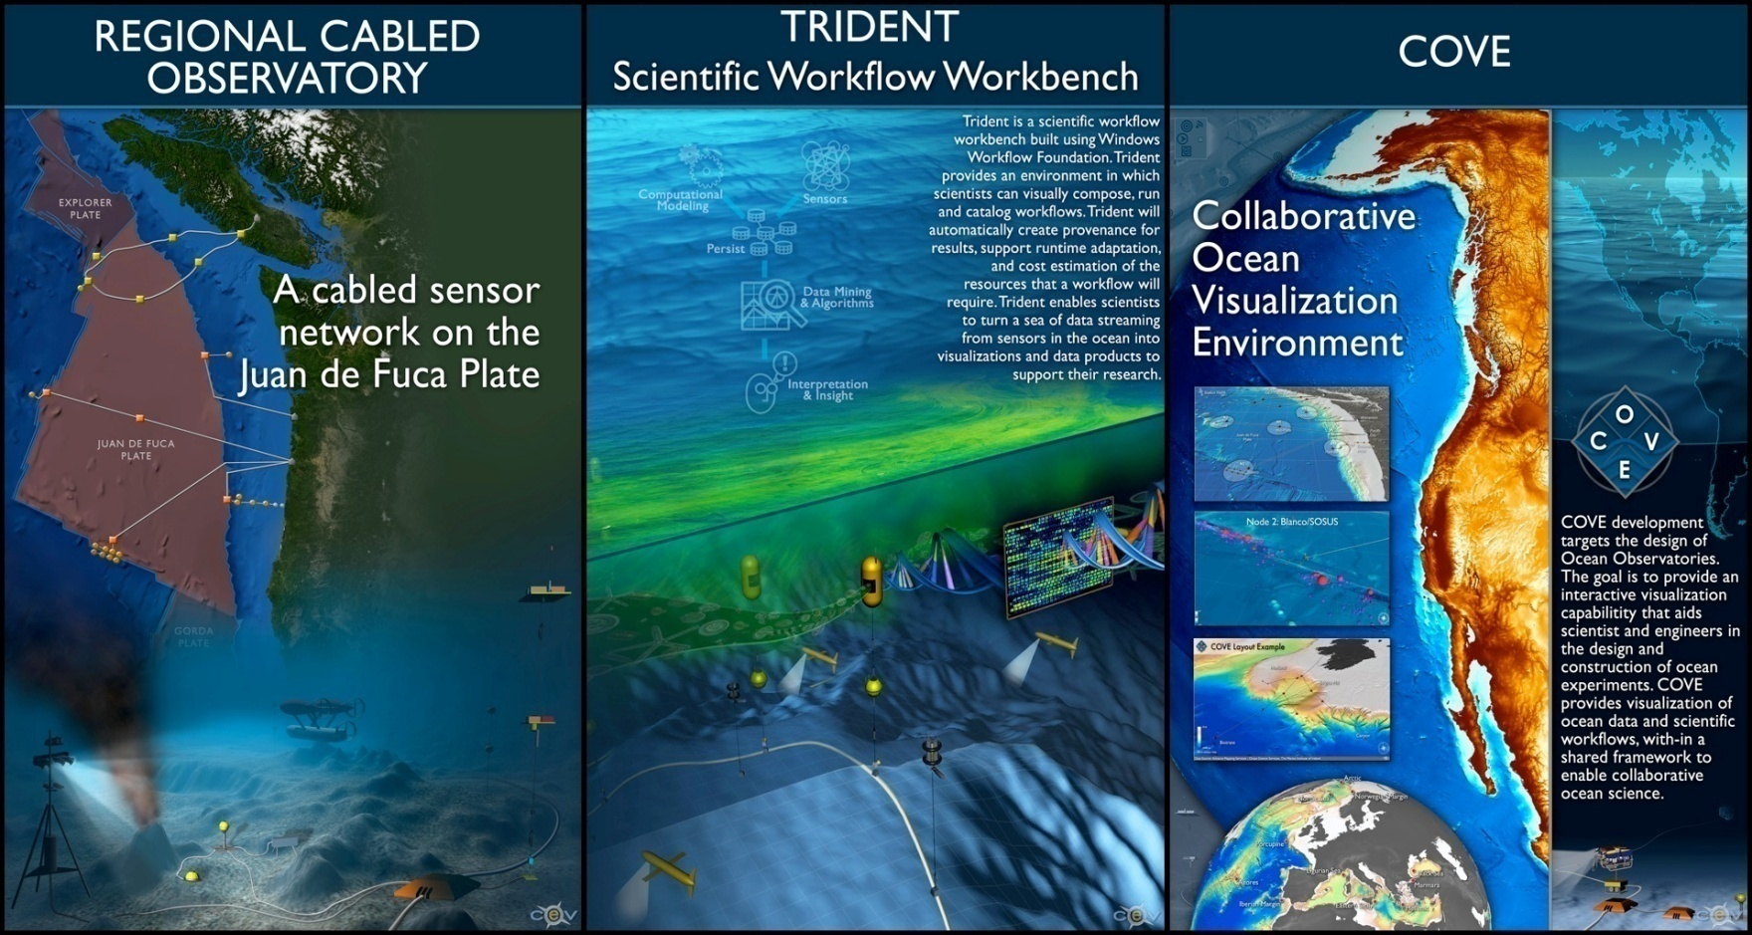
Trident – Scientific Workbench
Workflow for
Ocean Observatories,
part of an
“oceanographer’s
workbench”
Jim Gray
http://www.microsoft.com/mscorp/tc/trident.mspx

Slide 9

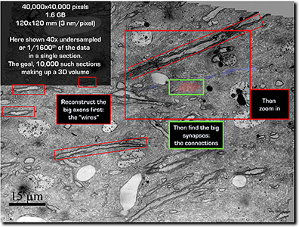
Connectome Project
Determine the detailed neural
circuitry of the brain
Participants
Jeff Lichtman, Kenny Blum, and Hanspeter Pfister;
Harvard University
Michael Cohen; Microsoft Research
Goals
Software for 3D registration, segmentation, and complete neural circuit reconstruction
Software to visualize and “fly through” 3D images of neural circuitry hundreds of GB in size
Database design and management for storing and querying multi-TB datasets containing 3D microscopy images of neural circuits and features extracted from them

Slide 10

Open Collaboration
Open access
Open source
Open data
“In order to help catalyze and facilitate
the growth of advanced CI, a critical
component is the adoption of open access
policy for data, publications and software.”
NSF Advisory Committee on
Cyberinfrastructure (ACCI)
Microsoft Interoperability Principles
  Open Connections to Microsoft Products
  Support for Standards
  Data Portability
  Open Engagement
http://www.microsoft.com/interop/

Slide 11
Current Scholarly Publishing
A model in crisis
Journal subscriptions rising faster than library budgets.
No freedom for new journals in new and emerging fields.
Web technology and digital media now make dissemination of knowledge ‘easy’ and ‘free’ without the traditional paper journals.
As Dean of Engineering at Southampton:
  Monitored the research output of over 200 Faculty and
  500 Post Docs and Grad Students
  University library could not afford to subscribe to all the journals
  that my staff published in, not to mention conference proceedings
  and workshop contributions …

Slide 12
  A set of free software tools to improve interoperability with existing tools used commonly by academics and scholars to better meet their research needs
announcing

Slide 13
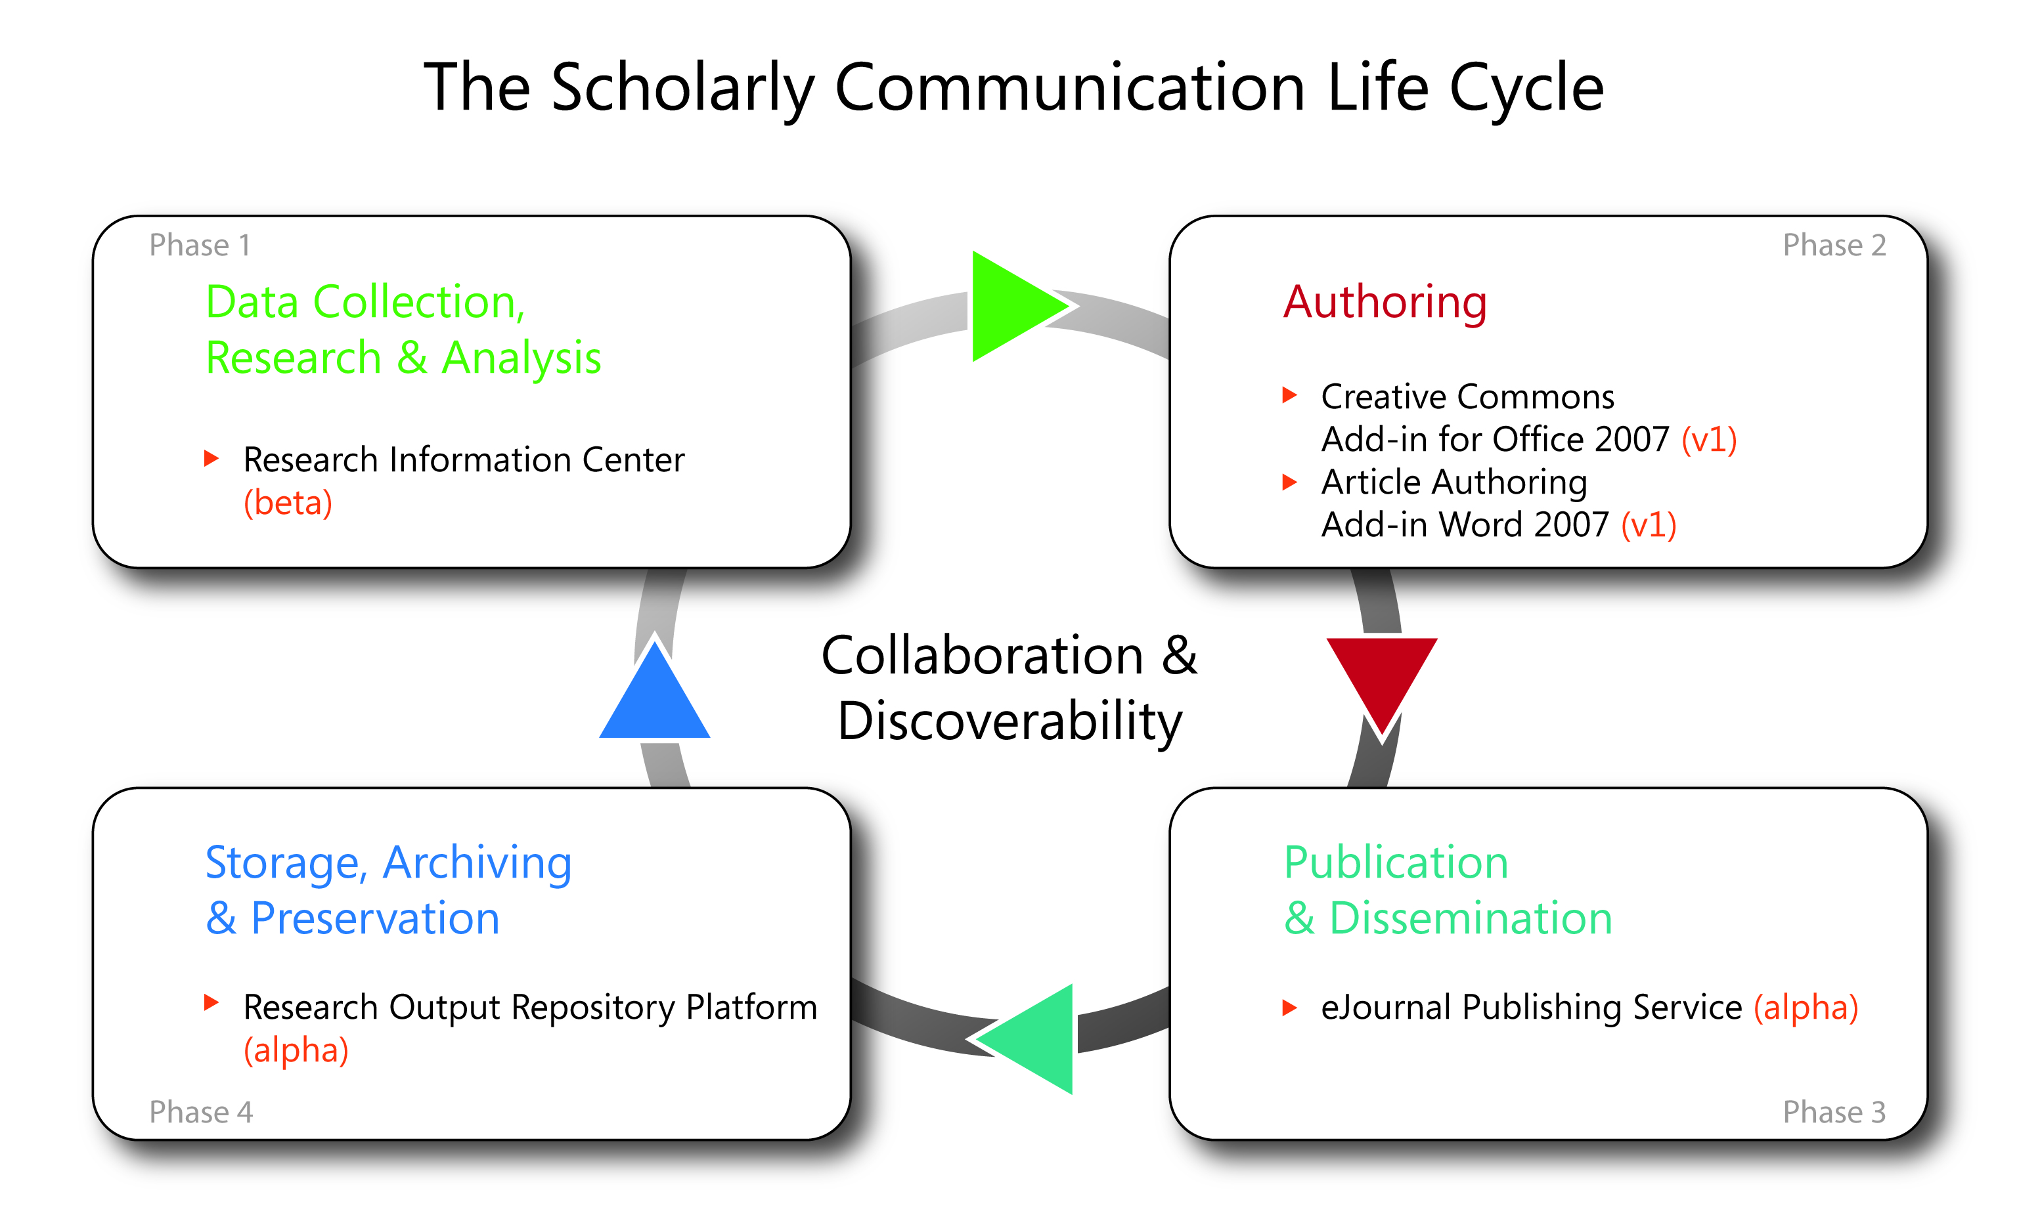
Collaborate, Publish, Preserve, And Share Data
http://www.microsoft.com/mscorp/tc/scholarly_communication.mspx

Slide 14


"I am pleased that Microsoft is taking innovative steps to support more open, efficient, and effective scholarly
communication in the digital networked environment. For example, the free eJournal Service gives many scholarly
societies a valuable new option for online publication and a way to avoid taking on high costs.
The Article Authoring and Creative Commons add-ins to Word also are good news, offering capacities that could bring down
production costs and allow authors to better manage their intellectual property rights.”
– Heather Joseph
Executive Director,
SPARC (Scholarly Publishing & Academic Resources Coalition)
“Partnering with members of the scholarly community, Microsoft External Research is working to facilitate the next step in the transformation of scholarly communications with networking tools built into Microsoft products. The Article Authoring add-in for Microsoft Word 2007 permits authors to produce documents directly in the format used by the NLM's PubMed Central repository, and is a significant step towards producing next-generation documents semantically tied to distributed network databases and relevant ontologies. The Microsoft team has also worked with the arXiv.org database on an automated upload protocol for documents and metadata, both for ingest from individuals and of entire conferences. We look forward to further enhancements, permitting autonomous discovery of related documents, relevant materials, and other linkages, accelerating the move towards a better integrated scholarly knowledge network."
– Paul Ginsparg, Professor Of Physics,
Computing and Information Science at Cornell University
(and founder of arXiv.org)

Slide 15



Parallel Computing Research
Intel / Microsoft Academic Partnerships
Accelerating developments in mainstream parallel computing
Centers located at the University of California, Berkeley; and the University of Illinois at Urbana-Champaign
Microsoft and Intel have committed a combined
$20 million over the next five years
Parallel programming applications, architecture,
and operating systems software
External Research has a history of working in this area; Joint Research Centre with the Barcelona Supercomputing Center
WWT application
WWT Download website

Slide 16
  $1.5 million to support seven academic research projects to further stimulating impactful research in safe and scalable multicore computing
announcing

Slide 17
Safe And Scalable Multicore Computing
Parallel and multicore computing will radically transform computing
Research projects rethink the relationships among computer architecture, operating systems, runtimes, compilers and applications
Recipients:
  Dan Grossman, University of Washington
  Kim Hazelwood, University of Virginia
  Antony Hosking, Jan Vitek, Suresh Jagannathan and Ananth Grama, Purdue University
  Paul Hudak, Yale University
  Tao Li, University of Florida
  Bertrand Meyer, ETH Zurich
  David Penry, Brigham Young University

Slide 18
Resources
http://research.microsoft.com
http://www.microsoft.com/science
http://www.microsoft.com/mscorp/tc/scholarly_communication.mspx
Have a Great Faculty Summit!

