Slide 2
Social Networks on the Semantic Web
Jennifer Golbeck
Assistant Professor, College of Information Studies
University of Maryland, College Park

Slide 3
The Semantic Web
One big goal of the Semantic Web:
  Represent knowledge in a standard, machine processable format
  Aggregate knowledge distributed across the web into a single knowledge model
  Reason over that knowledge

Slide 4
Social Networks on the Semantic Web
FOAF (Friend Of A Friend)
  A simple ontology for representing information about people and who they know
About 20,000,000 social network profiles are available in FOAF format
Approximately 60% of all semantic web data is FOAF data

Slide 5
Is FOAF a Success Story?
FOAF is a huge part of the Semantic Web
It is presented frequently as a success story of the Semantic Web
BUT - it is only a success if it demonstrates that the goals of the Semantic Web are being achieved

Slide 6

Experiment: Aggregate FOAF
FOAF is automatically generated by many social networking websites
  Advogato
  Buzznet
  DeadJournal
  eCademy
  FilmTrust
Can these networks be connected through people who have profiles on multiple sites?
  GreatestJournal
  InsaneJournal
  LiveJournal
  LJ.Rossia.org
  Minilog.com
  Tribe

Slide 7
Semantics of FOAF
Inverse Functional Properties
  foaf:mbox_sha1sum
  foaf:mbox
  foaf:homepage
  foaf:icqChatID
  foaf:jabberID
Two people who share a common value for one of these properties are inferred to be the SAME person
  foaf:msnChatID
  foaf:weblog
  foaf:yahooChatID
  foaf:aimChatID

Slide 8
Properties of FOAF Networks
Range from small to large
Some networks did not provide full member lists, so we had to crawl them

Slide 9
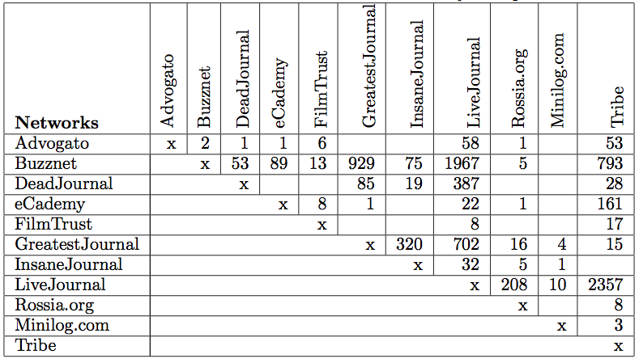
Network Overlap

Slide 10
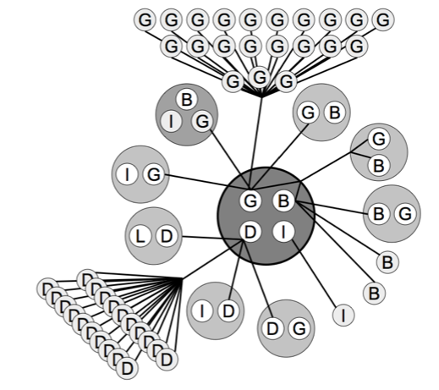

Slide 11
Overall Results
All networks could be connected to at least 4 other networks
Over 16,000 accounts could be merged
Small overall percentage of users, but this is consistent with the fraction of hubs we expect in a network

Slide 12
Conclusions for the Semantic Web
FOAF utilizes the logic of OWL
Reasoners can merge profiles of the same person maintained on different networks
FOAF is an interesting realization of the Semantic Web goal of maintaining distributed knowledge that can be unified through reasoning.

Slide 13
Potential Applications
Social Aggregating and Filtering Applications
  Recommender Systems
  Email Filtering
  Advertising
  News Syndication
  All improved with semantics
Trust in Context

Slide 14
Questions / Comments
Jennifer Golbeck
jgolbeck@umd.edu
http://www.cs.umd.edu/~golbeck
http://trust.mindswap.org

