Slide 2
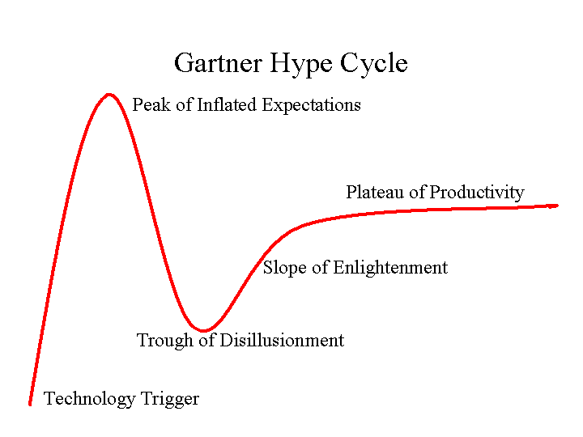
The Impact of Cloud Services on Science?
We are in the midst of a generational shift in research, driven by new "disruptive" technologies. The rapid emergence of a new world of eScience driven by very large scale data, next generation sensors, and advanced robotic instruments, in a host of disciplines from environmental, physical and other sciences and engineering through public health and medicine, requires a new approach to provide computational and data management tools and services for research. This session will focus on a software + service model with scientific services delivered from the Cloud that we believe will become an increasingly accepted model for research.
Monday 1:15pm – 2:30pm

Slide 3
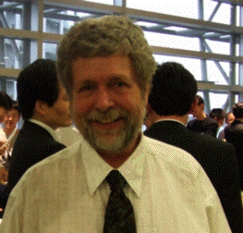
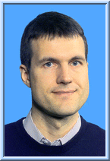
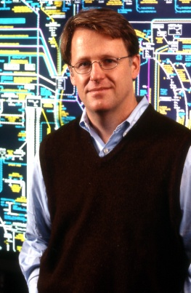
Break-out Technical Program
The Scientific Data Center 20 min
  Dennis Gannon
  Department of Computer Science
  School of Informatics, Indiana University
The CARMEN Science Cloud & Beyond 20 min
  Paul Watson
  Professor of Computer Science
  Newcastle University, UK
Towards a Data Cauldron 20 min
Ian Foster
Argonne National Laboratory
and the University of Chicago
Questions and Answers 15 min

